Slide 1
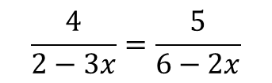
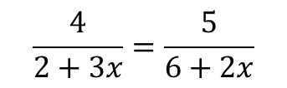

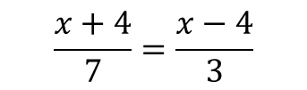

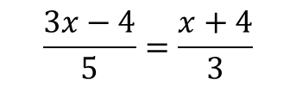

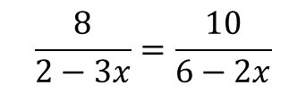
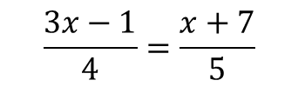



Worked Example
Reflection
Example by Fading
Your Turn
Solve
Why do I put brackets around the numerators?
Solve
Solve
$$\frac{3x−1}{4}=\frac{x+7}{5}$$
$$\frac{x+4}{7}=\frac{x−4}{3}$$
$$\frac{3x−4}{5}=\frac{x+4}{3}$$
Why do I cross multiply?
Decide (Cross Multiply)
Break and Repair
$$x=10$$
How many DBRS processes are there?
$$5\left(3x−1\right)=4(x+7)$$
Expand
$$15x−5=4x+28$$
Solve
Why do I put brackets around the denominators?
Solve
Solve
$$\frac{8}{2−3x}=\frac{10}{6−2x}$$
$$\frac{4}{2+3x}=\frac{5}{6+2x}$$
$$\frac{4}{2−3x}=\frac{5}{6−2x}$$
Why do I cross multiply?
Decide (Cross Multiply)
Break and Repair
$$x=2$$
How many DBRS processes are there?
$$8\left(6−2x\right)=10(2−3x)$$
Expand
$$48−16x=20−30x$$
@BerwickMaths

Slide 2
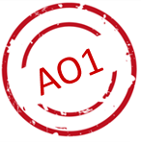

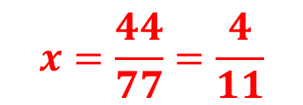
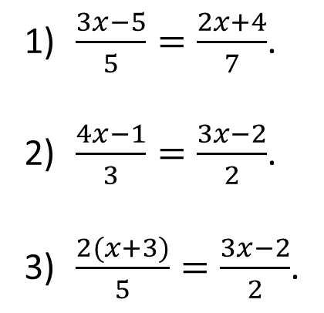

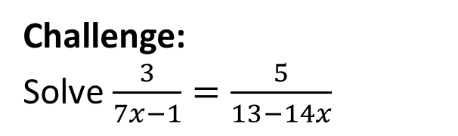


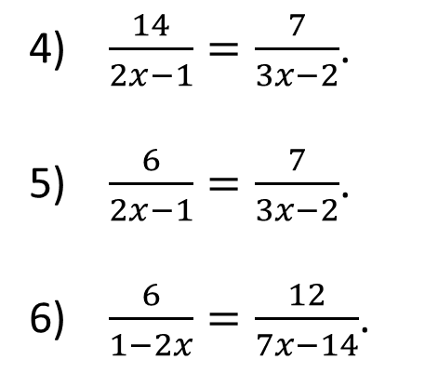


Questions
Solve the following equations:
$\frac{3x−5}{5}=\frac{2x+4}{7}$.
$\frac{4x−1}{3}=\frac{3x−2}{2}$.
$\frac{2(x+3)}{5}=\frac{3x−2}{2}$.
$\frac{14}{2x−1}=\frac{7}{3x−2}$.
$\frac{6}{2x−1}=\frac{7}{3x−2}$.
$\frac{6}{1−2x}=\frac{12}{7x−14}$.
$$x=5$$
$$x=1/2$$
$$x=4$$
$$x=5/4$$
$$x=2$$
$$x=2$$
Challenge:
Solve $\frac{3}{7x−1}=\frac{5}{13−14x}$
$$x=\frac{44}{77}=\frac{4}{11}$$
@BerwickMaths

