Slide 1
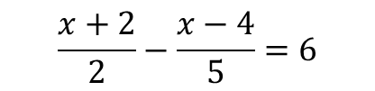
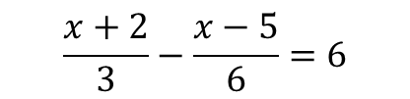

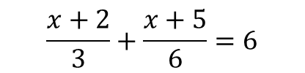

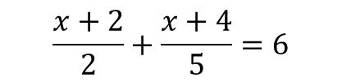

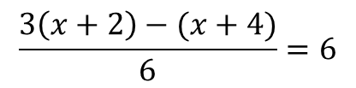
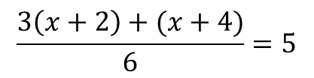
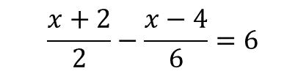
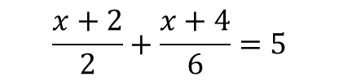

Worked Example
Reflection
Example by Fading
Your Turn
Solve
Why do I put brackets around the numerators?
Solve
Solve
$$\frac{x+2}{2}+\frac{x+4}{5}=6$$
$$\frac{x+2}{2}+\frac{x+4}{6}=5$$
$$\frac{x+2}{3}+\frac{x+5}{6}=6$$
Why do I add the fractions?
Decide (Add Fractions)
Break and Repair
$$x=9$$
How many DBRS processes are there?
$$\frac{3\left(x+2\right)+(x+4)}{6}=5$$
Decide (Eliminate Fraction)
$$3\left(x+2\right)+\left(x+4\right)=30$$
Solve
Why do I put brackets around the numerators?
Solve
Solve
$$\frac{x+2}{2}−\frac{x−4}{5}=6$$
$$\frac{x+2}{2}−\frac{x−4}{6}=6$$
$$\frac{x+2}{3}−\frac{x−5}{6}=6$$
Why do I add the fractions?
Decide (Add Fractions)
Break and Repair
$$x=27$$
How many DBRS processes are there?
$$\frac{3\left(x+2\right)−(x+4)}{6}=6$$
Decide (Eliminate Fraction)
$$3\left(x+2\right)+\left(x+4\right)=36$$
@BerwickMaths

Slide 2

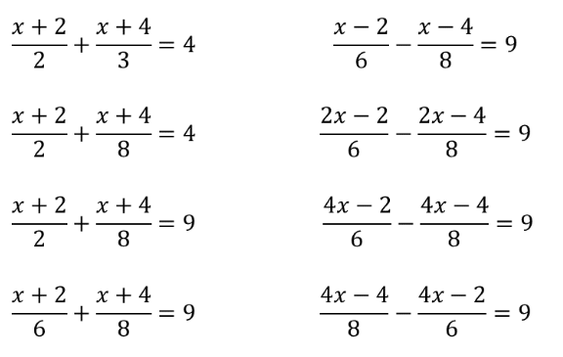
Questions
Solve the following equations:
@BerwickMaths

Slide 3
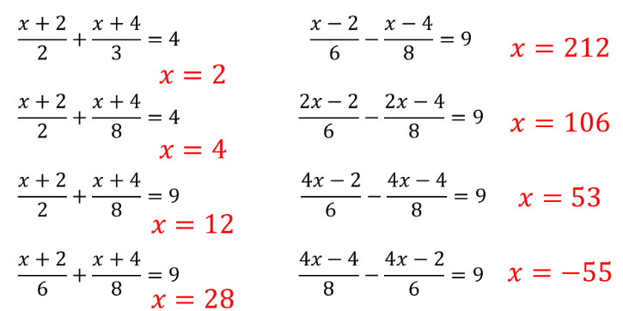
Questions
Solve the following equations:
@BerwickMaths

