Slide 1
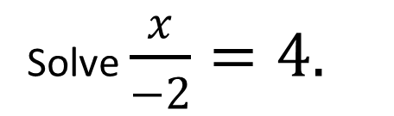
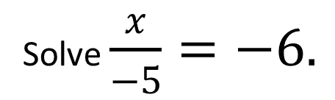
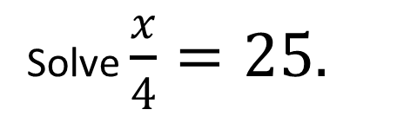
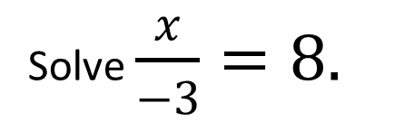

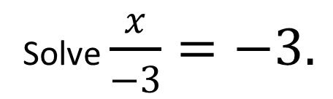
Worked example
Your turn
Solve $\frac{x}{4}=25.$
Solve $\frac{x}{6}=7.$
Solve $\frac{x}{−2}=4.$
Solve $\frac{x}{−3}=8.$
Solve $\frac{x}{−3}=−3.$
Solve $\frac{x}{−5}=−6.$
@BerwickMaths

Slide 2
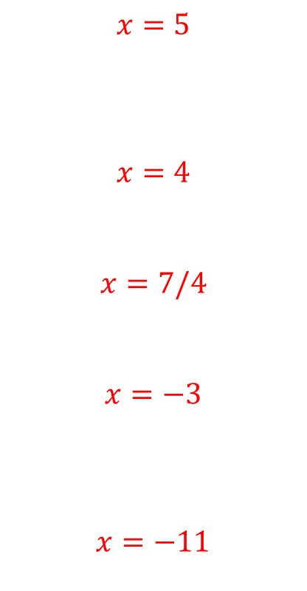
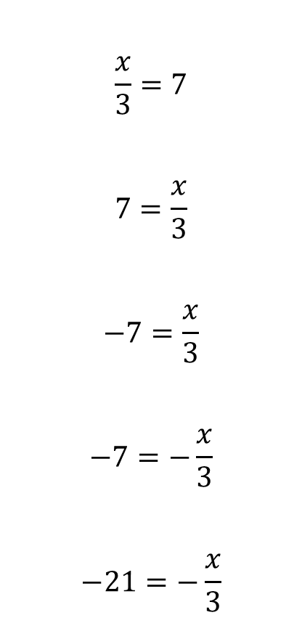
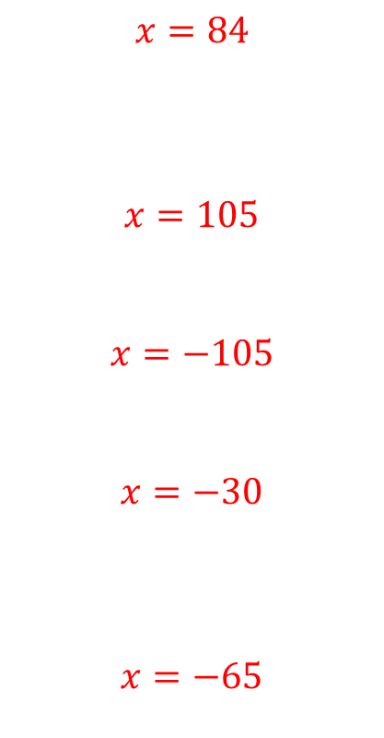
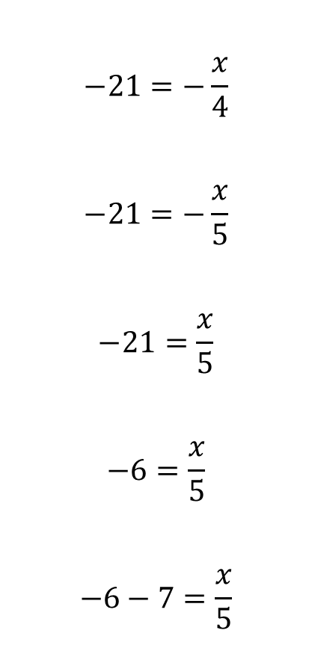
Solve the following equations:
$$\frac{x}{3}=7$$
$$7=\frac{x}{3}$$
$$−7=\frac{x}{3}$$
$$−7=−\frac{x}{3}$$
$$−21=−\frac{x}{3}$$
$$−21=−\frac{x}{4}$$
$$−21=−\frac{x}{5}$$
$$−21=\frac{x}{5}$$
$$−6=\frac{x}{5}$$
$$−6−7=\frac{x}{5}$$
$$x=5$$
$$x=4$$
$$x=7/4$$
$$x=−3$$
$$x=−11$$
$$x=84$$
$$x=105$$
$$x=−105$$
$$x=−30$$
$$x=−65$$
@BerwickMaths

