Slide 1

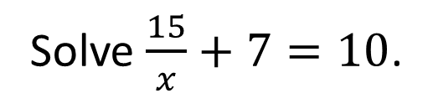
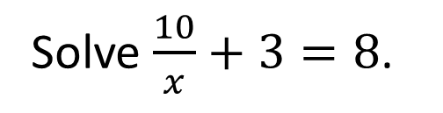

Worked examples
Your turn
Solve $\frac{6}{x}=3$.
Solve $\frac{20}{x}=4$.
Solve $\frac{10}{x}+3=8$.
Solve $\frac{15}{x}+7=10$.
@BerwickMaths

Slide 2



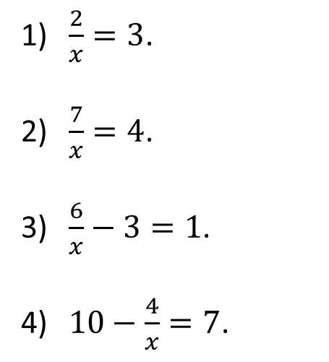





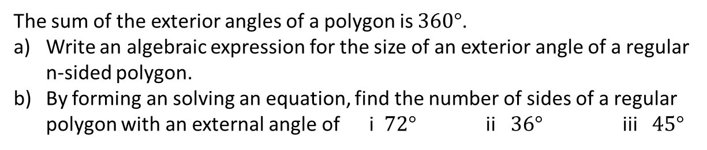

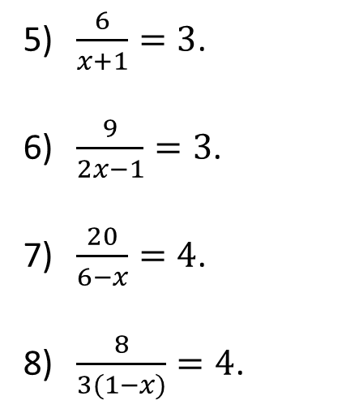

Questions
Solve the following equations:
$\frac{2}{x}=3$.
$\frac{7}{x}=4$.
$\frac{6}{x}−3=1$.
$10−\frac{4}{x}=7$.
$\frac{6}{x+1}=3$.
$\frac{9}{2x−1}=3$.
$\frac{20}{6−x}=4$.
$\frac{8}{3(1−x)}=4$.
$$x=2/3$$
$$x=1$$
$$x=7/4$$
$$x=2$$
$$x=3/2$$
$$x=1$$
$$x=4/3$$
$$x=1/3$$
The sum of the exterior angles of a polygon is $360°$.
Write an algebraic expression for the size of an exterior angle of a regular n-sided polygon.
By forming an solving an equation, find the number of sides of a regular polygon with an external angle of i $72°$ ii $36°$ iii $45°$
@BerwickMaths

