Slide 1
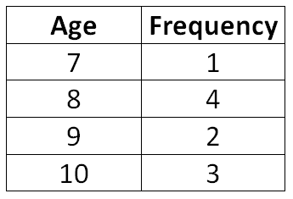

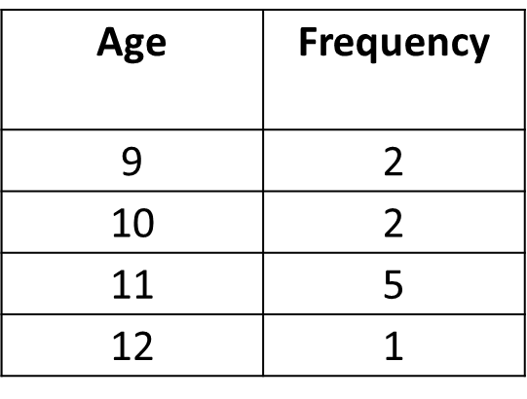


Worked Example
Example by Fading
Your Turn
Calculate the mean, mode and median age:
Calculate the mean, mode and median age:
Calculate the mean, mode and median age:
$$10.5$$
Multiply the “Age” with each corresponding frequency:
7x2=14
8x8=64
9x4=36
10x6=60
Add them all up!
$$14+64+36+60=174$$
Finish off the question!
@BerwickMaths

Slide 2
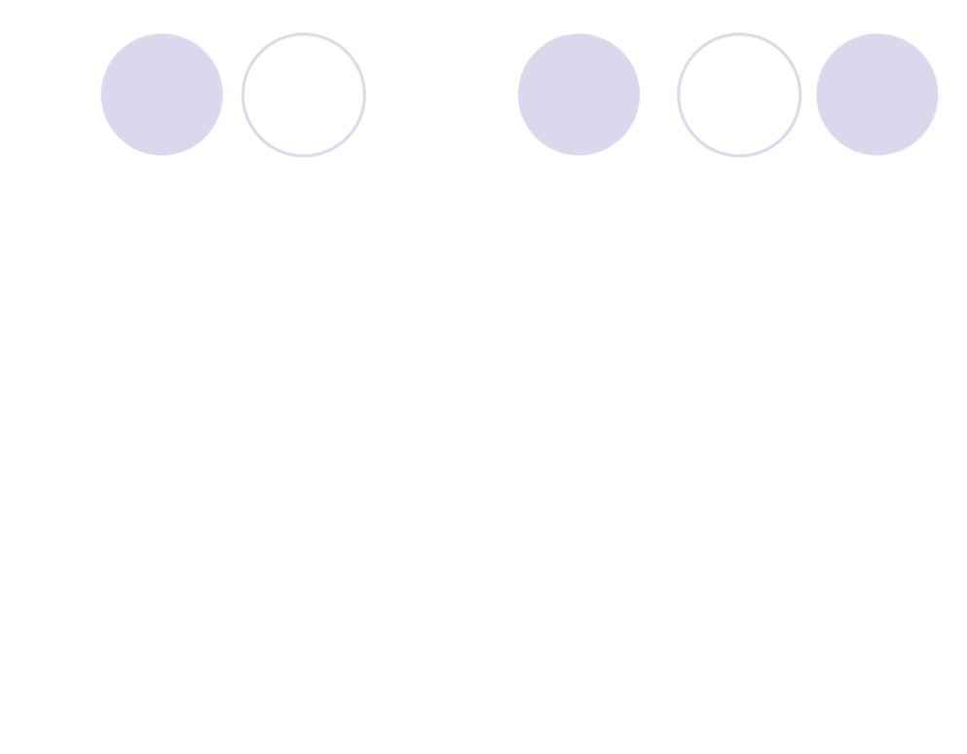



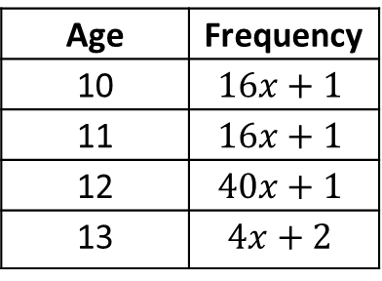
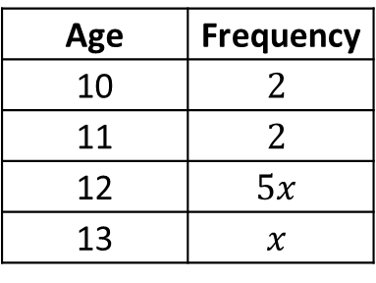

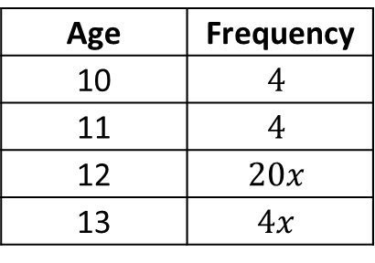


Questions
Calculate the mean, mode, median and range from each of the frequency tables below:
Age | Frequency
20 | 5
22 | 5
24 | 11
26 | 3
Age | Frequency
20 | 5
22 | 11
24 | 11
26 | 5
Age | Frequency
20 | 5
22 | 11
24 | 11
26 | 3
In a rugby team the mean weight of the eight forwards is 95kg and the mean weight of the seven backs is 83kg. Bill says the mean weight of the team is 89kg. Is he correct? Explain your answer.
No. 89 is the average of 83 and 95. The average weight is 89.4 kg.
Each frequency table below has a mean of 11.5. Calculate the value of $x$ for each table.
Age | Frequency
10 | $$2$$
11 | $$2$$
12 | $$5x$$
13 | $$x$$
Age | Frequency
10 | $$4$$
11 | $$4$$
12 | $$20x$$
13 | $$4x$$
Age | Frequency
10 | $$16x+1$$
11 | $$16x+1$$
12 | $$40x+1$$
13 | $$4x+2$$
@BerwickMaths
$$x=1$$
$$x=1/2$$
$$x=1/4$$

