Slide 1
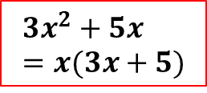
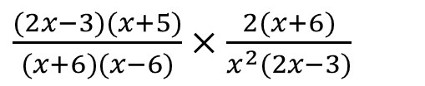
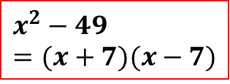
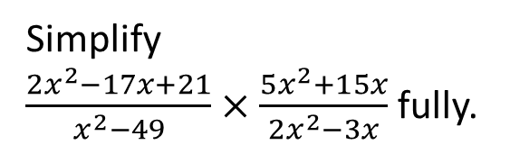
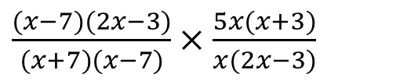
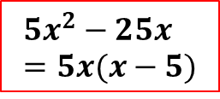
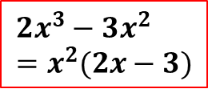
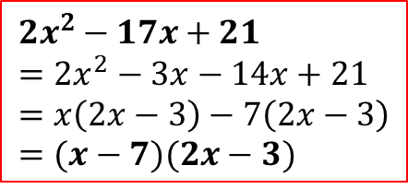
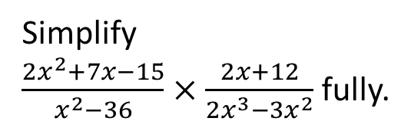
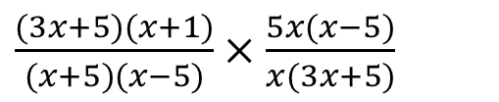
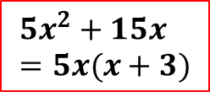
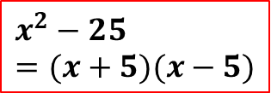
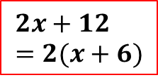
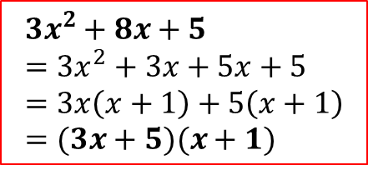
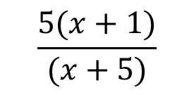
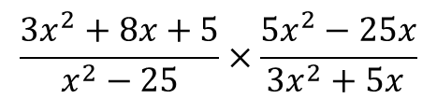
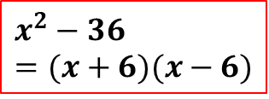

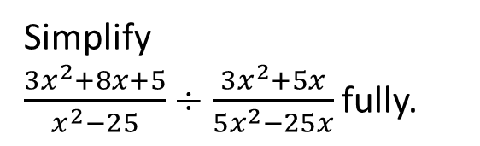
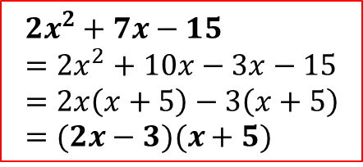
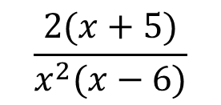
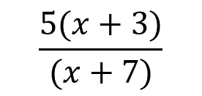
Worked Example 1
Reflective Process
Worked Example 2
Your Turn
Simplify
$\frac{2x^{2}+7x−15}{x^{2}−36}×\frac{2x+12}{{2x}^{3}−3x^{2}}$ fully.
Factorise the numerators (if you can)
Simplify
$\frac{3x^{2}+8x+5}{x^{2}−25}÷\frac{3x^{2}+5x}{5x^{2}−25x}$ fully.
Simplify
$\frac{2x^{2}−17x+21}{x^{2}−49}×\frac{5x^{2}+15x}{{2x}^{2}−3x}$ fully.
Factorise the denominators (if you can)
$$\frac{3x^{2}+8x+5}{x^{2}−25}×\frac{5x^{2}−25x}{3x^{2}+5x }$$
FACTORISE EVERYTHING
$$2x^{2}+7x−15=2x^{2}+10x−3x−15=2x\left(x+5\right)−3\left(x+5\right)=(2x−3)(x+5)$$
$$2x^{2}−17x+21=2x^{2}−3x−14x+21=x\left(2x−3\right)−7\left(2x−3\right)=(x−7)(2x−3)$$
Replace the expressions with their factorised versions
$$3x^{2}+8x+5=3x^{2}+3x+5x+5=3x\left(x+1\right)+5\left(x+1\right)=(3x+5)(x+1)$$
$$x^{2}−36=(x+6)(x−6)$$
$$x^{2}−49=(x+7)(x−7)$$
Cancel the common factors
$$x^{2}−25=(x+5)(x−5)$$
$$2x+12=2(x+6)$$
$${2x}^{3}−3x^{2}=x^{2}(2x−3)$$
$${5x}^{2}+15x=5x(x+3)$$
$${2x}^{2}−3x=x(2x−3)$$
Rewrite without the expressions that you have crossed out
$${5x}^{2}−25x=5x(x−5)$$
$${3x}^{2}+5x=x(3x+5)$$
Replace
$\frac{(2x−3)(x+5)}{(x+6)(x−6)}×\frac{2(x+6)}{x^{2}(2x−3)}$
$\frac{(x−7)(2x−3)}{(x+7)(x−7)}×\frac{5x(x+3)}{x(2x−3)}$
$\frac{(3x+5)(x+1)}{(x+5)(x−5)}×\frac{5x(x−5)}{x(3x+5)}$
Cancel the common factors
$$\frac{2(x+5)}{x^{2}(x−6)}$$
Cancel the common factors
$$\frac{5(x+3)}{(x+7)}$$
$$\frac{5(x+1)}{(x+5)}$$
@BerwickMaths

Slide 2

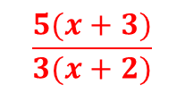

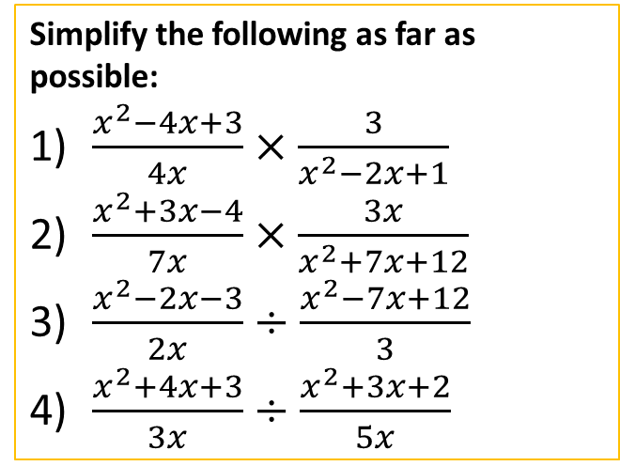
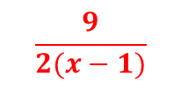
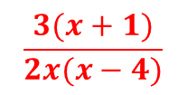

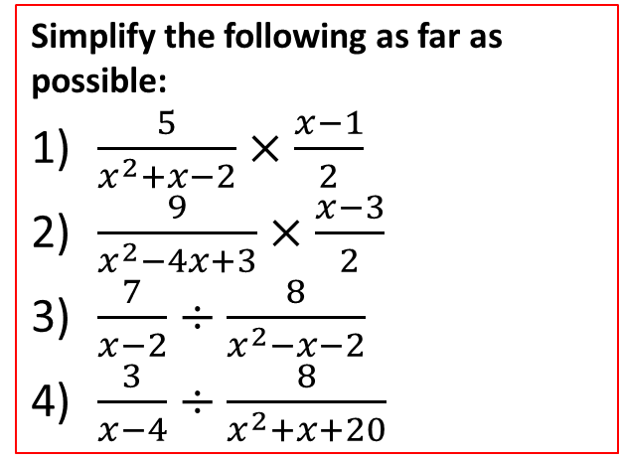


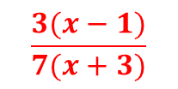
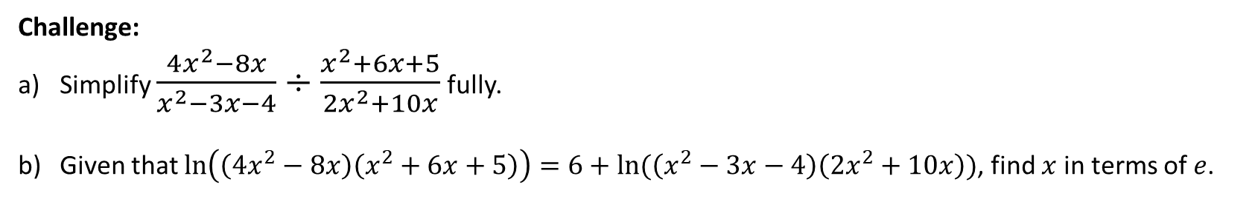

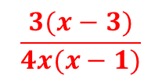
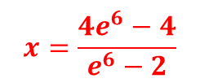
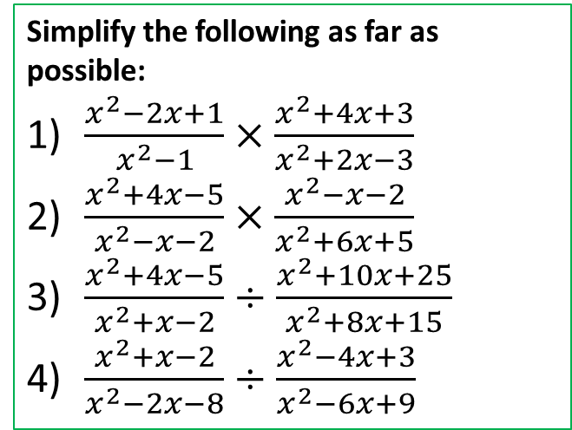


Questions
Simplify the following as far as possible:
$\frac{5}{x^{2}+x−2}×\frac{x−1}{2}$
$\frac{9}{x^{2}−4x+3}×\frac{x−3}{2}$
$\frac{7}{x−2}÷\frac{8}{x^{2}−x−2}$
$\frac{3}{x−4}÷\frac{8}{x^{2}+x+20}$
Simplify the following as far as possible:
$\frac{x^{2}−4x+3}{4x}×\frac{3}{x^{2}−2x+1}$
$\frac{x^{2}+3x−4}{7x}×\frac{3x}{x^{2}+7x+12}$
$\frac{x^{2}−2x−3}{2x}÷\frac{x^{2}−7x+12}{3}$
$\frac{x^{2}+4x+3}{3x}÷\frac{x^{2}+3x+2}{5x}$
Simplify the following as far as possible:
$\frac{x^{2}−2x+1}{x^{2}−1}×\frac{x^{2}+4x+3}{x^{2}+2x−3}$
$\frac{x^{2}+4x−5}{x^{2}−x−2}×\frac{x^{2}−x−2}{x^{2}+6x+5}$
$\frac{x^{2}+4x−5}{x^{2}+x−2}÷\frac{x^{2}+10x+25}{x^{2}+8x+15}$
$\frac{x^{2}+x−2}{x^{2}−2x−8}÷\frac{x^{2}−4x+3}{x^{2}−6x+9}$
$$\frac{5}{2(x+2)}$$
$$\frac{3(x−3)}{4x(x−1)}$$
$$1$$
$$\frac{9}{2(x−1)}$$
$$\frac{x−1}{x+1}$$
$$\frac{3(x−1)}{7(x+3)}$$
$$\frac{7(x+1)}{8}$$
$$\frac{x+3}{x+2}$$
$$\frac{3(x+1)}{2x(x−4)}$$
$$\frac{3(x+5)}{8}$$
$$\frac{5(x+3)}{3(x+2)}$$
$$\frac{x−3}{x−4}$$
Challenge:
Simplify $\frac{4x^{2}−8x}{x^{2}−3x−4}÷\frac{x^{2}+6x+5}{{2x}^{2}+10x}$ fully.
Given that $\ln\left(\left(4x^{2}−8x\right)\left(x^{2}+6x+5\right)\right)=6+ln⁡(\left(x^{2}−3x−4\right)\left(2x^{2}+10x\right))$, find $x$ in terms of $e$.
$$\frac{2(x−2)}{x−4}$$
$$x=\frac{4e^{6}−4}{e^{6}−2}$$
@BerwickMaths

