Slide 1

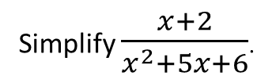
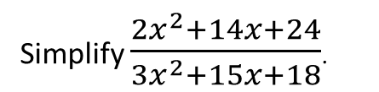
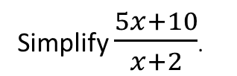
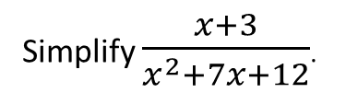
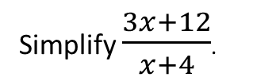
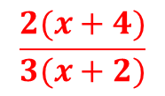
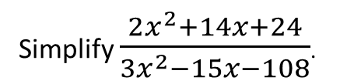
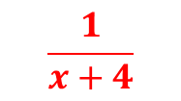
Worked Examples
Reflective Process
Your Turn
Simplify $\frac{5x+10}{x+2}$.
Factorise the numerator (if you can)
Simplify $\frac{3x+12}{x+4}$.
Factorise the denominator (if you can)
$$3$$
Replace the expressions with their factorised versions.
Simplify $\frac{x+2}{x^{2}+5x+6}$.
Simplify $\frac{x+3}{x^{2}+7x+12}$.
Cancel the common factors
$$\frac{1}{x+4}$$
Rewrite without the expression that you have cross out
Simplify $\frac{2x^{2}+14x+24}{{3x}^{2}−15x−108}$.
Simplify $\frac{2x^{2}+14x+24}{{3x}^{2}+15x+18}$.
$$\frac{2(x+4)}{3(x+2)}$$
@BerwickMaths

Slide 2
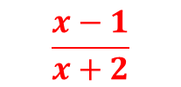
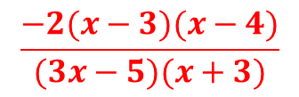
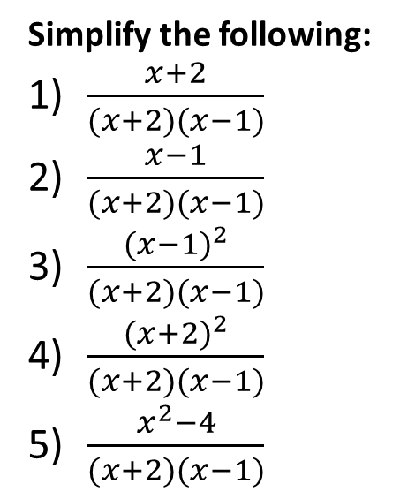
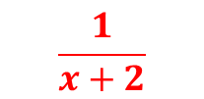
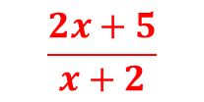
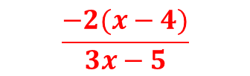
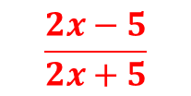
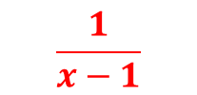
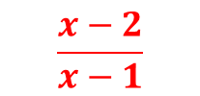
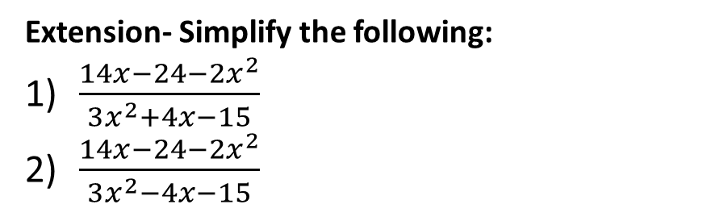
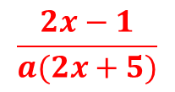
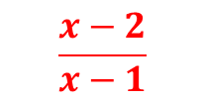
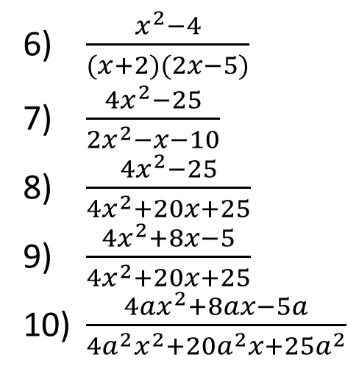
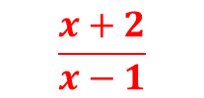
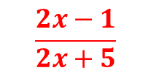
Questions
Simplify the following:
$\frac{x+2}{(x+2)(x−1)}$
$\frac{x−1}{(x+2)(x−1)}$
$\frac{{(x−1)}^{2}}{(x+2)(x−1)}$
$\frac{{(x+2)}^{2}}{(x+2)(x−1)}$
$\frac{x^{2}−4}{(x+2)(x−1)}$
$$\frac{1}{x−1}$$
$$\frac{x−2}{x−1}$$
$\frac{x^{2}−4}{(x+2)(2x−5)}$
$\frac{{4x}^{2}−25}{2x^{2}−x−10}$
$\frac{{4x}^{2}−25}{4x^{2}+20x+25}$
$\frac{{4x}^{2}+8x−5}{4x^{2}+20x+25}$
$\frac{{4ax}^{2}+8ax−5a}{4a^{2}x^{2}+20a^{2}x+25a^{2}}$
$$\frac{1}{x+2}$$
$$\frac{2x+5}{x+2}$$
$$\frac{x−1}{x+2}$$
$$\frac{2x−5}{2x+5}$$
$$\frac{x+2}{x−1}$$
$$\frac{2x−1}{2x+5}$$
$$\frac{x−2}{x−1}$$
$$\frac{2x−1}{a(2x+5)}$$
Extension- Simplify the following:
$\frac{{14x−24−2x}^{2}}{3x^{2}+4x−15}$
$\frac{{14x−24−2x}^{2}}{3x^{2}−4x−15}$
$$\frac{−2(x−3)(x−4)}{(3x−5)(x+3)}$$
$$\frac{−2(x−4)}{3x−5}$$
@BerwickMaths
Notes:
Notes: Questions 5 and 6 on page 183 for homework (book 2C)

