Slide 1
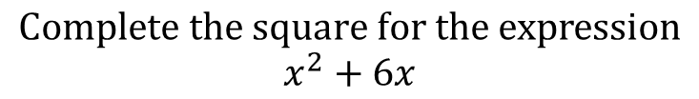
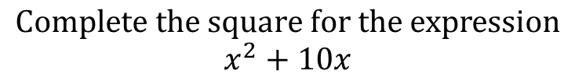
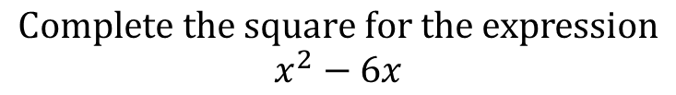
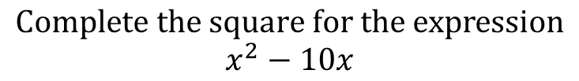
Worked Examples
Your Turn
$$Complete the square for the expression$$
$$x^{2}+10x$$
$$Complete the square for the expression$$
$$x^{2}+6x$$
$$Complete the square for the expression$$
$$x^{2}−10x$$
$$Complete the square for the expression$$
$$x^{2}−6x$$
@BerwickMaths

Slide 2









Complete the square on the following expressions:
$$x^{2}+4x$$
$$x^{2}+8x$$
$$x^{2}+12x$$
$$x^{2}−4x$$
$$x^{2}−8x$$
$$x^{2}−12x$$
$$x^{2}+3x$$
$$x^{2}+5x$$
$$x^{2}−7x$$

Slide 3









Complete the square on the following expressions:
$$x^{2}+4x$$
$${\left(x+2\right)}^{2}−4$$
$$x^{2}+8x$$
$${\left(x+4\right)}^{2}−16$$
$$x^{2}+12x$$
$${\left(x+6\right)}^{2}−36$$
$$x^{2}−4x$$
$${\left(x−2\right)}^{2}−4$$
$$x^{2}−8x$$
$${\left(x−4\right)}^{2}−16$$
$$x^{2}−12x$$
$${\left(x−6\right)}^{2}−36$$
$$x^{2}+3x$$
$${\left(x+1.5\right)}^{2}−2.25$$
$$x^{2}+5x$$
$${\left(x+2.5\right)}^{2}−6.25$$
$$x^{2}−7x$$
$${\left(x−3.5\right)}^{2}−12.25$$
@BerwickMaths

