Slide 1
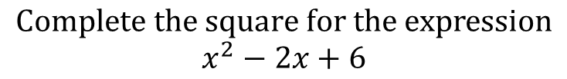
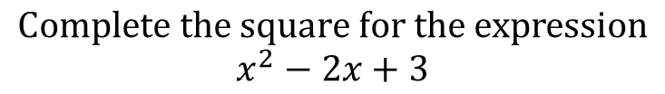
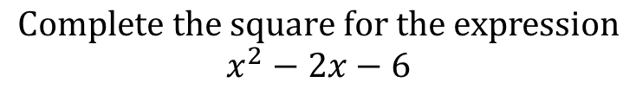
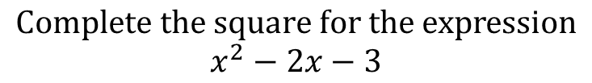
Worked Examples
Your Turn
$$Complete the square for the expression$$
$$x^{2}−2x+3$$
$$Complete the square for the expression$$
$$x^{2}−2x+6$$
$$Complete the square for the expression$$
$$x^{2}−2x−3$$
$$Complete the square for the expression$$
$$x^{2}−2x−6$$
@BerwickMaths

Slide 2


















Complete the square on the following expressions:
$$x^{2}−4x+4$$
$$x^{2}−10x+4$$
$$x^{2}−4x+3$$
$$x^{2}−10x+3$$
$$x^{2}−4x+2$$
$$x^{2}−10x+2$$
$$x^{2}−4x+1$$
$$x^{2}−10x+1$$
$$x^{2}−4x$$
$$x^{2}−10x$$
$$x^{2}−4x−1$$
$$x^{2}−10x−1$$
$$x^{2}−4x−2$$
$$x^{2}−10x−2$$
$$x^{2}−4x−3$$
$$x^{2}−10x−3$$
$$x^{2}−4x−4$$
$$x^{2}−10x−4$$
@BerwickMaths

Slide 3


















Complete the square on the following expressions:
$$x^{2}−4x+4$$
$${\left(x−2\right)}^{2}$$
$$x^{2}−10x+4$$
$${\left(x−5\right)}^{2}−21$$
$$x^{2}−4x+3$$
$${\left(x−2\right)}^{2}−1$$
$$x^{2}−10x+3$$
$${\left(x−5\right)}^{2}−22$$
$$x^{2}−4x+2$$
$${\left(x−2\right)}^{2}−2$$
$$x^{2}−10x+2$$
$${\left(x−5\right)}^{2}−23$$
$$x^{2}−4x+1$$
$${\left(x−2\right)}^{2}−3$$
$$x^{2}−10x+1$$
$${\left(x−5\right)}^{2}−24$$
$$x^{2}−4x$$
$${\left(x−2\right)}^{2}−4$$
$$x^{2}−10x$$
$${\left(x−5\right)}^{2}−25$$
$$x^{2}−4x−1$$
$${\left(x−2\right)}^{2}−5$$
$$x^{2}−10x−1$$
$${\left(x−5\right)}^{2}−26$$
$$x^{2}−4x−2$$
$${\left(x−2\right)}^{2}−6$$
$$x^{2}−10x−2$$
$${\left(x−5\right)}^{2}−27$$
$$x^{2}−4x−3$$
$${\left(x−2\right)}^{2}−7$$
$$x^{2}−10x−3$$
$${\left(x−5\right)}^{2}−28$$
$$x^{2}−4x−4$$
$${\left(x−2\right)}^{2}−8$$
$$x^{2}−10x−4$$
$${\left(x−5\right)}^{2}−29$$
@BerwickMaths

