Slide 1
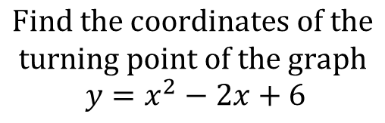
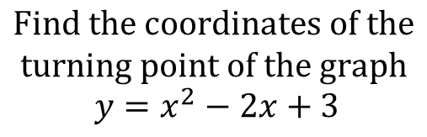
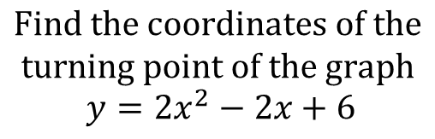
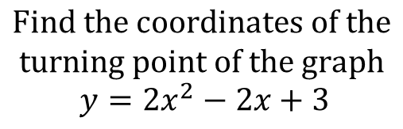
Worked Examples
Your Turn
$$Find the coordinates of the$$
$$turning point of the graph$$
$$y=x^{2}−2x+3$$
$$Find the coordinates of the$$
$$turning point of the graph$$
$$y=x^{2}−2x+6$$
$$Find the coordinates of the$$
$$turning point of the graph$$
$$y={2x}^{2}−2x+3$$
$$Find the coordinates of the$$
$$turning point of the graph$$
$$y={2x}^{2}−2x+6$$
@BerwickMaths

Slide 2
















Find the coordinates of the turning point of the following graphs:
$$y=x^{2}+10x+4$$
$${y=2x}^{2}+4x+4$$
$$y=x^{2}+10x+3$$
$${y=2x}^{2}+4x+3$$
$$y=x^{2}+10x+2$$
$${y=2x}^{2}+4x+2$$
$$y=x^{2}+10x+1$$
$${y=2x}^{2}+4x+1$$
$$y=x^{2}−10x−1$$
$${y=2x}^{2}−4x−1$$
$$y=x^{2}−10x−2$$
$${y=2x}^{2}−4x−2$$
$${y=x}^{2}−10x−3$$
$${y=2x}^{2}−4x−3$$
$${y=x}^{2}−10x−4$$
$${y=2x}^{2}−4x−4$$
@BerwickMaths

Slide 3
















Find the coordinates of the turning point of the following graphs:
$$y=x^{2}+10x+4$$
$$(−5,−21)$$
$${y=2x}^{2}+4x+4$$
$$(−1,2)$$
$$y=x^{2}+10x+3$$
$$(−5,−22)$$
$${y=2x}^{2}+4x+3$$
$$(−1,1)$$
$$y=x^{2}+10x+2$$
$$(−5,−23)$$
$${y=2x}^{2}+4x+2$$
$$(−1,0)$$
$$y=x^{2}+10x+1$$
$$(−5,−24)$$
$${y=2x}^{2}+4x+1$$
$$(−1,−1)$$
$$y=x^{2}−10x−1$$
$$(5,−26)$$
$${y=2x}^{2}−4x−1$$
$$(1,−3)$$
$$y=x^{2}−10x−2$$
$$(5,−27)$$
$${y=2x}^{2}−4x−2$$
$$(1,−4)$$
$${y=x}^{2}−10x−3$$
$$(5,−28)$$
$${y=2x}^{2}−4x−3$$
$$(1,−5)$$
$${y=x}^{2}−10x−4$$
$$(5,−29)$$
$${y=2x}^{2}−4x−4$$
$$(1,−6)$$
@BerwickMaths

