Slide 1
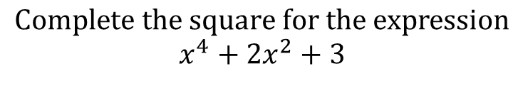
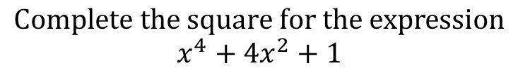
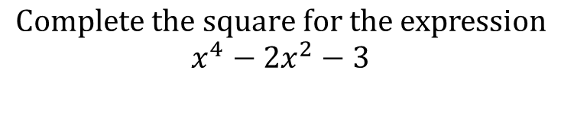
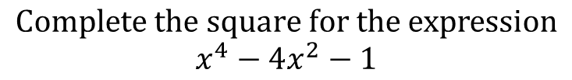
Worked Examples
Your Turn
$$Complete the square for the expression$$
$$x^{4}+4x^{2}+1$$
$$Complete the square for the expression$$
$$x^{4}+2x^{2}+3$$
$$Complete the square for the expression$$
$$x^{4}−4x^{2}−1$$
$$Complete the square for the expression$$
$$x^{4}−2x^{2}−3$$
@BerwickMaths

Slide 2









Complete the square on the following expressions:
$$x^{4}+6x^{2}−10$$
$$x^{4}+8x^{2}+4$$
$$x^{4}+12x^{2}+100$$
$$x^{4}−10x^{2}+20$$
$$x^{4}−12x^{2}+32$$
$$x^{6}+10x^{3}−5$$
$$x^{6}+9x^{3}+8$$
$$x^{8}−10x^{4}−6$$
$$x^{8}−12x^{4}+122$$
@BerwickMaths

Slide 3









Complete the square on the following expressions:
$$x^{4}+6x^{2}−10$$
$${\left(x^{2}+3\right)}^{2}−19$$
$$x^{4}+8x^{2}+4$$
$${\left(x^{2}+4\right)}^{2}−12$$
$$x^{4}+12x^{2}+100$$
$${\left(x^{2}+4\right)}^{2}−12$$
$$x^{4}−10x^{2}+20$$
$${\left(x^{2}−5\right)}^{2}−5$$
$$x^{4}−12x^{2}+32$$
$${\left(x^{2}−6\right)}^{2}−4$$
$$x^{6}+10x^{3}−5$$
$${\left(x^{3}+5\right)}^{2}−30$$
$$x^{6}+9x^{3}+8$$
$${\left(x^{3}+4.5\right)}^{2}−20.25$$
$$x^{8}−10x^{4}−6$$
$${\left(x^{2}−5\right)}^{2}−31$$
$$x^{8}−12x^{4}+122$$
$${\left(x^{2}−6\right)}^{2}+86$$
@BerwickMaths

