Slide 1




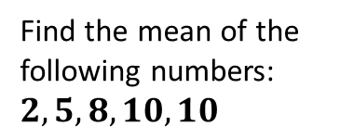
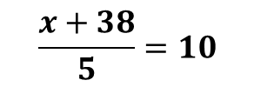
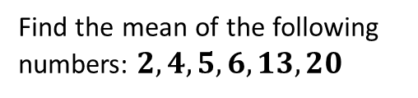

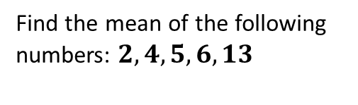

Worked Example
Example by Fading
Your Turn
Find the mean of the following numbers: $2, 4, 5, 6, 13$
Find the mean of the following numbers: $2, 4, 5, 6, 13, 20$
Find the mean of the following numbers:
$$2, 5, 8, 10, 10$$
$$7$$
Add all of the numbers up!
$$2+4+5+6+13+20=50$$
Finish off the question!
Four numbers have a mean of 10.
Three of the numbers are 8, 15, 7.
What is the fourth number?
Five numbers have a mean of 10.
Four of the numbers are 8, 15, 7, 8.
What is the fifth number?
Five numbers have a mean of 10.
Four of the numbers are 20, 28, 25 and 17. What is the fifth number?
Add all of the numbers up along with the unknown ($x$)!
$$−40$$
$$8+15+7+8+x=x+38$$
The 5 numbers have a mean of 10.
$$\frac{x+38}{5}=10$$
Finish off the question!
@BerwickMaths

Slide 2
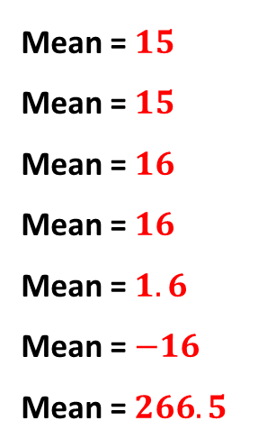
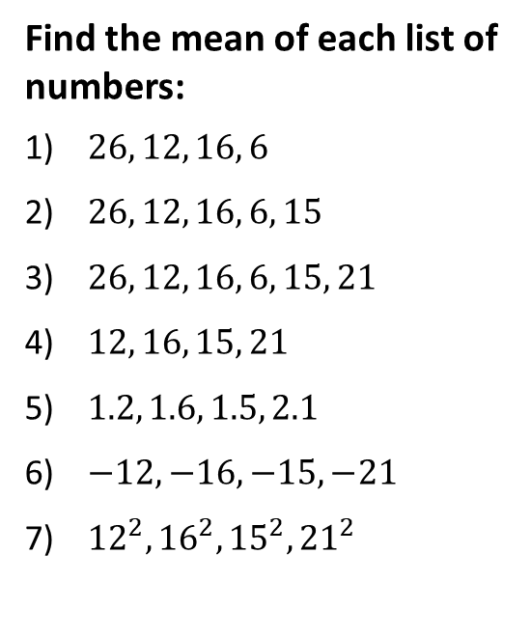
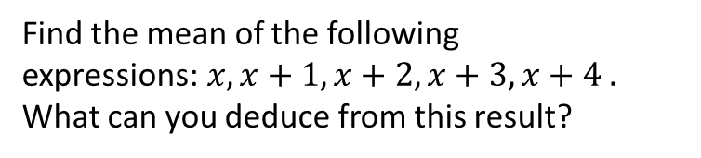
Questions
Find the mean of each list of numbers:
$26, 12, 16, 6$
$26, 12, 16, 6, 15$
$26, 12, 16, 6, 15, 21$
$12, 16, 15, 21$
$1.2, 1.6, 1.5, 2.1$
$−12, −16, −15, −21$
${12}^{2},{16}^{2},{15}^{2},{21}^{2}$
Four numbers have a mean of 22. First three scores are 20, 28 and 25. What is the fourth number?
Five numbers have a mean of 2.2. The first three are 2.0,2.8, 2.5 What is the fourth number?
Four numbers have a mean of 44. First four scores are 40, 56, 50 and 34. What is the fifth number?
Five numbers have a mean of 11. The first four are 10,14,12 and 9. What is the fifth number?
Four numbers have a mean of 15. The first three are 15, 15, and 15. What is the fourth number?
Mean = $15$
Mean = $15$
Mean = $16$
Mean = $16$
Mean = $1.6$
Mean = $−16$
Mean = $266.5$
Fourth score = 15
Fourth score = 1.5
Fourth score = 40
Fifth number = 10
Find the mean of the following expressions:$x, x+1, x+2, x+3, x+4 .$ What can you deduce from this result?
Fourth number = 15
The mean of 5 consecutive numbers is always the middle number.
@BerwickMaths

