Slide 1
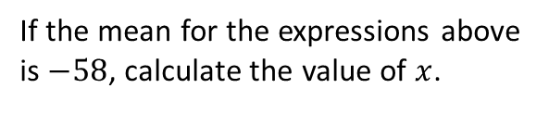
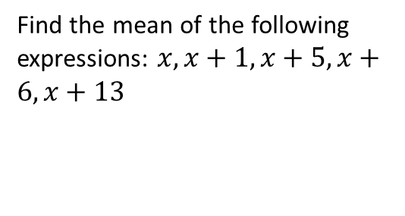
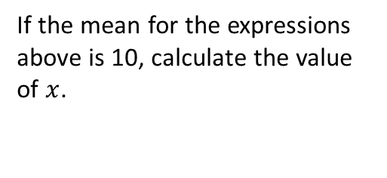



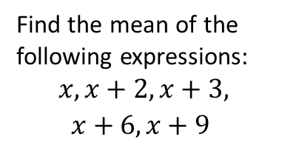

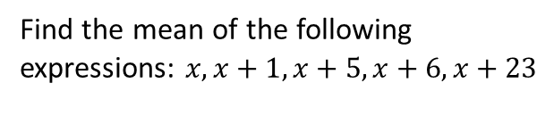
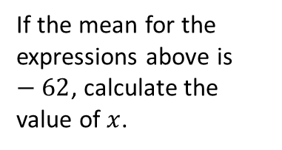
Worked Example
Example by Fading
Your Turn
Find the mean of the following expressions: $x, x+1, x+5, x+6, x+13$
Find the mean of the following expressions: $x, x+1, x+5, x+6, x+23$
Find the mean of the following expressions:
$$x, x+2, x+3, x+6, x+9$$
Add all the expressions up!
$$5x+35$$
Finish off the question!
$$x+4$$
If the mean for the expressions above is 10, calculate the value of $x$.
If the mean for the expressions above is $−58$, calculate the value of $x$.
If the mean for the expressions above is $−62$, calculate the value of $x$.
Set equal!
$$−66$$
$$x+7=−58$$
Finish off the question!
@BerwickMaths

Slide 2
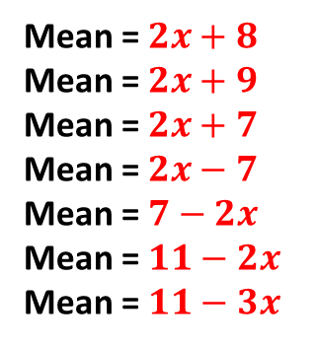
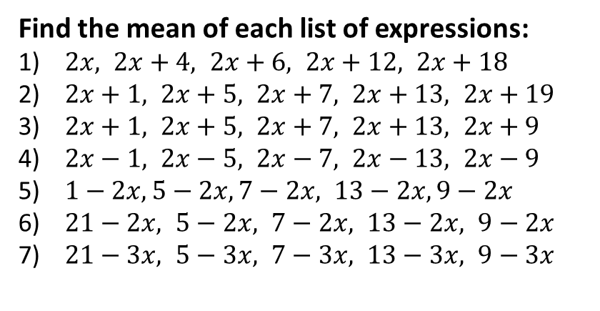

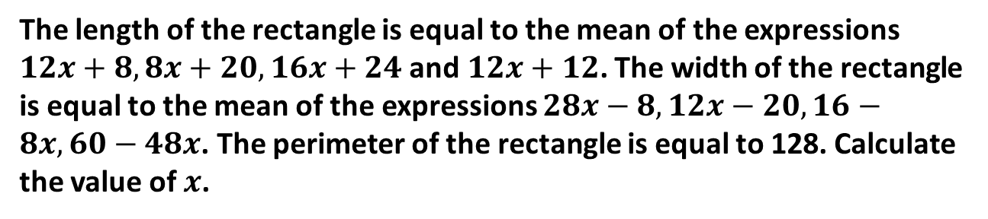
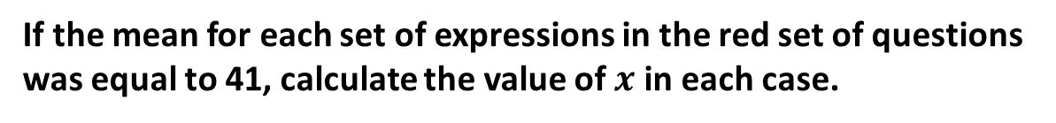
Questions
Find the mean of each list of expressions:
$2x, 2x+4, 2x+6, 2x+12, 2x+18$
$2x+1, 2x+5, 2x+7, 2x+13, 2x+19$
$2x+1, 2x+5, 2x+7, 2x+13, 2x+9$
$2x−1, 2x−5, 2x−7, 2x−13, 2x−9$
$1−2x, 5−2x, 7−2x, 13−2x, 9−2x$
$21−2x, 5−2x, 7−2x, 13−2x, 9−2x$
$21−3x, 5−3x, 7−3x, 13−3x, 9−3x$
Mean = $2x+8$
Mean = $2x+9$
Mean = $2x+7$
Mean = $2x−7$
Mean = $7−2x$
Mean = $11−2x$
Mean = $11−3x$
If the mean for each set of expressions in the red set of questions was equal to 41, calculate the value of $x$ in each case.
The length of the rectangle is equal to the mean of the expressions $12x+8, 8x+20, 16x+24$ and$12x+12$. The width of the rectangle is equal to the mean of the expressions $28x−8, 12x−20, 16−8x, 60−48x$. The perimeter of the rectangle is equal to 128. Calculate the value of $x$.
$$x=4.5$$
@BerwickMaths

