Slide 1

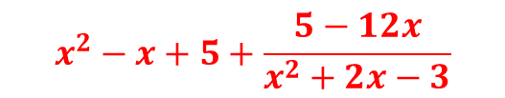

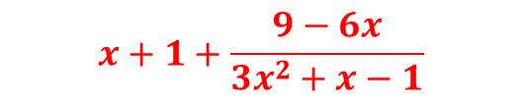


Worked Examples
Your turn
Divide $(6x^{3}−3x^{2}+x−1)$ by $(2x^{2}−x+4)$
Divide $(3x^{3}+4x^{2}−6x+8)$ by $(3x^{2}+x−1)$
$$x+1+\frac{9−6x}{3x^{2}+x−1}$$
Divide $(x^{4}−x^{3}+7x+2)$ by $(x^{2}+x−1)$
Divide $(x^{4}+x^{3}+x−10)$ by $(x^{2}+2x−3)$
$$x^{2}−x+5+\frac{5−12x}{x^{2}+2x−3}$$
@BerwickMaths

Slide 2



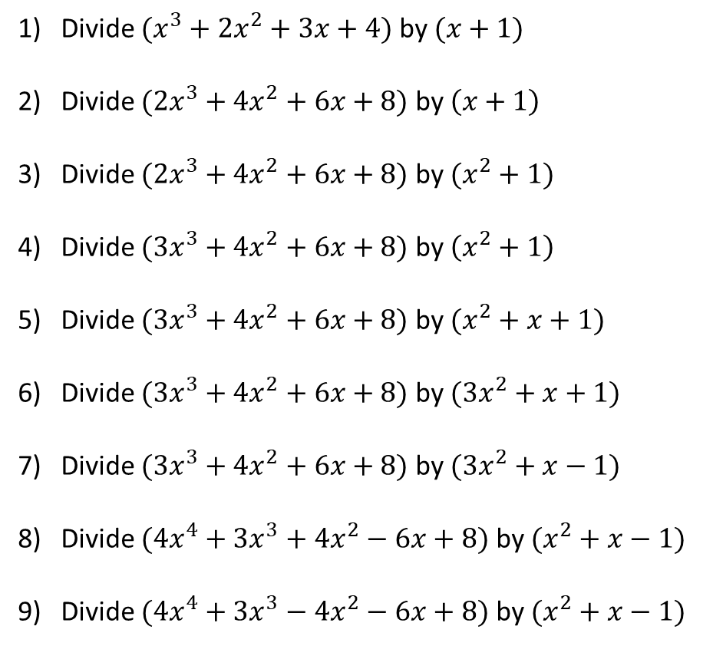






Questions
Divide $(x^{3}+2x^{2}+3x+4)$ by $(x+1)$
Divide $(2x^{3}+4x^{2}+6x+8)$ by $\left(x+1\right)$
Divide $(2x^{3}+4x^{2}+6x+8)$ by $(x^{2}+1)$
Divide $(3x^{3}+4x^{2}+6x+8)$ by $\left(x^{2}+1\right)$
Divide $(3x^{3}+4x^{2}+6x+8)$ by $(x^{2}+x+1)$
Divide $(3x^{3}+4x^{2}+6x+8)$ by $(3x^{2}+x+1)$
Divide $(3x^{3}+4x^{2}+6x+8)$ by $(3x^{2}+x−1)$
Divide $(4x^{4}+3x^{3}+4x^{2}−6x+8)$ by $(x^{2}+x−1)$
Divide $(4x^{4}+3x^{3}−4x^{2}−6x+8)$ by $(x^{2}+x−1)$
$$x^{2}+x+2+\frac{2}{x+1}$$
$$2x^{2}+2x+4+\frac{4}{x+1}$$
$$2x+4+\frac{4x+4}{x^{2}+1}$$
$$3x+4+\frac{3x+4}{x^{2}+1}$$
$$3x+1+\frac{2x+7}{x^{2}+x+1}$$
$$x+1+\frac{4x+7}{3x^{2}+x+1}$$
$$x+1+\frac{6x+9}{3x^{2}+x−1}$$
$${4x}^{2}−x+9+\frac{9−8x}{x^{2}+x−1}$$
$${4x}^{2}−x+1+\frac{7−8x}{x^{2}+x−1}$$
@BerwickMaths

