Slide 1

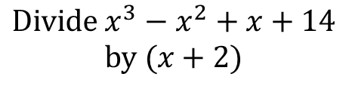
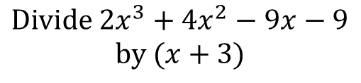
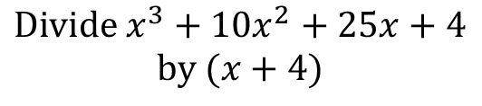
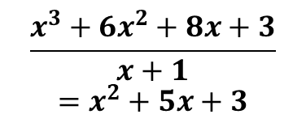
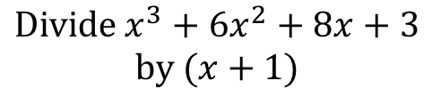
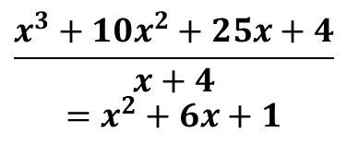

Worked Example
Example by fading
Your Turn
$$Divide x^{3}+10x^{2}+25x+4$$
$$by (x+4)$$
$$Divide x^{3}+6x^{2}+8x+3$$
$$by (x+1)$$
$$Divide x^{3}−x^{2}+x+14$$
$$by (x+2)$$
x²
+
6x
+
1
x²
+
5x
$$x^{2}−3x+7$$
x + 4
x³ + 10x² + 25x + 4
x + 1
x³ + 6x² + 8x + 3
x³ + 4x²
x³ + x²
6x² + 25x
5x² + 8x
6x² + 24x
5x² + 5x
x + 4
$$Divide {2x}^{3}+4x^{2}−9x−9$$
$$by (x+3)$$
x + 4
Finish it off!
0
$$2x^{2}−2x−3$$
$$\frac{x^{3}+10x^{2}+25x+4}{x+4}=x^{2}+6x+1$$
$$\frac{x^{3}+6x^{2}+8x+3}{x+1}=x^{2}+5x+3$$
@BerwickMaths

Slide 2




$$Divide x^{3}+4x^{2}+5x+6 by (x+3)$$
$$Divide x^{3}+x^{2}−4x−4 by (x−2)$$
$$Divide x^{3}+x^{2}−7x−15 by (x−3)$$
$$Divide x^{3}−5x^{2}−6x−56 by (x−7)$$
$$Divide x^{3}+x−2 by (x−1)$$
$$Divide x^{3}+2x^{2}−3x by (x−1)$$
$$Divide {2x}^{3}+4x^{2}−9x−9 by (x+3)$$
$$Divide {2x}^{3}+4x^{2}−9x−9 by (x+3)$$
$$Divide {4x}^{3}+9x^{2}−3x−10 by (x+2)$$
$$Divide {−4x}^{3}+9x^{2}−3x+2 by (x−2)$$
@BerwickMaths

Slide 3














$$Divide x^{3}+4x^{2}+5x+6 by (x+3)$$
$$x^{2}+x+2$$
$$Divide x^{3}+x^{2}−4x−4 by (x−2)$$
$$x^{2}+3x+2$$
$$Divide x^{3}+x^{2}−7x−15 by (x−3)$$
$$x^{2}+4x+5$$
$$Divide x^{3}−5x^{2}−6x−56 by (x−7)$$
$$x^{2}+2x+8$$
$$Divide x^{3}+x−2 by (x−1)$$
$$x^{2}+x+2$$
$$Divide x^{3}+2x^{2}−3x by (x−1)$$
$$x^{2}+3x$$
$$Divide {2x}^{3}+4x^{2}−9x−9 by (x+3)$$
$${2x}^{2}−2x−3$$
$$Divide {2x}^{3}−10x^{2}+3x−15 by (x−5)$$
$${2x}^{2}+3$$
$$Divide {4x}^{3}+9x^{2}−3x−10 by (x+2)$$
$${4x}^{2}+x−5$$
$$Divide {−4x}^{3}+9x^{2}−3x+2 by (x−2)$$
$${−4x}^{2}+x−1$$
@BerwickMaths

