Slide 1
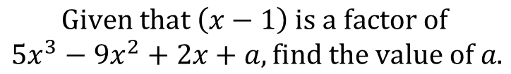
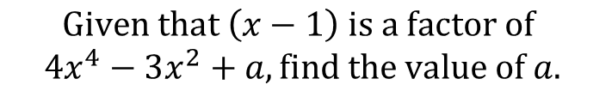
Worked Example
Your Turn
$$Given that \left(x−1\right) is a factor of$$
$${4x}^{4}−3x^{2}+a, find the value of a.$$
$$Given that \left(x−1\right) is a factor of$$
$${5x}^{3}−9x^{2}+2x+a, find the value of a.$$
@BerwickMaths

Slide 2
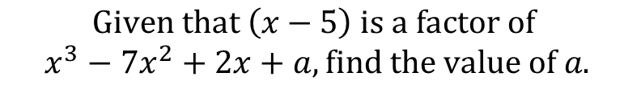
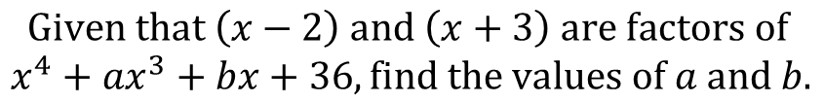
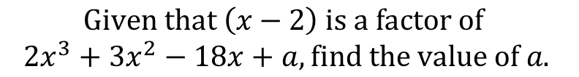
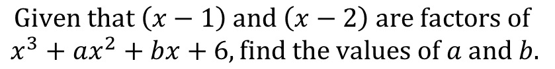
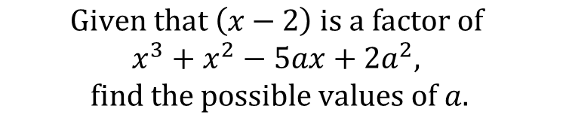
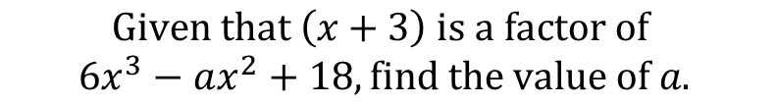
$$Given that \left(x−5\right) is a factor of$$
$$x^{3}−7x^{2}+2x+a, find the value of a.$$
$$Given that \left(x−2\right) is a factor of$$
$${2x}^{3}+3x^{2}−18x+a, find the value of a.$$
$$Given that \left(x+3\right) is a factor of$$
$${6x}^{3}−ax^{2}+18, find the value of a.$$
$$Given that \left(x−2\right) is a factor of$$
$$x^{3}+x^{2}−5ax+2a^{2},$$
$$find the possible values of a.$$
$$Given that \left(x−1\right) and \left(x−2\right) are factors of$$
$$x^{3}+ax^{2}+bx+6, find the values of a and b.$$
$$Given that \left(x−2\right) and \left(x+3\right) are factors of$$
$${x^{4}+ax}^{3}+bx+36, find the values of a and b.$$
@BerwickMaths

Slide 3
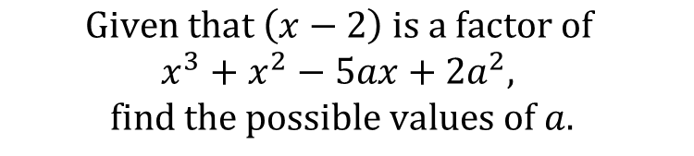





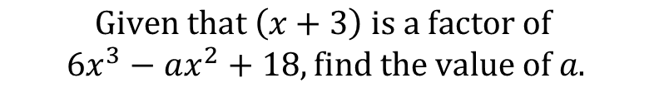
$$Given that \left(x−5\right) is a factor of$$
$$x^{3}−7x^{2}+2x+a, find the value of a.$$
$$a=40$$
$$Given that \left(x−2\right) is a factor of$$
$${2x}^{3}+3x^{2}−18x+a, find the value of a.$$
$$a=8$$
$$Given that \left(x+3\right) is a factor of$$
$${6x}^{3}−ax^{2}+18, find the value of a.$$
$$a=−16$$
$$Given that \left(x−2\right) is a factor of$$
$$x^{3}+x^{2}−5ax+2a^{2},$$
$$find the possible values of a.$$
$$Possible values of a are 2 and 3$$
$$Given that \left(x−1\right) and \left(x−2\right) are factors of$$
$$x^{3}+ax^{2}+bx+6, find the values of a and b.$$
$$a=0 and b=−7$$
$$Given that \left(x−2\right) and \left(x+3\right) are factors of$$
$${x^{4}+ax}^{3}+bx+36, find the values of a and b.$$
$$a=13 and b=−78$$
@BerwickMaths

