Slide 1
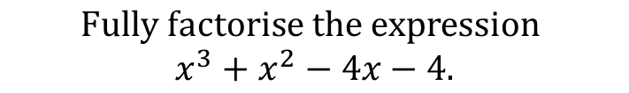
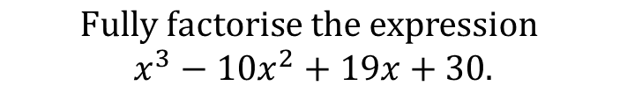
Worked Example
Your Turn
$$Fully factorise the expression$$
$$x^{3}−10x^{2}+19x+30.$$
$$Fully factorise the expression$$
$$x^{3}+x^{2}−4x−4.$$
@BerwickMaths

Slide 2
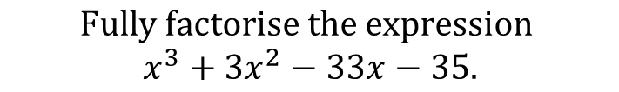

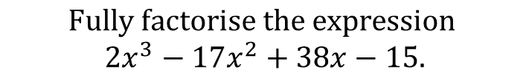
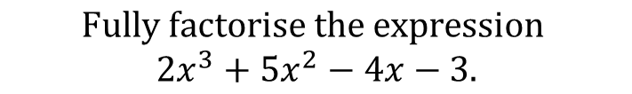
$$Fully factorise the expression$$
$$x^{3}−4x^{2}−11x+30.$$
$$Fully factorise the expression$$
$$x^{3}+3x^{2}−33x−35.$$
$$Fully factorise the expression$$
$${2x}^{3}+5x^{2}−4x−3.$$
$$Fully factorise the expression$$
$${2x}^{3}−17x^{2}+38x−15.$$
@BerwickMaths

Slide 3





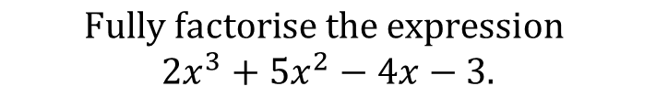

$$Fully factorise the expression$$
$$x^{3}−4x^{2}−11x+30.$$
$$(x−5)(x+3)(x−2)$$
$$Fully factorise the expression$$
$$x^{3}+3x^{2}−33x−35.$$
$$(x−5)(x+1)(x+7)$$
$$Fully factorise the expression$$
$${2x}^{3}+5x^{2}−4x−3.$$
$$(x−1)(x+3)(2x+1)$$
$$Fully factorise the expression$$
$${2x}^{3}−17x^{2}+38x−15.$$
$$(x−3)(x−5)(2x−1)$$
@BerwickMaths

