Slide 1
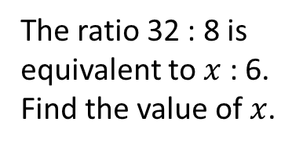


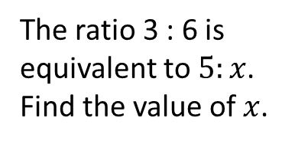

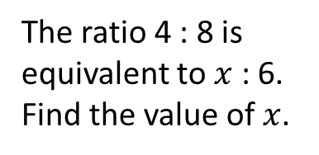
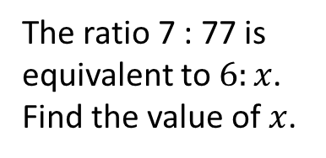

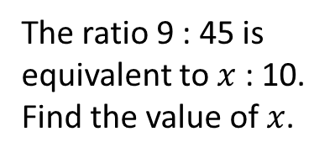
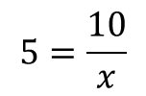


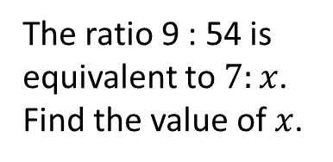

Worked Example
Reflection
Example by Fading
Your Turn
The ratio 7 : 77 is equivalent to $6:x$. Find the value of $x$.
Why did I put the ratios in the form 1 : n?
The ratio 3 : 6 is equivalent to $5:x$. Find the value of $x$.
The ratio 9 : 54 is equivalent to $7:x$. Find the value of $x$.
Why are the parts equal?
Put in the form $1:n$.
$1:2$ and $1:\frac{x}{7}$
$$x=42$$
How many DBRS processes are there?
Set parts equal.
$$2=\frac{x}{7}$$
The ratio 4 : 8 is equivalent to $x$ : 6. Find the value of $x$.
Why did I put the ratios in the form 1 : n?
The ratio 9 : 45 is equivalent to $x$ : 10. Find the value of $x$.
The ratio 32 : 8 is equivalent to $x$ : 6. Find the value of $x$.
Why are the parts equal?
Put in the form $1:n$.
$1:5$ and $1:\frac{10}{x}$
$$x=24$$
How many DBRS processes are there?
Set parts equal.
$$5=\frac{10}{x}$$
@BerwickMaths

Slide 2
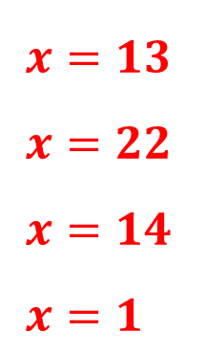
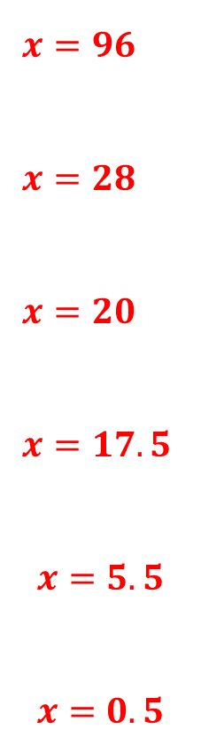
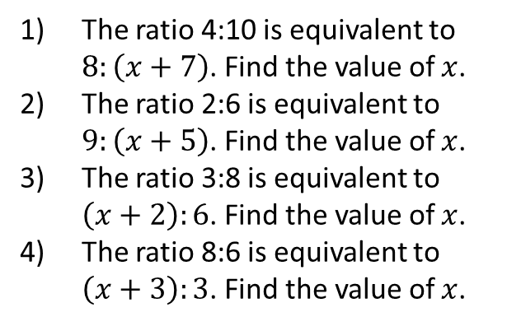
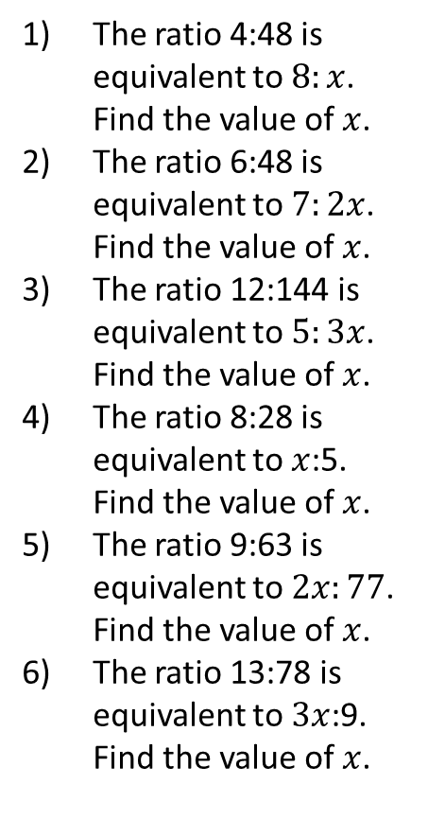
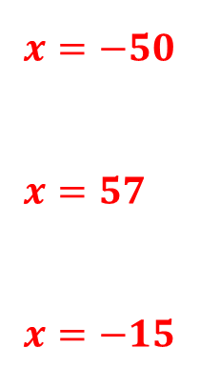
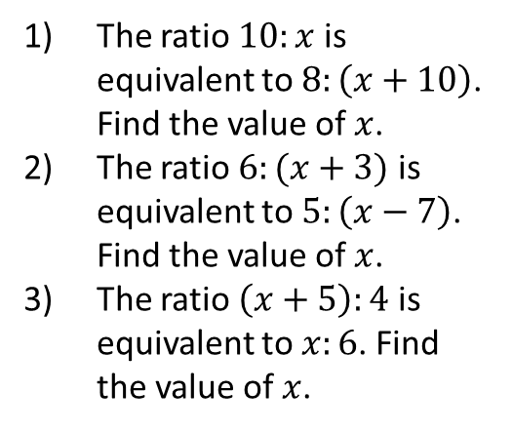
Questions
$x=96$
$x=28$
$x=20$
$x=17.5$
$$x=5.5$$
$$x=0.5$$
The ratio 4:48 is equivalent to $8:x$. Find the value of $x$.
The ratio 6:48 is equivalent to $7:2x$. Find the value of $x$.
The ratio 12:144 is equivalent to $5:3x$. Find the value of $x$.
The ratio 8:28 is equivalent to $x$:5. Find the value of $x$.
The ratio 9:63 is equivalent to $2x:77$. Find the value of $x$.
The ratio 13:78 is equivalent to $3x$:9. Find the value of $x$.
The ratio 4:10 is equivalent to $8:\left(x+7\right)$. Find the value of $x$.
The ratio 2:6 is equivalent to $9:\left(x+5\right)$. Find the value of $x$.
The ratio 3:8 is equivalent to $\left(x+2\right):6$. Find the value of $x$.
The ratio 8:6 is equivalent to $\left(x+3\right):3$. Find the value of $x$.
$x=13$
$x=22$
$x=14$
$x=1$
The ratio $10:x$ is equivalent to $8:\left(x+10\right)$. Find the value of $x$.
The ratio $6:(x+3)$ is equivalent to $5:\left(x−7\right)$. Find the value of $x$.
The ratio $\left(x+5\right):4$ is equivalent to $x:6$. Find the value of $x$.
$x=−50$
$x=57$
$x=−15$
@BerwickMaths

