Slide 1
Worked example
Your turn
8 cm
8 cm
7 cm
6 cm
46°
56°
@BerwickMaths

Slide 2












Sine Rule: Missing Angles
1.
2.
14cm
15cm
12cm
11cm
$$a°$$
$$41°$$
$$38°$$
$$b°$$
3.
17cm
$$97°$$
4.
2cm
$$93°$$
23cm
$$d°$$
$$c°$$
4cm
6.
$$89°$$
5.
14.1cm
$$102°$$
$$e°$$
8.6cm
$$f°$$
17.3cm
20.7cm
@BerwickMaths

Slide 3









Sine Rule: Missing Angle Answers
1.
2.
14cm
15cm
12cm
11cm
$$56.6°$$
$$50.3°$$
$$a°$$
$$41°$$
$$38°$$
$$b°$$
3.
17cm
$$97°$$
4.
2cm
$$93°$$
$$47.6°$$
$$29.8°$$
23cm
$$d°$$
$$c°$$
4cm
6.
$$89°$$
14.1cm
5.
$$102°$$
$$e°$$
$$42.9°$$
$$29.1°$$
$$f°$$
8.6cm
17.3cm
20.7cm
@BerwickMaths

Slide 4
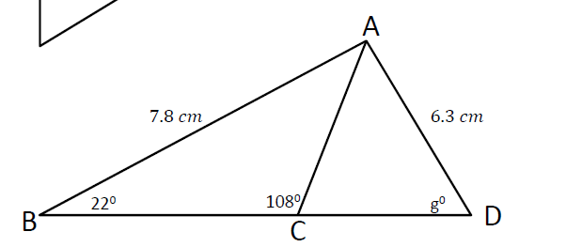
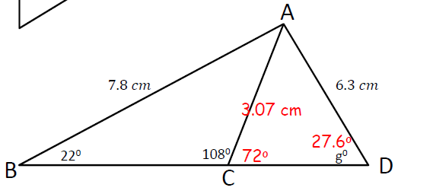
Challenge
@BerwickMaths

