Slide 1
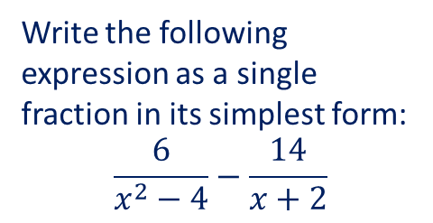
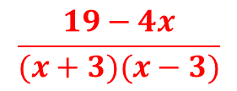
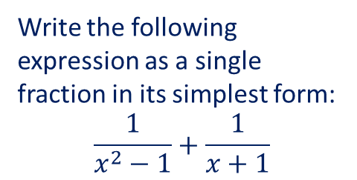
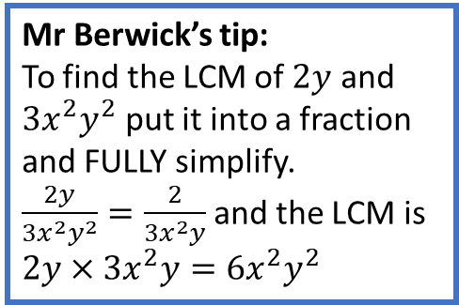
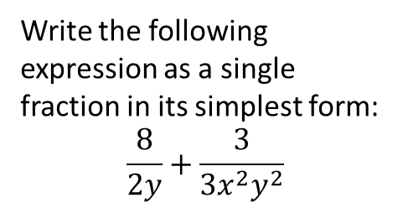
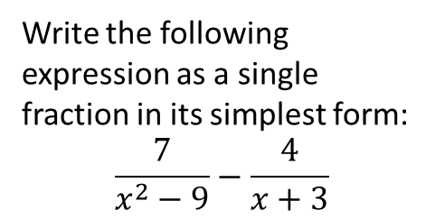
Worked Example 1
Worked Example 2
Worked Example 3
Reflective Process
Write the following expression as a single fraction in its simplest form:
$$\frac{8}{2y}+\frac{3}{3x^{2}y^{2}}$$
Write the following expression as a single fraction in its simplest form:
$$\frac{1}{x^{2}−1}+\frac{1}{x+1}$$
Write the following expression as a single fraction in its simplest form:
$$\frac{6}{x^{2}−4}−\frac{14}{x+2}$$
Factorise the denominators (if you can)
Replace the expressions with their factorised versions (if you can)
Choose a common denominator and make each fraction have the common denominator
Put into one fraction
Clean up the numerator if you can
Simplify again if you can
Your Turn
Write the following expression as a single fraction in its simplest form:
$$\frac{7}{x^{2}−9}−\frac{4}{x+3}$$
Mr Berwick’s tip:
To find the LCM of $2y$ and $3x^{2}y^{2}$ put it into a fraction and FULLY simplify.
$\frac{2y}{3x^{2}y^{2}}=\frac{2}{3x^{2}y}$ and the LCM is $2y×3x^{2}y=6x^{2}y^{2}$
Things to watch out for:
You may be able to simplify further.
When performing a subtraction you must remember that you are subtracting the whole fraction.
$$\frac{19−4x}{(x+3)(x−3)}$$

Slide 2

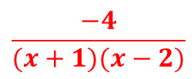
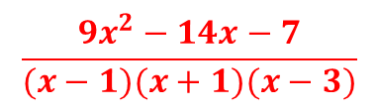
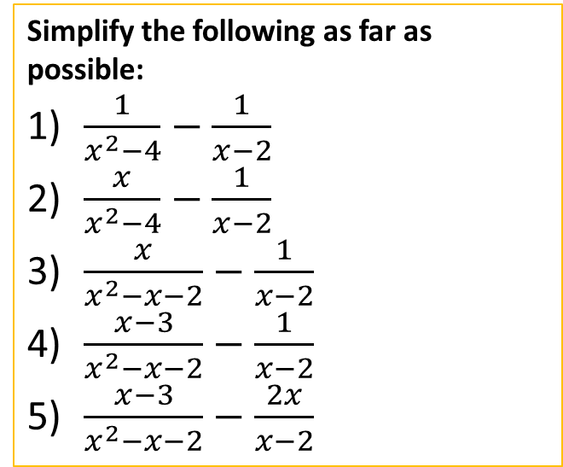

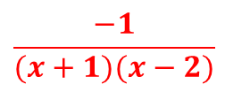
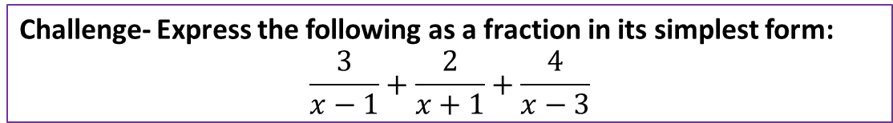
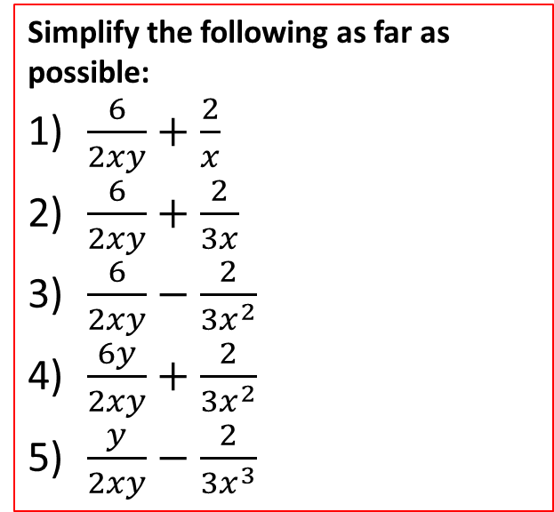


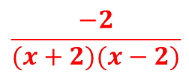

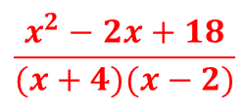
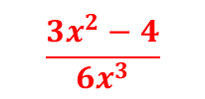
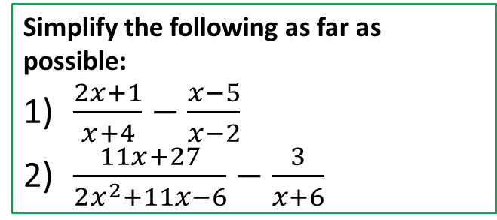
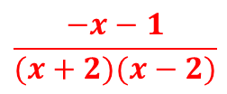
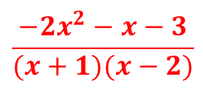
Questions
Simplify the following as far as possible:
$\frac{6}{2xy}+\frac{2}{x}$
$\frac{6}{2xy}+\frac{2}{3x}$
$\frac{6}{2xy}−\frac{2}{3x^{2}}$
$\frac{6y}{2xy}+\frac{2}{3x^{2}}$
$\frac{y}{2xy}−\frac{2}{3x^{3}}$
Simplify the following as far as possible:
$\frac{1}{x^{2}−4}−\frac{1}{x−2}$
$\frac{x}{x^{2}−4}−\frac{1}{x−2}$
$\frac{x}{x^{2}−x−2}−\frac{1}{x−2}$
$\frac{x−3}{x^{2}−x−2}−\frac{1}{x−2}$
$\frac{x−3}{x^{2}−x−2}−\frac{2x}{x−2}$
Simplify the following as far as possible:
$\frac{2x+1}{x+4}−\frac{x−5}{x−2}$
$\frac{11x+27}{2x^{2}+11x−6}−\frac{3}{x+6}$
$$\frac{2y+3}{xy}$$
$$\frac{−x−1}{(x+2)(x−2)}$$
$$\frac{x^{2}−2x+18}{(x+4)(x−2)}$$
$$\frac{2y+9}{3xy}$$
$$\frac{−2}{(x+2)(x−2)}$$
$$\frac{5}{2x−1}$$
$$\frac{9x−2y}{3x^{2}y}$$
$$\frac{−1}{(x+1)(x−2)}$$
$$\frac{2+9x}{3x^{2}}$$
$$\frac{−4}{(x+1)(x−2)}$$
$$\frac{−2x^{2}−x−3}{(x+1)(x−2)}$$
$$\frac{3x^{2}−4}{6x^{3}}$$
Challenge- Express the following as a fraction in its simplest form:
$$\frac{3}{x−1}+\frac{2}{x+1}+\frac{4}{x−3}$$
$$\frac{9x^{2}−14x−7}{(x−1)(x+1)(x−3)}$$
@BerwickMaths

