Slide 1






Worked Examples
Your Turn
$${(x+2)}^{2}$$
$${(x+3)}^{2}$$
$${(x+2)}^{2}+{(x+4)}^{2}$$
$${(x+3)}^{2}+{(x+1)}^{2}$$
$${(x+2)}^{2}−{(x−4)}^{2}$$
$${(x+3)}^{2}−{(x−1)}^{2}$$
@BerwickMaths

Slide 2
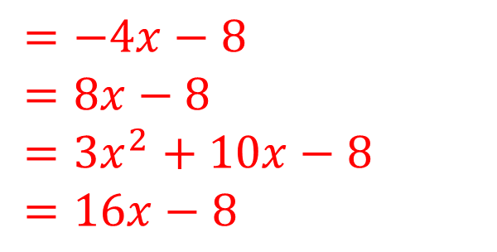
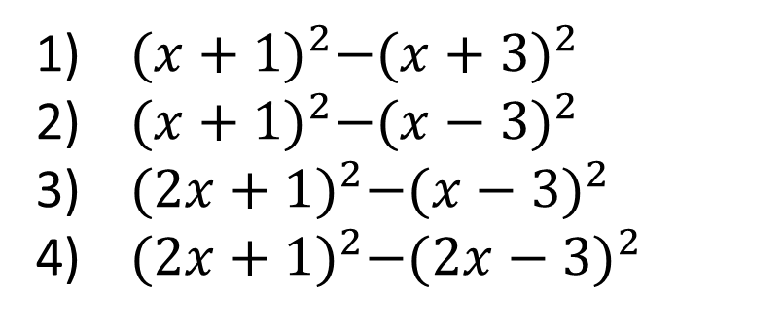
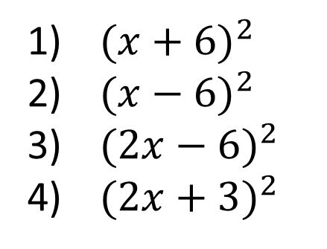
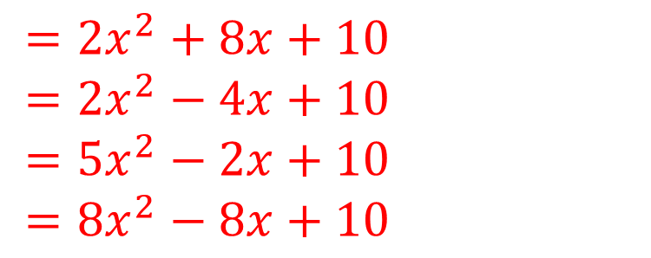
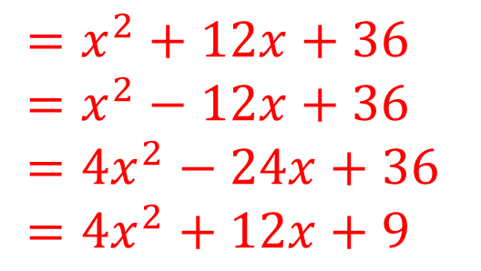
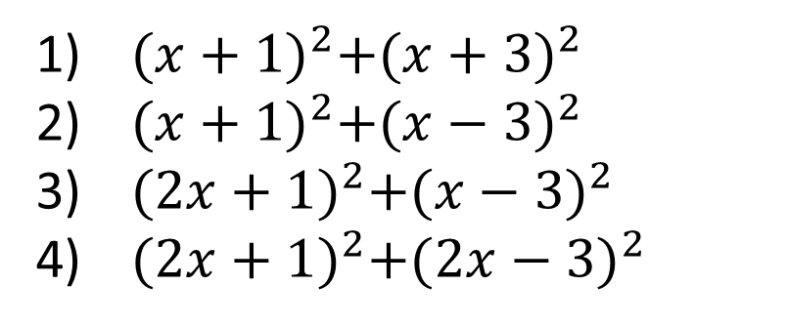
Questions
${(x+6)}^{2}$
${(x−6)}^{2}$
${(2x−6)}^{2}$
${(2x+3)}^{2}$
$=x^{2}+12x+36$
$=x^{2}−12x+36$
$=4x^{2}−24x+36$
$=4x^{2}+12x+9$
${(x+1)}^{2}+{(x+3)}^{2}$
${(x+1)}^{2}+{(x−3)}^{2}$
${(2x+1)}^{2}+{(x−3)}^{2}$
${(2x+1)}^{2}+{(2x−3)}^{2}$
$=2x^{2}+8x+10$
$=2x^{2}−4x+10$
$=5x^{2}−2x+10$
$={8x}^{2}−8x+10$
${(x+1)}^{2}−{(x+3)}^{2}$
${(x+1)}^{2}−{(x−3)}^{2}$
${(2x+1)}^{2}−{(x−3)}^{2}$
${(2x+1)}^{2}−{(2x−3)}^{2}$
$=−4x−8$
$=8x−8$
$=3x^{2}+10x−8$
$=16x−8$
@BerwickMaths

