Slide 1



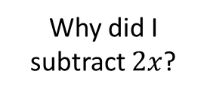






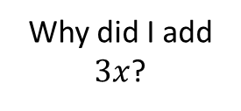







Worked Example
Reflection
Example by Fading
Your Turn
Solve
What do I need to remember with brackets?
Solve
Solve
$$3\left(x+2\right)<2(x+3)$$
$$7\left(x−3\right)≤2(x+7)$$
$$9\left(x−3\right)≤4(x+7)$$
Expand
$$7x−21≤2x+14$$
Why did I subtract $2x$?
Decide $(−2x)$
$$x≤11$$
Break and Repair Inequality
How many DBRS processes are there?
$$7x−21−2x≤2x+14−2x$$
Simplify
$$5x−21≤14$$
Solve
What do I need to remember with brackets?
Solve
Solve
$$3\left(x+8\right)>3(2−x)$$
$$3\left(x−5\right)≥5(5−x)$$
$$7\left(x+6\right)≥4(x+3)$$
Expand
$$3x−15≥25−5x$$
Why did I add $3x$?
Decide $(+5x)$
$$x≥−10$$
Break and Repair Inequality
How many DBRS processes are there?
$$3x−15+5x≥25−5x+5x$$
Simplify
$$8x−15≥25$$
@BerwickMaths

Slide 2
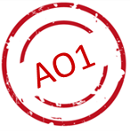

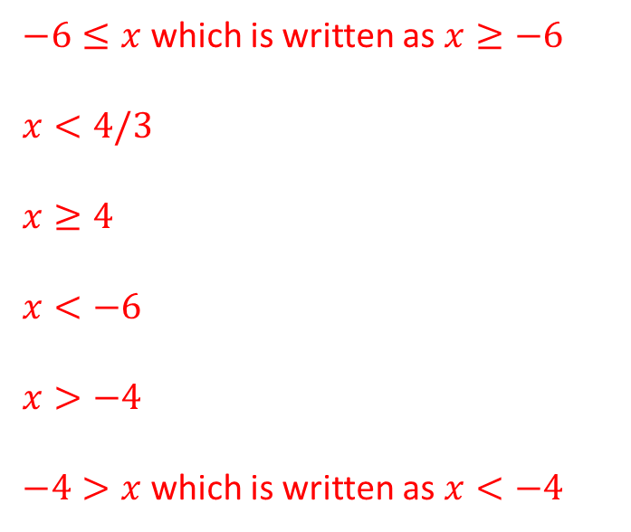
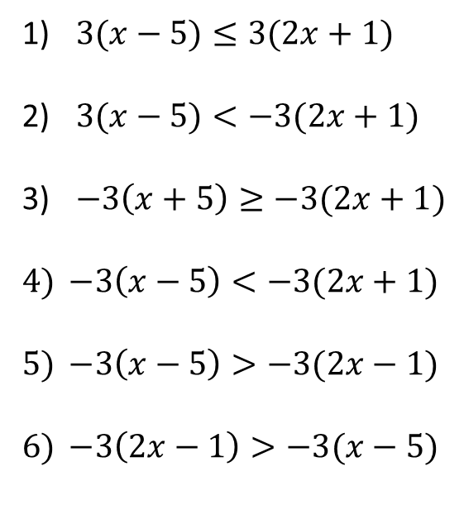
Questions
Solve the following inequalities:
$3(x−5)≤3(2x+1)$
$3(x−5)<−3(2x+1)$
$−3\left(x+5\right)≥−3(2x+1)$
$−3\left(x−5\right)<−3(2x+1)$
$−3\left(x−5\right)>−3(2x−1)$
$−3\left(2x−1\right)>−3(x−5)$
$−6≤x$ which is written as $x≥−6$
$x<4/3$
$x≥4$
$x<−6$
$x>−4$
$−4>x$ which is written as $x<−4$
Explain your thinking process to solve the inequality $\frac{x}{4}−2<3(2x−7)$.
@BerwickMaths

