Slide 1
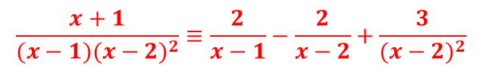
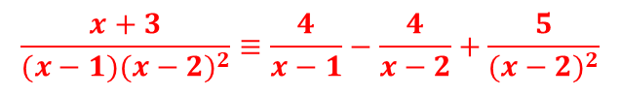

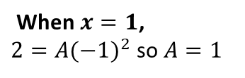
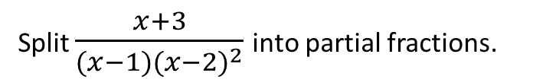
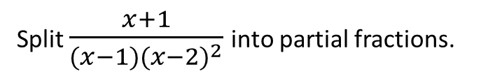
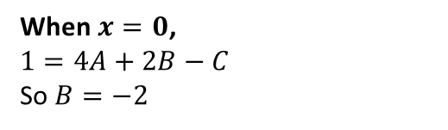



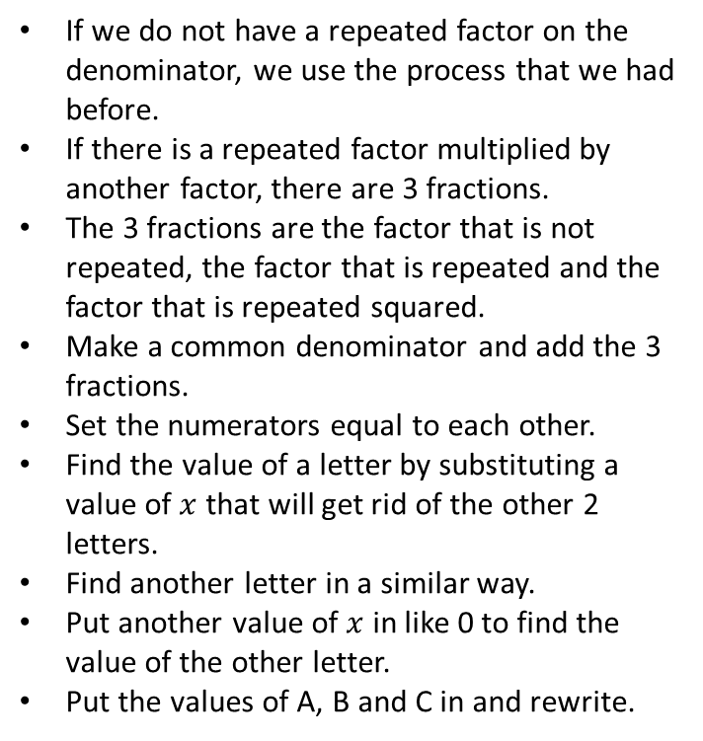
Worked Example
Reflection
Split $\frac{x+1}{{(x−1)(x−2)}^{2}}$ into partial fractions.
If we do not have a repeated factor on the denominator, we use the process that we had before.
If there is a repeated factor multiplied by another factor, there are 3 fractions.
The 3 fractions are the factor that is not repeated, the factor that is repeated and the factor that is repeated squared.
Make a common denominator and add the 3 fractions.
Set the numerators equal to each other.
Find the value of a letter by substituting a value of $x$ that will get rid of the other 2 letters.
Find another letter in a similar way.
Put another value of $x$ in like 0 to find the value of the other letter.
Put the values of A, B and C in and rewrite.
$$\frac{x+1}{{(x−1)(x−2)}^{2}}≡\frac{A}{x−1}+\frac{B}{x−2}+\frac{C}{{(x−2)}^{2}}$$
$$≡\frac{A{\left(x−2\right)}^{2}}{{\left(x−1\right)\left(x−2\right)}^{2}}+\frac{B\left(x−1\right)\left(x−2\right)}{{\left(x−1\right)\left(x−2\right)}^{2}}+\frac{C(x−1)}{{(x−1)(x−2)}^{2}}$$
$$\frac{x+1}{{(x−1)(x−2)}^{2}}≡\frac{A{\left(x−2\right)}^{2}+B\left(x−1\right)\left(x−2\right)+C(x−1)}{{(x−1)(x−2)}^{2}}$$
$x+1=A{\left(x−2\right)}^{2}+B\left(x−1\right)\left(x−2\right)+C(x−1)$
When $x=1$,
$2=A({−1)}^{2}$ so $A=1$
When $x=2$,
$C=3$
When $x=0$,
$1=4A+2B−C$
So $B=−2$
$$\frac{x+1}{{(x−1)(x−2)}^{2}}≡\frac{2}{x−1}−\frac{2}{x−2}+\frac{3}{{(x−2)}^{2}}$$
Your turn
Split $\frac{x+3}{{(x−1)(x−2)}^{2}}$ into partial fractions.
$$\frac{x+3}{{(x−1)(x−2)}^{2}}≡\frac{4}{x−1}−\frac{4}{x−2}+\frac{5}{{(x−2)}^{2}}$$

Slide 2

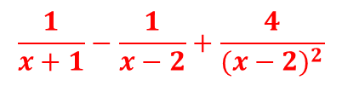



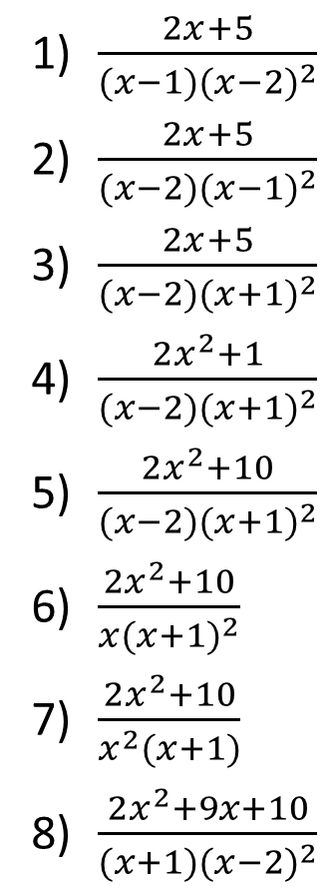




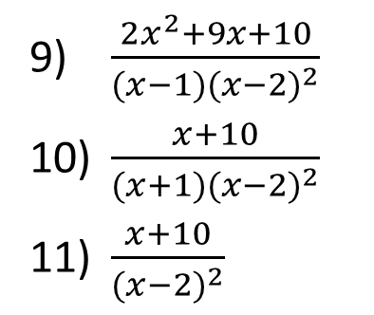

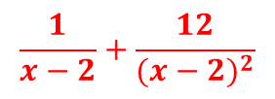
Split the following into partial fractions:
$\frac{2x+5}{{(x−1)(x−2)}^{2}}$
$\frac{2x+5}{{(x−2)(x−1)}^{2}}$
$\frac{2x+5}{{(x−2)(x+1)}^{2}}$
$\frac{2x^{2}+1}{{(x−2)(x+1)}^{2}}$
$\frac{2x^{2}+10}{{(x−2)(x+1)}^{2}}$
$\frac{2x^{2}+10}{{x(x+1)}^{2}}$
$\frac{2x^{2}+10}{x^{2}(x+1)}$
$\frac{2x^{2}+9x+10}{{(x+1)(x−2)}^{2}}$
$$\frac{7}{x−1}−\frac{7}{x−2}+\frac{9}{{(x−2)}^{2}}$$
$\frac{2x^{2}+9x+10}{{(x−1)(x−2)}^{2}}$
$\frac{x+10}{{(x+1)(x−2)}^{2}}$
$\frac{x+10}{{(x−2)}^{2}}$
$$\frac{1}{3(x+1)}−\frac{5}{3(x−2)}+\frac{12}{{(x−2)}^{2}}$$
$$\frac{9}{x−2}−\frac{9}{x−1}−\frac{7}{{(x−1)}^{2}}$$
$$\frac{1}{x+1}−\frac{1}{x−2}+\frac{4}{{(x−2)}^{2}}$$
$$\frac{1}{x−2}−\frac{1}{x+1}−\frac{1}{{(x+1)}^{2}}$$
$$\frac{1}{x−2}+\frac{12}{{(x−2)}^{2}}$$
$$\frac{1}{x−2}+\frac{1}{x+1}−\frac{1}{{(x+1)}^{2}}$$
$$\frac{2}{x−2}+\frac{0}{x+1}−\frac{4}{{(x+1)}^{2}}$$
$$\frac{10}{x}−\frac{8}{x+1}−\frac{12}{{(x+1)}^{2}}$$
$$\frac{12}{x+1}−\frac{10}{x}+\frac{10}{x^{2}}$$
$$\frac{3}{x+1}−\frac{1}{x}+\frac{10}{x^{2}}$$
@BerwickMaths

