Slide 1
The conditions of the difference of two squares
The coefficients of the variables are square numbers
The powers of the variables must be even
The powers of the variables are NEVER odd numbers
One term will be negative AND the other term will be positive
If there is a number, then it must be a square number
@BerwickMaths

Slide 2
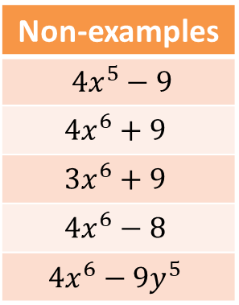
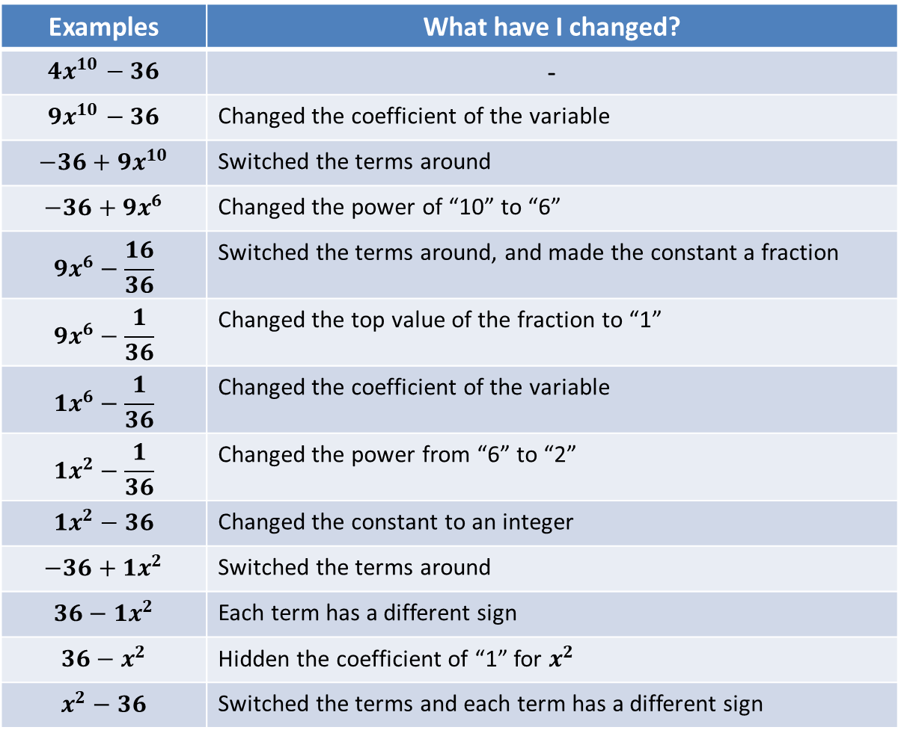
Difference of two squares
Examples | What have I changed?
$$4x^{10}−36$$ | -
$$9x^{10}−36$$ | Changed the coefficient of the variable
$$−36+9x^{10}$$ | Switched the terms around
$$−36+9x^{6}$$ | Changed the power of “10” to “6”
$$9x^{6}−\frac{16}{36}$$ | Switched the terms around, and made the constant a fraction
$$9x^{6}−\frac{1}{36}$$ | Changed the top value of the fraction to “1”
$$1x^{6}−\frac{1}{36}$$ | Changed the coefficient of the variable
$$1x^{2}−\frac{1}{36}$$ | Changed the power from “6” to “2”
$$1x^{2}−36$$ | Changed the constant to an integer
$$−36+1x^{2}$$ | Switched the terms around
$$36−1x^{2}$$ | Each term has a different sign
$$36−x^{2}$$ | Hidden the coefficient of “1” for $x^{2}$
$$x^{2}−36$$ | Switched the terms and each term has a different sign
Non-examples
$$4x^{5}−9$$
$$4x^{6}+9$$
$$3x^{6}+9$$
$$4x^{6}−8$$
$$4x^{6}−9y^{5}$$
@BerwickMaths

Slide 3

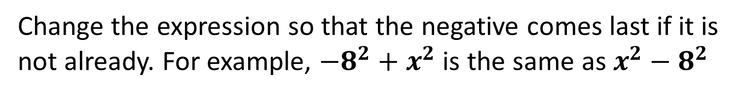
Thinking about factorising…
What is ${10}^{2}−6^{2}$?
Notice that $(10+6)(10−6)$is equal to $64$ as well…
Can anyone tell me how to factorise $x^{2}−6^{2}$?
Change the expression so that the negative comes last if it is not already. For example, $−8^{2}+x^{2}$ is the same as $x^{2}−8^{2}$
@BerwickMaths

Slide 4
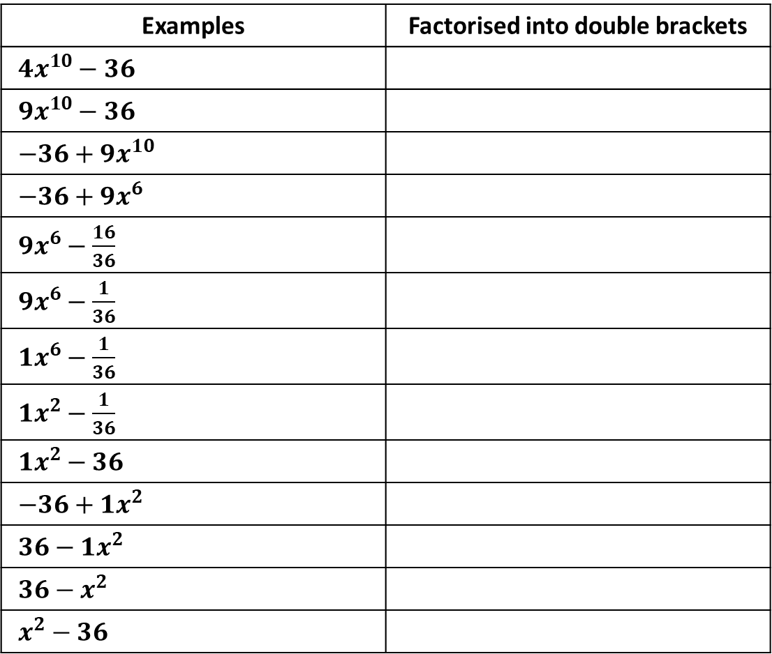
Examples | Factorised into double brackets
$4x^{10}−36$
$9x^{10}−36$
$−36+9x^{10}$
$−36+9x^{6}$
$9x^{6}−\frac{16}{36}$
$9x^{6}−\frac{1}{36}$
$1x^{6}−\frac{1}{36}$
$1x^{2}−\frac{1}{36}$
$1x^{2}−36$
$−36+1x^{2}$
$36−1x^{2}$
$36−x^{2}$
$x^{2}−36$
@BerwickMaths

Slide 5
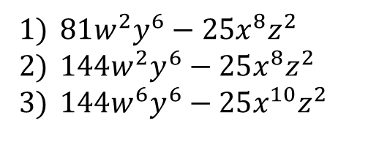
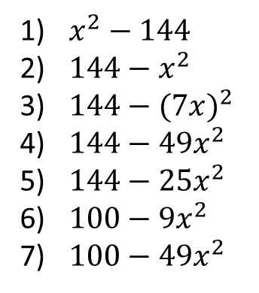
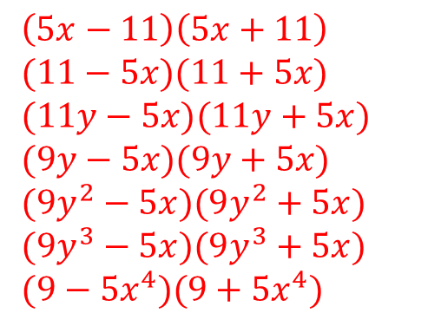
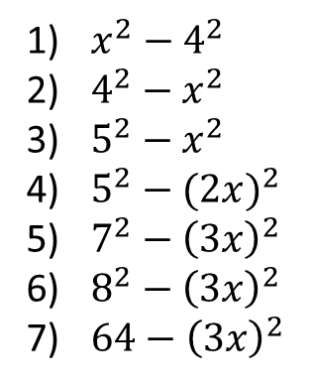
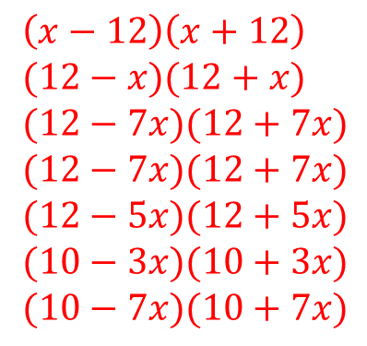
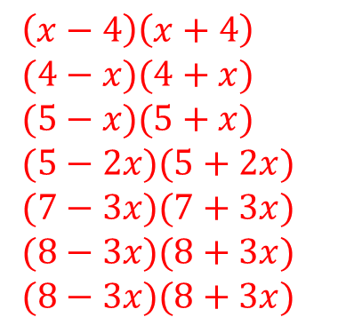
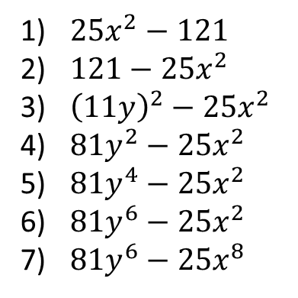
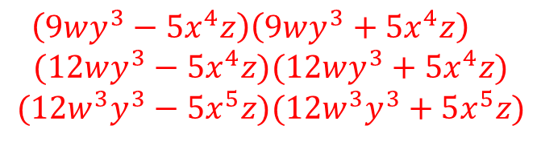
$x^{2}−4^{2}$
$4^{2}−x^{2}$
$5^{2}−x^{2}$
$5^{2}−{(2x)}^{2}$
$7^{2}−{\left(3x\right)}^{2}$
$8^{2}−{\left(3x\right)}^{2}$
$64−{\left(3x\right)}^{2}$
$\left(x−4\right)\left(x+4\right)$
$(4−x)(4+x)$
$(5−x)(5+x)$
$(5−2x)(5+2x)$
$(7−3x)(7+3x)$
$(8−3x)(8+3x)$
$(8−3x)(8+3x)$
$x^{2}−144$
$144−x^{2}$
$144−{(7x)}^{2}$
$144−49x^{2}$
$144−25x^{2}$
$100−9x^{2}$
$100−49x^{2}$
$\left(x−12\right)\left(x+12\right)$
$(12−x)(12+x)$
$(12−7x)(12+7x)$
$(12−7x)(12+7x)$
$(12−5x)(12+5x)$
$(10−3x)(10+3x)$
$(10−7x)(10+7x)$
$25x^{2}−121$
$121−{25x}^{2}$
${\left(11y\right)}^{2}−{25x}^{2}$
$81y^{2}−25x^{2}$
$81y^{4}−25x^{2}$
$81y^{6}−25x^{2}$
$81y^{6}−25x^{8}$
$\left(5x−11\right)\left(5x+11\right)$
$(11−5x)(11+5x)$
$(11y−5x)(11y+5x)$
$(9y−5x)(9y+5x)$
$(9y^{2}−5x)(9y^{2}+5x)$
$(9y^{3}−5x)(9y^{3}+5x)$
$(9−5x^{4})(9+5x^{4})$
$81w^{2}y^{6}−25x^{8}z^{2}$
$144w^{2}y^{6}−25x^{8}z^{2}$
$144w^{6}y^{6}−25x^{10}z^{2}$
$\left(9wy^{3}−5x^{4}z\right)\left(9wy^{3}+5x^{4}z\right)$
$$(12wy^{3}−5x^{4}z)(12wy^{3}+5x^{4}z)$$
$$(12w^{3}y^{3}−5x^{5}z)(12w^{3}y^{3}+5x^{5}z)$$
@BerwickMaths

