Slide 1




Worked Examples
Your turn
$$2x^{2}−8$$
$$2x^{2}−50$$
$$2x^{2}−8y^{4}$$
$$2x^{2}−50y^{4}$$
@BerwickMaths

Slide 2
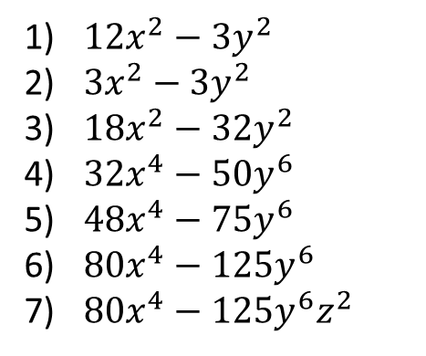
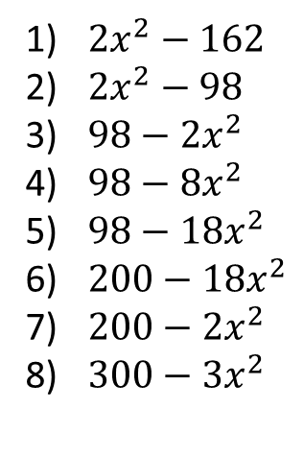
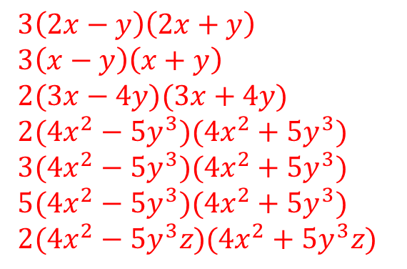
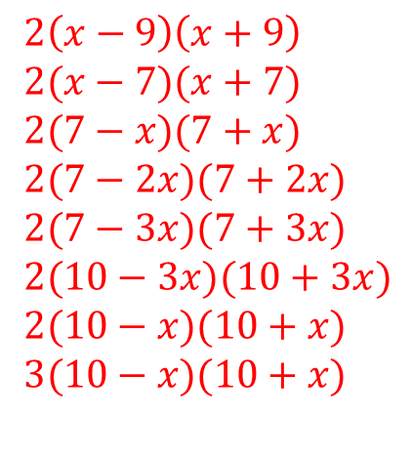
Fluency
$2x^{2}−162$
$2x^{2}−98$
$98−2x^{2}$
$98−8x^{2}$
$98−18x^{2}$
$200−18x^{2}$
$200−2x^{2}$
$300−3x^{2}$
$2\left(x−9\right)\left(x+9\right)$
$2(x−7)(x+7)$
$2(7−x)(7+x)$
$2(7−2x)(7+2x)$
$2(7−3x)(7+3x)$
$2(10−3x)(10+3x)$
$2(10−x)(10+x)$
$3(10−x)(10+x)$
Challenge
$3\left(2x−y\right)\left(2x+y\right)$
$3\left(x−y\right)\left(x+y\right)$
$2(3x−4y)(3x+4y)$
$2(4x^{2}−5y^{3})(4x^{2}+5y^{3})$
$3(4x^{2}−5y^{3})(4x^{2}+5y^{3})$
$5(4x^{2}−5y^{3})(4x^{2}+5y^{3})$
$2(4x^{2}−5y^{3}z)(4x^{2}+5y^{3}z)$
$12x^{2}−3y^{2}$
$3x^{2}−{3y}^{2}$
${18x}^{2}−32y^{2}$
${32x}^{4}−50y^{6}$
${48x}^{4}−75y^{6}$
${80x}^{4}−125y^{6}$
${80x}^{4}−125y^{6}z^{2}$
@BerwickMaths

