Slide 1
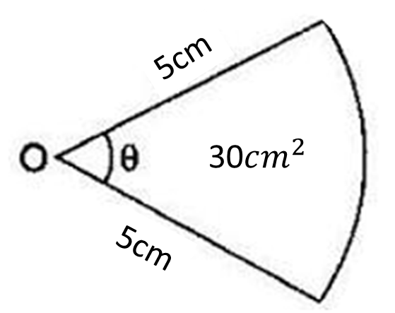

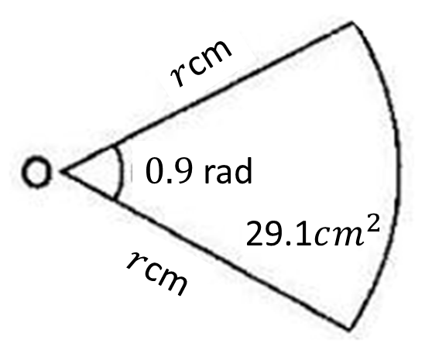
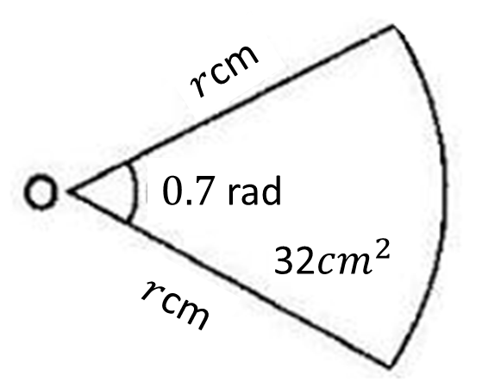





Worked Examples
Your turn
Calculate the value of $θ$ for the sector below:
Calculate the value of $θ$ for the sector below:
54$cm^{2}$
3 rad
Calculate the value of $r$ for the sector below:
Calculate the value of $r$ for the sector below:
9.56cm (3sf)

