Slide 1
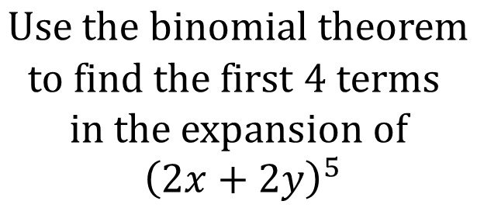
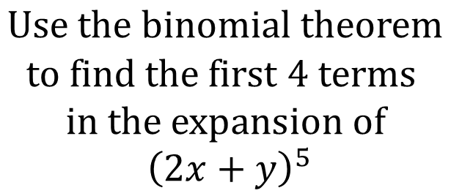
Worked Example
Your Turn
$$Use the binomial theorem$$
$$to find the first 4 terms$$
$$in the expansion of$$
$${\left(2x+y\right)}^{5}$$
$$Use the binomial theorem$$
$$to find the first 4 terms$$
$$in the expansion of$$
$${\left(2x+2y\right)}^{5}$$
$$32x^{5}+160x^{4}y+320x^{3}y^{2}+320x^{2}y^{3}$$
@BerwickMaths

Slide 2
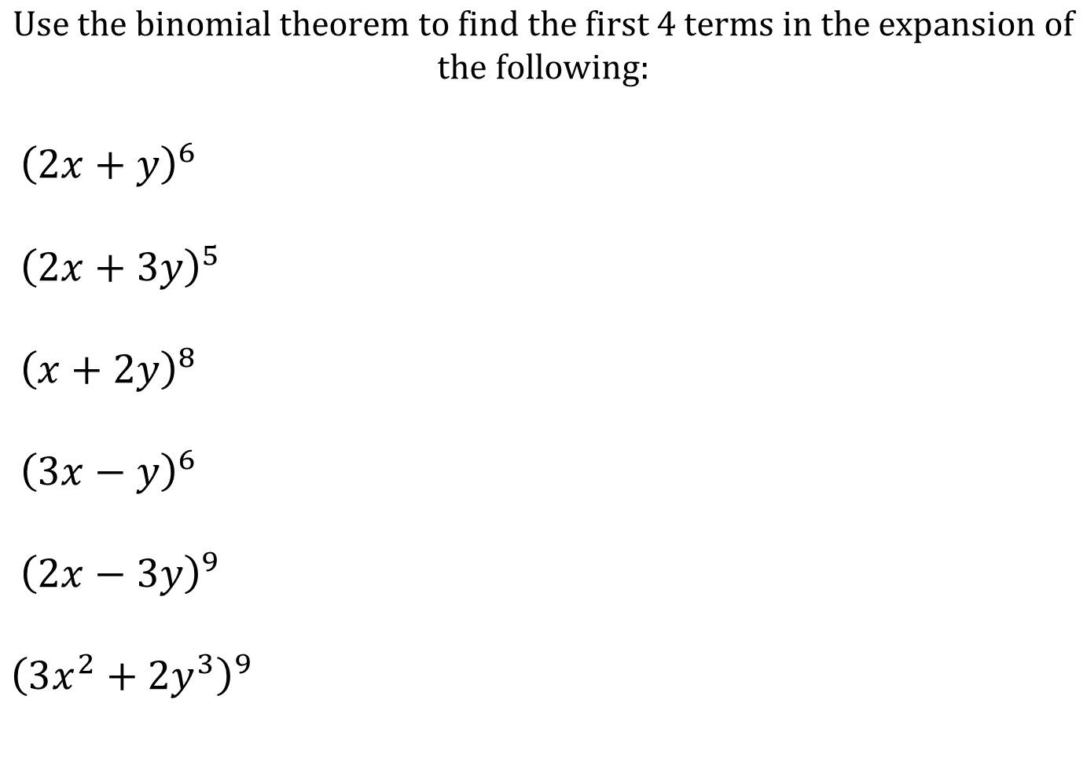
$$Use the binomial theorem to find the first 4 terms in the expansion of$$
$$the following:$$
${\left(2x+y\right)}^{6}$
${\left(2x+3y\right)}^{5}$
${\left(x+2y\right)}^{8}$
${\left(3x−y\right)}^{6}$
${\left(2x−3y\right)}^{9}$
${\left(3x^{2}+2y^{3}\right)}^{9}$
@BerwickMaths

Slide 3

$$Use the binomial theorem to find the first 4 terms in the expansion of$$
$$the following:$$
${\left(2x+y\right)}^{6}$
${\left(2x+3y\right)}^{5}$
${\left(x+2y\right)}^{8}$
${\left(3x−y\right)}^{6}$
${\left(2x−3y\right)}^{9}$
${\left(3x^{2}+2y^{3}\right)}^{9}$
$$64x^{6}+192x^{5}y+240x^{4}y^{2}+160x^{3}y^{3}$$
$$32x^{5}+240x^{4}y+720x^{3}y^{2}+1080x^{2}y^{3}$$
$$x^{8}+16x^{7}y+112x^{6}y^{2}+448x^{5}y^{3}$$
$$729x^{6}−1458x^{5}y+1215x^{4}y^{2}−540x^{3}y^{3}$$
$$512x^{9}−6912x^{8}y+41,472x^{7}y^{2}−145,152x^{6}y^{3}$$
$$19,683x^{18}+59,049x^{16}y^{3}+314,928x^{14}y^{6}+489,888x^{12}y^{9}$$
@BerwickMaths

