Slide 1
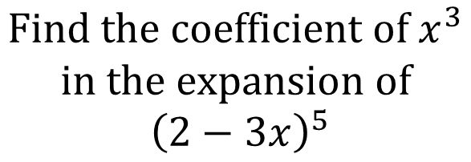
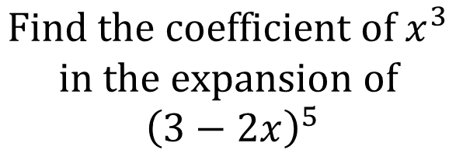

Worked Example
Your Turn
$$Find the coefficient of x^{3}$$
$$in the expansion of$$
$${\left(3−2x\right)}^{5}$$
$$Find the coefficient of x^{3}$$
$$in the expansion of$$
$${\left(2−3x\right)}^{5}$$
$$−1080$$
@BerwickMaths

Slide 2
$$Find the coefficient of x^{3} in the expansion of {\left(2−3x\right)}^{8}$$
$$Find the coefficient of x^{8} in the expansion of {\left(2−x\right)}^{10}$$
$$Find the coefficient of x^{5} in the expansion of {\left(5+2x\right)}^{7}$$
$$Find the coefficient of x^{3} in the expansion of {\left(3+\frac{x}{4}\right)}^{7}$$
$$Find the coefficient of x^{4} in the expansion of {\left(x+3\right)}^{7}$$
@BerwickMaths

Slide 3



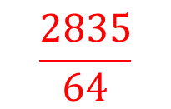

$$Find the coefficient of x^{3} in the expansion of {\left(2−3x\right)}^{8}$$
$$−48,384$$
$$Find the coefficient of x^{8} in the expansion of {\left(2−x\right)}^{10}$$
$$180$$
$$Find the coefficient of x^{5} in the expansion of {\left(5+2x\right)}^{7}$$
$$16,800$$
$$Find the coefficient of x^{3} in the expansion of {\left(3+\frac{x}{4}\right)}^{7}$$
$$\frac{2835}{64}$$
$$Find the coefficient of x^{4} in the expansion of {\left(x+3\right)}^{7}$$
$$945$$
@BerwickMaths

