Slide 1
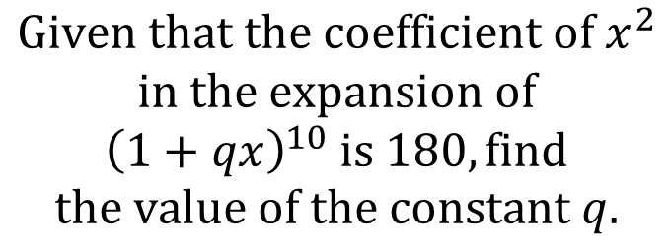
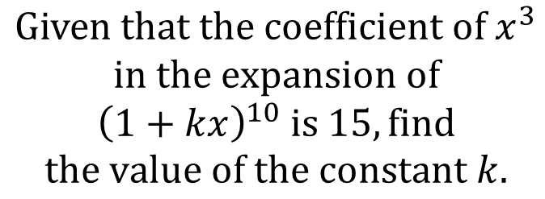


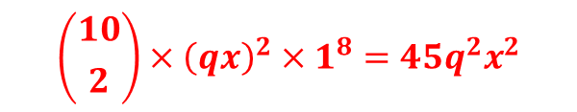
Worked Example
Your Turn
$$Given that the coefficient of x^{3}$$
$$in the expansion of$$
$${\left(1+kx\right)}^{10} is 15, find$$
$$the value of the constant k.$$
$$Given that the coefficient of x^{2}$$
$$in the expansion of$$
$${\left(1+qx\right)}^{10} is 180, find$$
$$the value of the constant q.$$
$$\left({10 \atop 2}\right)×{\left(qx\right)}^{2}×1^{8}=45q^{2}x^{2}$$
$$45q^{2}=180$$
$$q=±2$$
@BerwickMaths

Slide 2
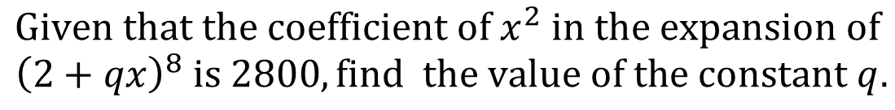
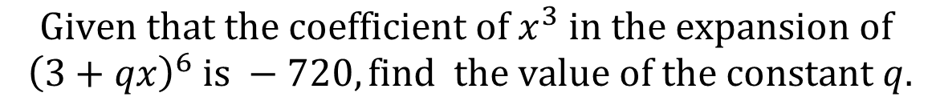
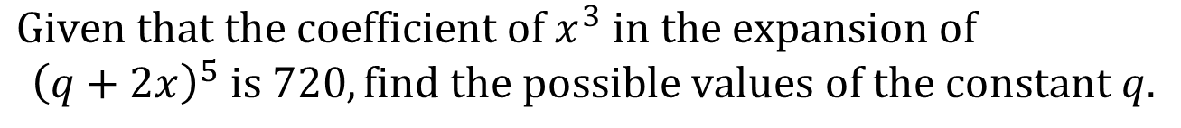
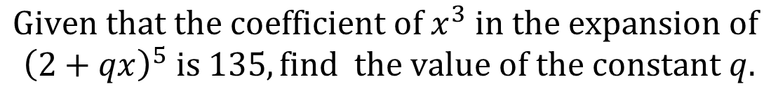
$$Given that the coefficient of x^{2} in the expansion of$$
$${\left(2+qx\right)}^{8} is 2800, find the value of the constant q.$$
$$Given that the coefficient of x^{3} in the expansion of$$
$${\left(3+qx\right)}^{6} is −720, find the value of the constant q.$$
$$Given that the coefficient of x^{3} in the expansion of$$
$${\left(2+qx\right)}^{5} is 135, find the value of the constant q.$$
$Given that the coefficient of x^{3} in the expansion of$
$${\left(q+2x\right)}^{5} is 720, find the possible values of the constant q.$$
@BerwickMaths

Slide 3




$$Given that the coefficient of x^{2} in the expansion of$$
$${\left(2+qx\right)}^{8} is 2800, find the value of the constant q.$$
$$1.25$$
$$Given that the coefficient of x^{3} in the expansion of$$
$${\left(3+qx\right)}^{6} is −720, find the value of the constant q.$$
$$−1.10$$
$$Given that the coefficient of x^{3} in the expansion of$$
$${\left(2+qx\right)}^{5} is 135, find the value of the constant q.$$
$$1.5$$
$Given that the coefficient of x^{3} in the expansion of$
$${\left(q+2x\right)}^{5} is 720, find the possible values of the constant q.$$
$$±3$$
@BerwickMaths

