Slide 1
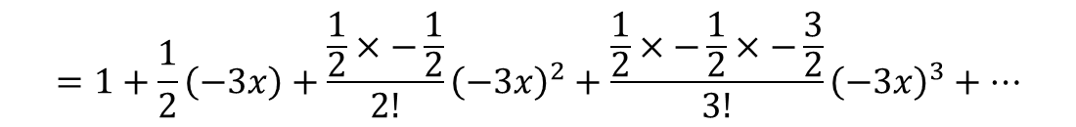
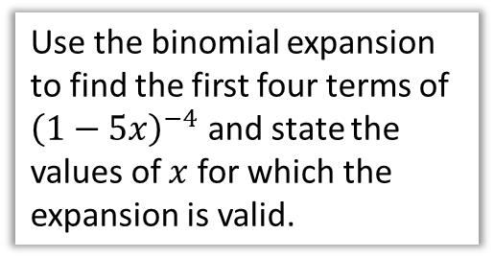
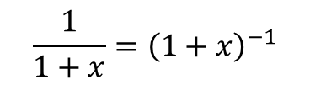

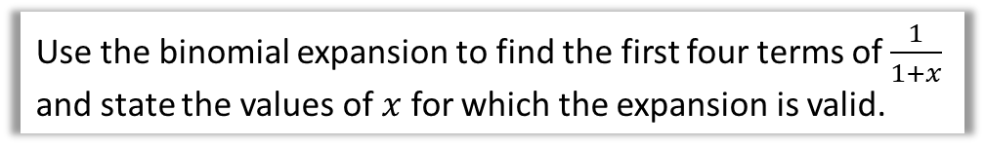
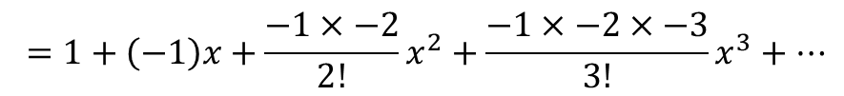




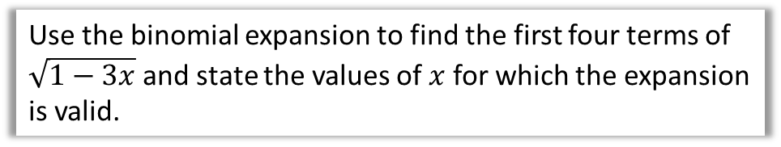
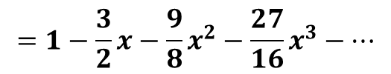

Worked Examples
Your turn
Use the binomial expansion to find the first four terms of $\frac{1}{1+x}$ and state the values of $x$ for which the expansion is valid.
Use the binomial expansion to find the first four terms of ${\left(1−5x\right)}^{−4}$ and state the values of $x$ for which the expansion is valid.
$$\frac{1}{1+x}={\left(1+x\right)}^{−1}$$
$$=1+\left(−1\right)x+\frac{−1×−2}{2!}x^{2}+\frac{−1×−2×−3}{3!}x^{3}+…$$
$$1+20x+250x^{2}+2500x^{3}$$
$$=1−x+x^{2}−x^{3}+…$$
Valid if $\left|x\right|<\frac{1}{5}$.
For ${\left(1+x\right)}^{−1}$to converge, we require $\left|x\right|<1$.
Use the binomial expansion to find the first four terms of $\sqrt{1−3x}$ and state the values of $x$ for which the expansion is valid.
$$\sqrt{1−3x}={\left(1−3x\right)}^{\frac{1}{2}}$$
$$=1+\frac{1}{2}\left(−3x\right)+\frac{\frac{1}{2}×−\frac{1}{2}}{2!}{\left(−3x\right)}^{2}+\frac{\frac{1}{2}×−\frac{1}{2}×−\frac{3}{2}}{3!}{\left(−3x\right)}^{3}+…$$
$$=1−\frac{3}{2}x−\frac{9}{8}x^{2}−\frac{27}{16}x^{3}−…$$
For ${\left(1−3x\right)}^{\frac{1}{2}}$to converge, we require $\left|x\right|<\frac{1}{3}$.
! ${\left(1+x\right)}^{n}=1+nx+\frac{n\left(n−1\right)}{2!}x^{2}+\frac{n\left(n−1\right)\left(n−2\right)}{3!}x^{3}+…+\frac{n\left(n−1\right)\left(n−2\right)…\left(n−r+1\right)}{r!}x^{r}+…$
@BerwickMaths

