Slide 1
Chapter 4- Binomial expansion

Slide 2

Expanding ${\left(1+x\right)}^{n}$ (4.1)

Slide 3

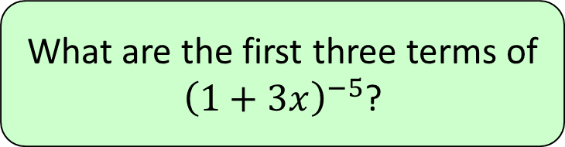




1
What are the first three terms of
${\left(1+3x\right)}^{−5}$?
a) $1−5x+15x^{2}$
b) $1−15x+135x^{2}$
c) $1−15x−135x^{2}$
d) $1+15x+135x^{2}$

Slide 4
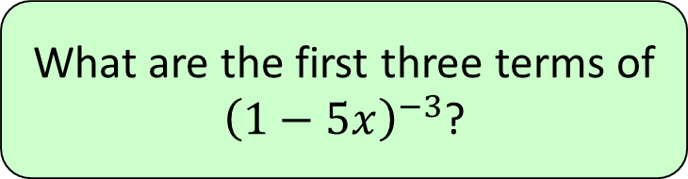




2
What are the first three terms of
${\left(1−5x\right)}^{−3}$?
a) $1−5x+150x^{2}$
b) $1−15x−150x^{2}$
c) $1−15x+150x^{2}$
d) $1+15x+150x^{2}$

Slide 5
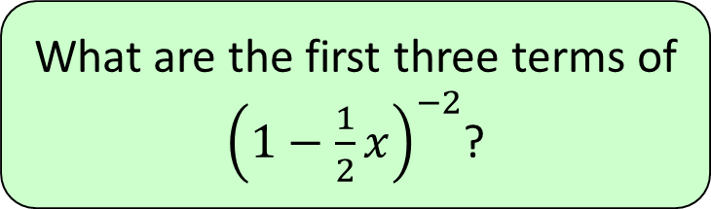


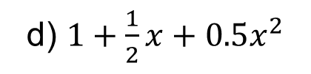
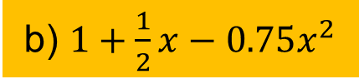
3
What are the first three terms of
${\left(1−\frac{1}{2}x\right)}^{−2}$?
a) $1+x−0.5x^{2}$
b) $1+\frac{1}{2}x−0.75x^{2}$
c) $1+x+0.75x^{2}$
d) $1+\frac{1}{2}x+0.5x^{2}$

Slide 6
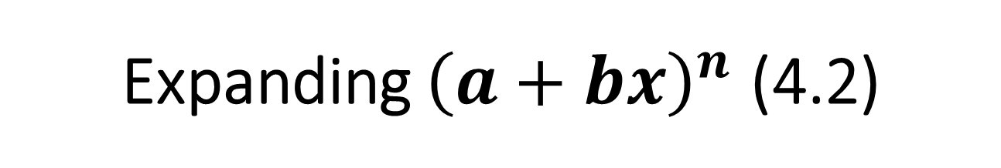
Expanding ${\left(a+bx\right)}^{n}$ (4.2)

Slide 7
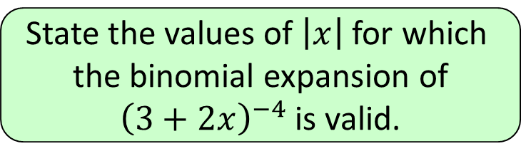


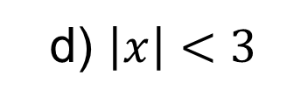
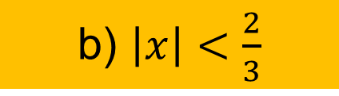
1
State the values of $\left|x\right|$ for which
the binomial expansion of
${\left(3+2x\right)}^{−4}$ is valid.
a) $\left|x\right|<1$
b) $\left|x\right|<\frac{2}{3}$
c) $\left|x\right|<\frac{3}{2}$
d) $\left|x\right|<3$

Slide 8
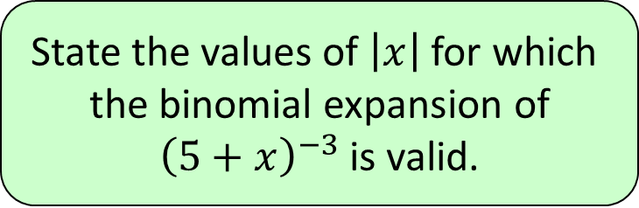


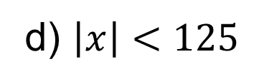

2
State the values of $\left|x\right|$ for which
the binomial expansion of
${\left(5+x\right)}^{−3}$ is valid.
a) $\left|x\right|<5$
b) $\left|x\right|<1$
c) $\left|x\right|<\frac{1}{5}$
d) $\left|x\right|<125$

Slide 9
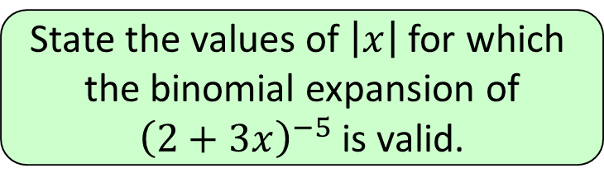
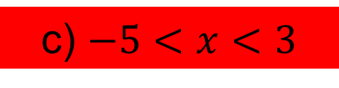
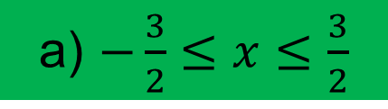
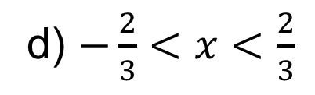

State the values of $\left|x\right|$ for which
the binomial expansion of
${\left(2+3x\right)}^{−5}$ is valid.
3
a) $−\frac{3}{2}≤x≤\frac{3}{2}$
b) $2≤x≤3$
c) $−5<x<3$
d) $−\frac{2}{3}<x<\frac{2}{3}$

Slide 10
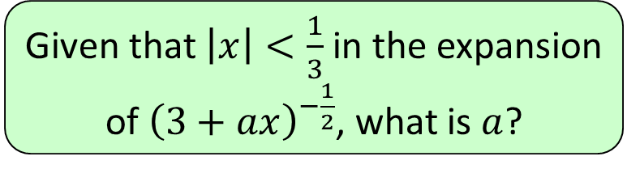


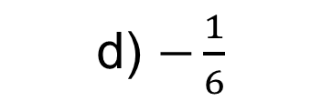

4
Given that $\left|x\right|<\frac{1}{3}$ in the expansion
of ${\left(3+ax\right)}^{−\frac{1}{2}}$, what is $a$?
a) $9$
b) $3$
c) $\frac{1}{3}$
d) $−\frac{1}{6}$

Slide 11
Using partial fractions (4.3)

Slide 12
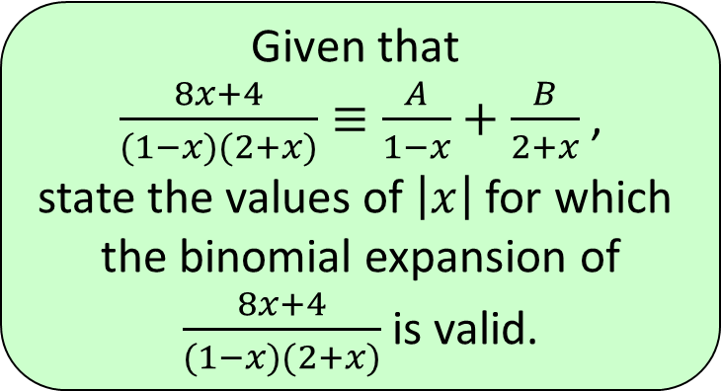


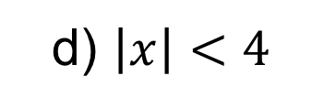

1
Given that
$\frac{8x+4}{(1−x)(2+x)}≡\frac{A}{1−x}+\frac{B}{2+x}$ ,
state the values of $\left|x\right|$ for which
the binomial expansion of
$\frac{8x+4}{(1−x)(2+x)}$ is valid.
a) $\left|x\right|<2$
b) $\left|x\right|<1$
c) $\left|x\right|<\frac{1}{2}$
d) $\left|x\right|<4$

Slide 13
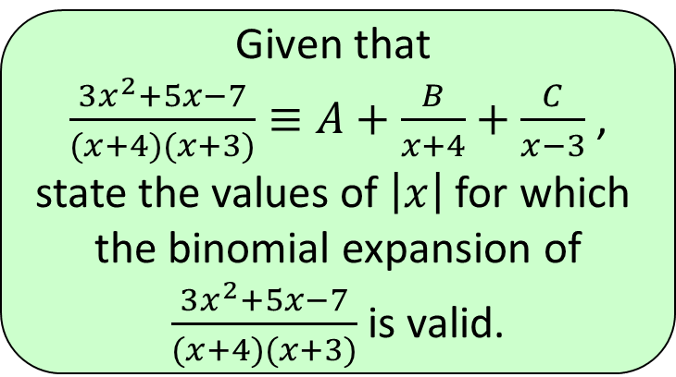


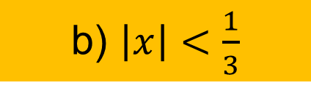
2
Given that
$\frac{3x^{2}+5x−7}{(x+4)(x+3)}≡A+\frac{B}{x+4}+\frac{C}{x−3}$ ,
state the values of $\left|x\right|$ for which
the binomial expansion of
$\frac{3x^{2}+5x−7}{(x+4)(x+3)}$is valid.
a) $\left|x\right|<4$
b) $\left|x\right|<\frac{1}{3}$
c) $\left|x\right|<\frac{1}{4}$
d) $\left|x\right|<3$

