Slide 1
Chapter 7- Algebraic methods

Slide 2
Algebraic fractions (7.1)

Slide 3

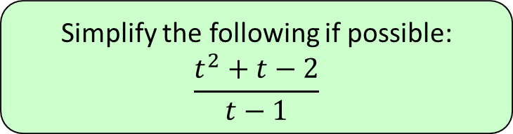



1
Simplify the following if possible:
$$\frac{t^{2}+t−2}{t−1}$$
a) $t+2$
b) $t−2$
c) $t−1$
d) Does not simplify

Slide 4
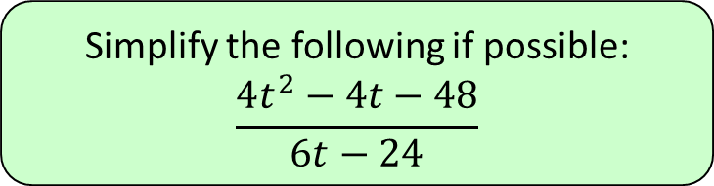



2
Simplify the following if possible:
$$\frac{4t^{2}−4t−48}{6t−24}$$
a) $2(t−4)$
b) $\frac{4\left(t+1\right)}{3}$
c) $\frac{2\left(t+3\right)}{3}$
d) Does not simplify

Slide 5
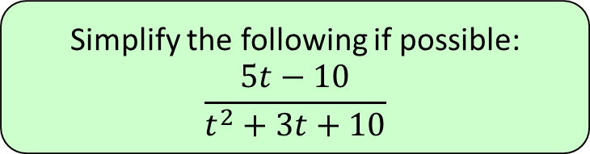



3
Simplify the following if possible:
$$\frac{5t−10}{t^{2}+3t+10}$$
a) $\frac{5}{t+3}$
b) $\frac{5t}{t^{2}+3t}$
c) $\frac{5}{t+5}$
d) Does not simplify

Slide 6
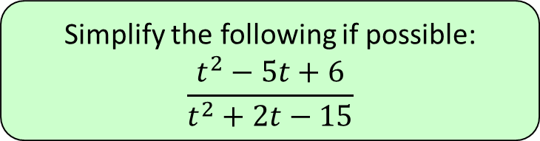




4
Simplify the following if possible:
$$\frac{t^{2}−5t+6}{t^{2}+2t−15}$$
a) $−\frac{2}{5}$
b) $\frac{−5t+2}{2t−5}$
c) $\frac{t+2}{t−5}$
d) $\frac{t−2}{t+5}$

Slide 7
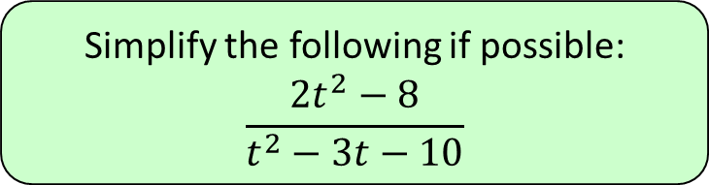

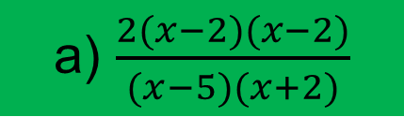

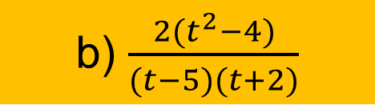
5
Simplify the following if possible:
$$\frac{2t^{2}−8}{t^{2}−3t−10}$$
a) $\frac{2(x−2)(x−2)}{(x−5)(x+2)}$
b) $\frac{2(t^{2}−4)}{(t−5)(t+2)}$
c) $\frac{2(t−2)}{t−5}$
d) $2−\frac{8}{3t−10}$

Slide 8
Dividing polynomials (7.2)

Slide 9

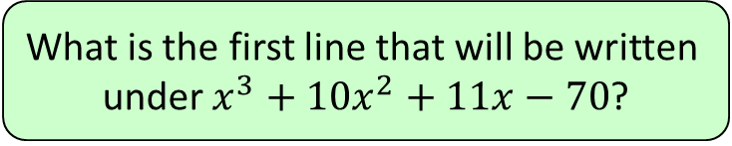

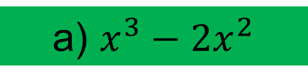


1
What is the first line that will be written
under $x^{3}+10x^{2}+11x−70$?
a) $x^{3}−2x^{2}$
b) $x^{2}−2x$
c) $x−2$
d) $2x−x^{2}$

Slide 10
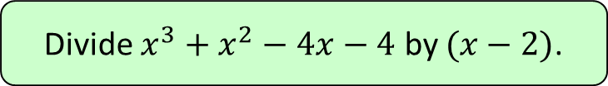
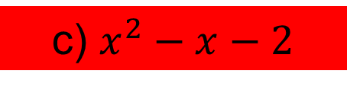
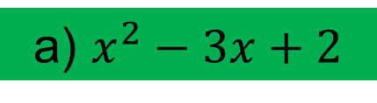
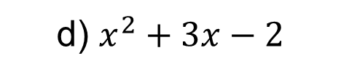
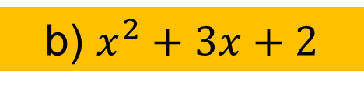
2
Divide $x^{3}+x^{2}−4x−4$ by $(x−2)$.
a) $x^{2}−3x+2$
b) $x^{2}+3x+2$
c) $x^{2}−x−2$
d) $x^{2}+3x−2$

Slide 11
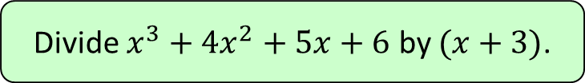

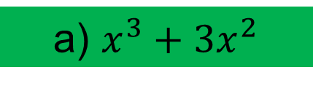

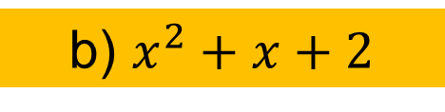
3
Divide $x^{3}+4x^{2}+5x+6$ by $(x+3)$.
a) $x^{3}+3x^{2}$
b) $x^{2}+x+2$
c) $x^{2}+3x$
d) $x^{2}+2$

Slide 12
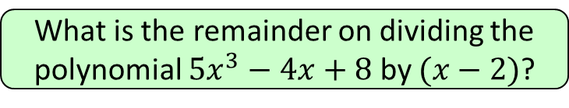




4
What is the remainder on dividing the
polynomial $5x^{3}−4x+8$ by $(x−2)$?
a) $−24$
b) $0$
c) $8$
d) $40$

Slide 13
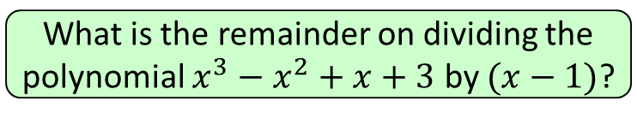



5
What is the remainder on dividing the
polynomial $x^{3}−x^{2}+x+3$ by $(x−1)$?
a) $3$
b) $0$
c) $4$
d) $2$

Slide 14
The factor theorem (7.3)

Slide 15
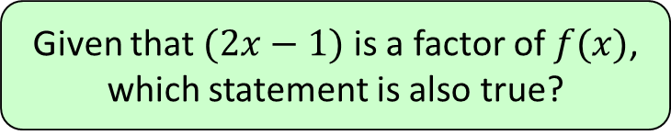
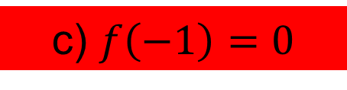
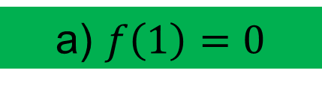


1
Given that $(2x−1)$ is a factor of $f(x)$,
which statement is also true?
a) $f\left(1\right)=0$
b) $f\left(2\right)=0$
c) $f\left(−1\right)=0$
d) $f\left(\frac{1}{2}\right)=0$

Slide 16
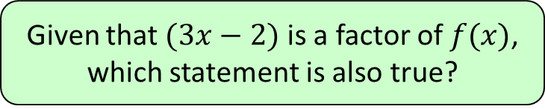
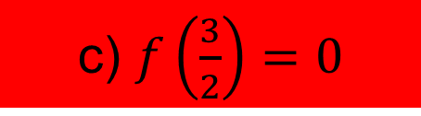


2
Given that $(3x−2)$ is a factor of $f(x)$,
which statement is also true?
a) $f\left(2\right)=0$
b) $f\left(\frac{2}{3}\right)=0$
c) $f\left(\frac{3}{2}\right)=0$
d) None are true

Slide 17
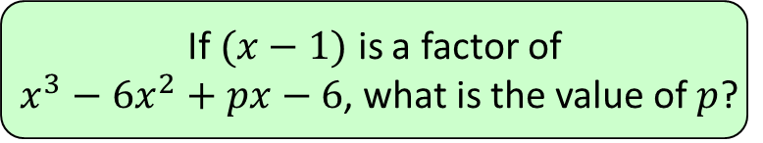




3
If $(x−1)$ is a factor of
$x^{3}−6x^{2}+px−6$, what is the value of $p$?
a) $−6$
b) $1$
c) $−1$
d) $11$

Slide 18
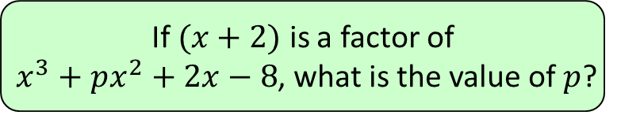




4
If $(x+2)$ is a factor of
$x^{3}+px^{2}+2x−8$, what is the value of $p$?
a) $5$
b) $7$
c) $2$
d) $0$

Slide 19





5
Which is not a factor of
$$2x^{3}−3x^{2}−8x−3$$
a) $(x+1)$
b) $(x−3)$
c) $(x−1)$
d) $(2x+1)$

Slide 20
Methods of proof
You will be presented with a proof question and your job is to identify which type of proof you would use or how you would go about proving it.

Slide 21
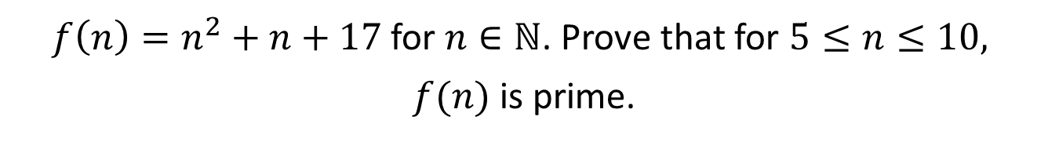
$f\left(n\right)=n^{2}+n+17$ for $n∈ℕ$. Prove that for $5≤n≤10,$
$f(n)$ is prime.
Proof by exhaustion.

Slide 22
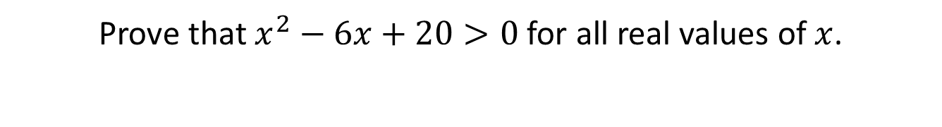
Prove that $x^{2}−6x+20>0$ for all real values of $x$.
Complete the square.

Slide 23
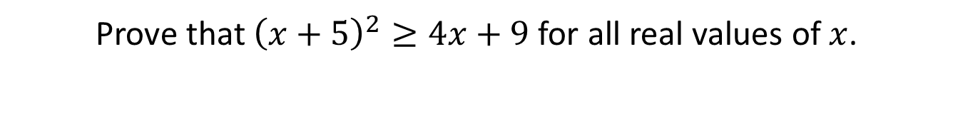
Prove that ${\left(x+5\right)}^{2}≥4x+9$ for all real values of $x$.
Take everything over to one side and then complete the square.

Slide 24

Prove that for all positive values of $x$, ${\left(1+2x\right)}^{2}>1+4x^{2}$.
Expand and take everything over to one side and recognise that the $x^{2}$ terms cancel.

Slide 25
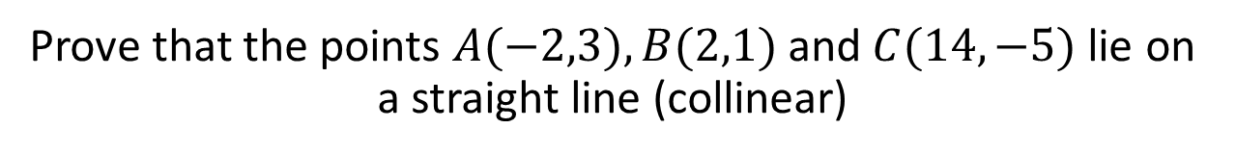
Prove that the points $A(−2,3), B(2,1)$and $C(14,−5)$lie on a straight line (collinear)
Calculate the gradient between points A and B.
Calculate the gradient between points B and C.
See that they have the same gradient and share a common point.

