Slide 1
Chapter 3- Equations and Inequalities

Slide 2
Linear simultaneous equations (3.1)

Slide 3
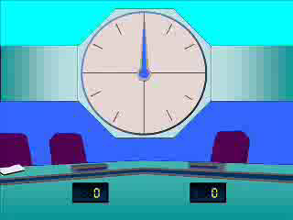
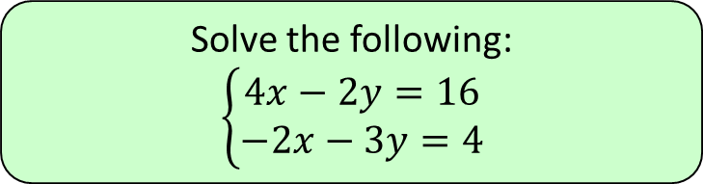
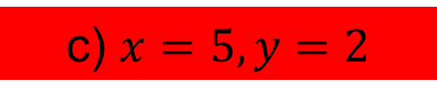
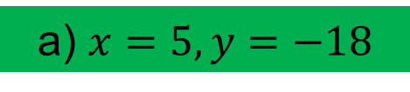
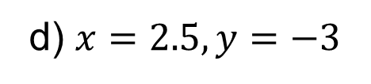
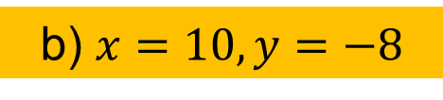
1
Solve the following:
$$\left\{\begin{aligned}4x−2y=16 \\ −2x−3y=4\end{aligned}\right.$$
a) $x=5, y=−18$
b) $x=10, y=−8$
c) $x=5, y=2$
d) $x=2.5, y=−3$

Slide 4
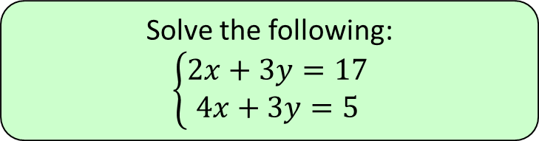
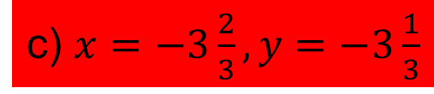
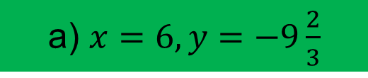
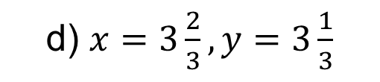
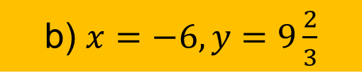
2
Solve the following:
$$\left\{\begin{aligned}2x+3y=17 \\ 4x+3y=5\end{aligned}\right.$$
a) $x=6, y=−9\frac{2}{3}$
b) $x=−6, y=9\frac{2}{3}$
c) $x=−3\frac{2}{3}, y=−3\frac{1}{3}$
d) $x=3\frac{2}{3}, y=3\frac{1}{3}$

Slide 5
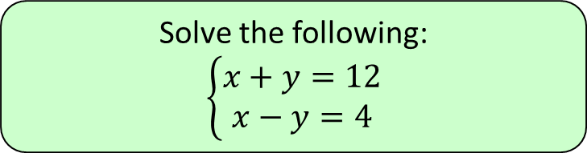
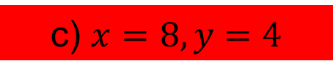
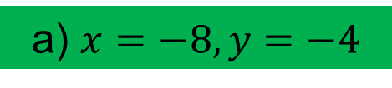
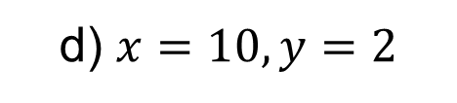
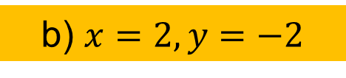
3
Solve the following:
$$\left\{\begin{aligned}x+y=12 \\ x−y=4\end{aligned}\right.$$
a) $x=−8, y=−4$
b) $x=2, y=−2$
c) $x=8, y=4$
d) $x=10, y=2$

Slide 6
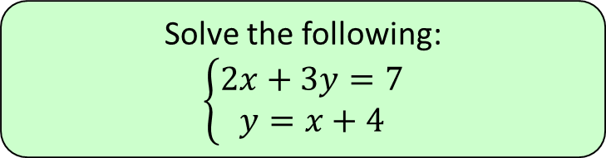
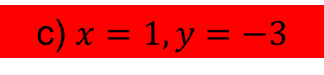
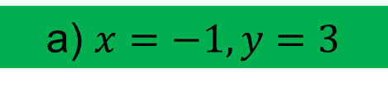
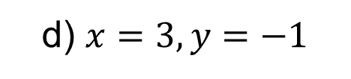
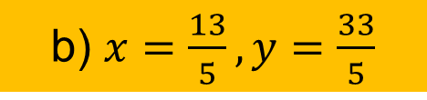
4
Solve the following:
$$\left\{\begin{aligned}2x+3y=7 \\ y=x+4\end{aligned}\right.$$
a) $x=−1, y=3$
b) $x=\frac{13}{5}, y=\frac{33}{5}$
c) $x=1, y=−3$
d) $x=3, y=−1$

Slide 7
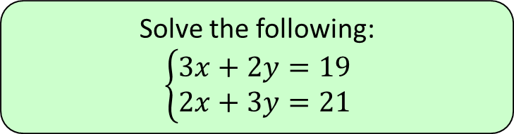
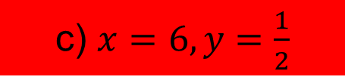
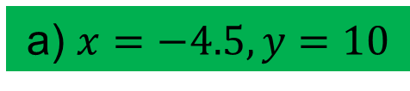
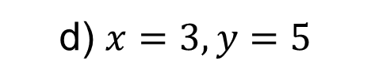
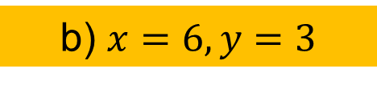
5
Solve the following:
$$\left\{\begin{aligned}3x+2y=19 \\ 2x+3y=21\end{aligned}\right.$$
a) $x=−4.5, y=10$
b) $x=6, y=3$
c) $x=6, y=\frac{1}{2}$
d) $x=3, y=5$

Slide 8
Quadratic simultaneous equations (3.2)

Slide 9

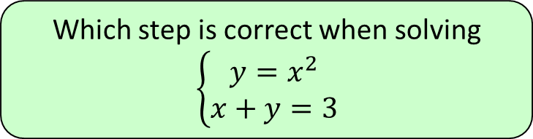




1
Which step is correct when solving
$$\left\{\begin{aligned}y=x^{2} \\ x+y=3\end{aligned}\right.$$
a) $4$
b) $1 \& 2$
c) $1 \& 4$
d) $2$

Slide 10
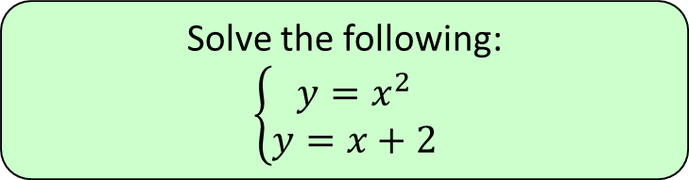

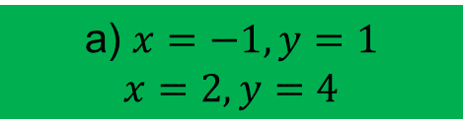
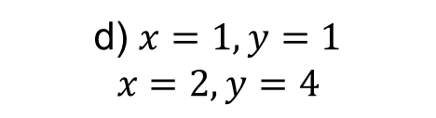

2
Solve the following:
$$\left\{\begin{aligned}y=x^{2} \\ y=x+2\end{aligned}\right.$$
a) $x=−1, y=1$
$$x=2, y=4$$
b) $x=−1, y=1$
c) $x=−1, y=2$
d) $x=1, y=1$
$$x=2, y=4$$

Slide 11
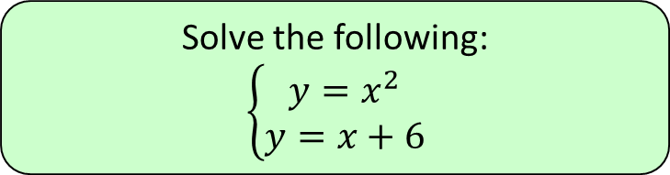

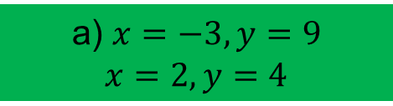
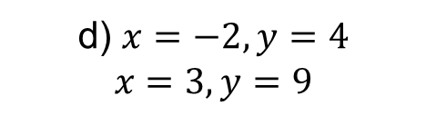

3
Solve the following:
$$\left\{\begin{aligned}y=x^{2} \\ y=x+6\end{aligned}\right.$$
a) $x=−3, y=9$
$$x=2, y=4$$
b) $x=3, y=9$
c) $x=−2, y=3$
d) $x=−2, y=4$
$$x=3, y=9$$

Slide 12
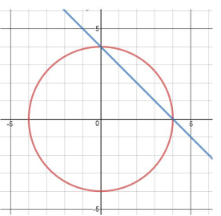
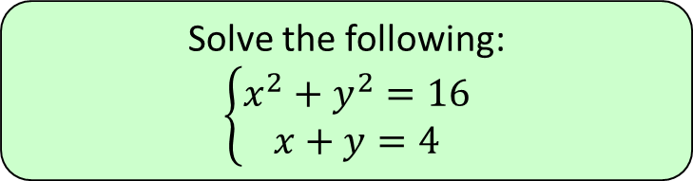

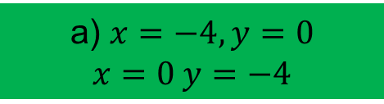
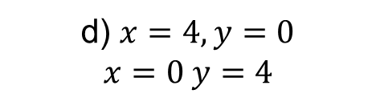

4
Solve the following:
$$\left\{\begin{aligned}x^{2}+y^{2}=16 \\ x+y=4\end{aligned}\right.$$
a) $x=−4, y=0$
$$x=0 y=−4$$
b) $x=4, y=4$
c) $x=4, y=0$
d) $x=4, y=0$
$$x=0 y=4$$

Slide 13
Simultaneous equations on graphs (3.3)

Slide 14
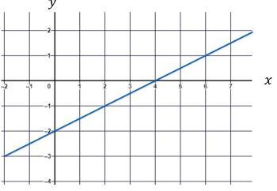
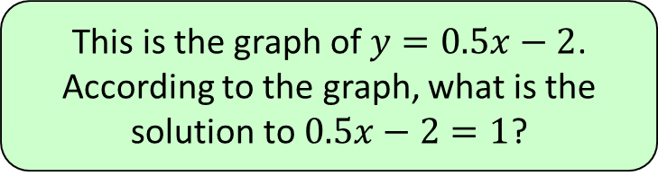




1
This is the graph of $y=0.5x−2$.
According to the graph, what is the
solution to $0.5x−2=1$?
a) $x=6$
b) $x=1.5$
c) $x=4$
d) $x=2$

Slide 15
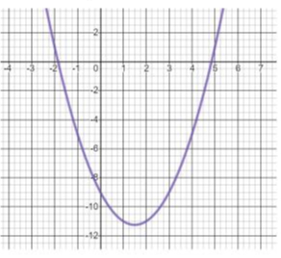
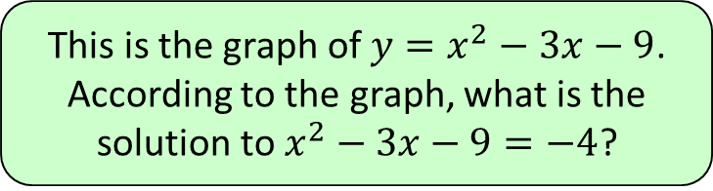
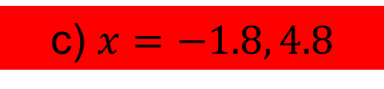

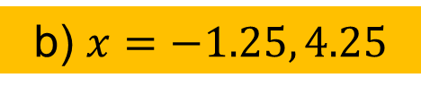
2
This is the graph of $y=x^{2}−3x−9$.
According to the graph, what is the
solution to $x^{2}−3x−9=−4$?
a) $x=−8.5$
b) $x=−1.25, 4.25$
c) $x=−1.8, 4.8$
d) No solutions

Slide 16
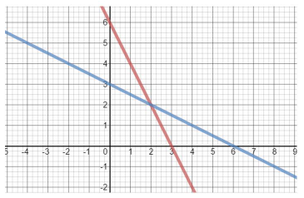
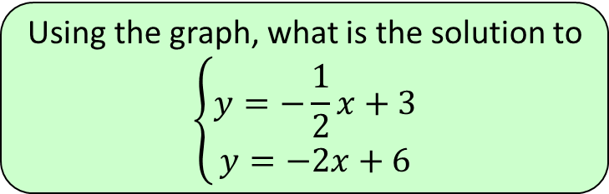

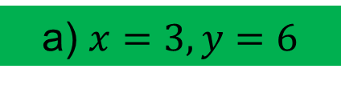
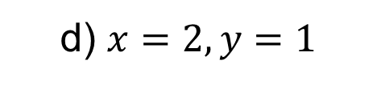
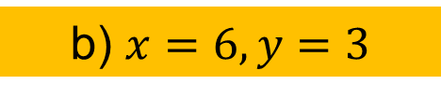
3
Using the graph, what is the solution to
$$\left\{\begin{aligned}y=−\frac{1}{2}x+3 \\ y=−2x+6\end{aligned}\right.$$
a) $x=3, y=6$
b) $x=6, y=3$
c) $x=2, y=2$
d) $x=2, y=1$

Slide 17
Linear inequalities (3.4)

Slide 18
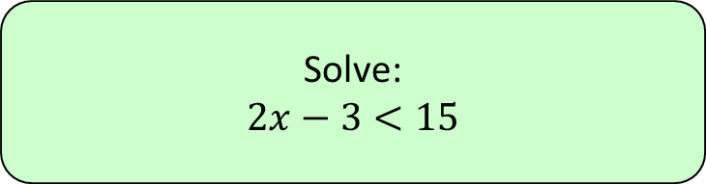




1
Solve:
$$2x−3<15$$
a) $x=9$
b) $x<9$
c) $x=6$
d) $x<6$

Slide 19
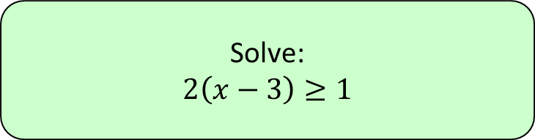




2
Solve:
$$2\left(x−3\right)≥1$$
a) $x≥2$
b) $x>3.5$
c) $x≥3.5$
d) $x≤2$

Slide 20





3
Solve:
$$\frac{−2x+3}{5}≥\frac{3}{7}$$
a) $x≤\frac{3}{7}$
b) $x≤\frac{36}{7}$
c) $x≥\frac{3}{7}$
d) $x≥\frac{36}{7}$

Slide 21


4
In which of the following inequalities
could $d=2$?
a) Only inequality 1
b) Only inequality 2
c) Both inequalities 1 &2
d) Neither inequalities 1 &2

Slide 22


5
In which of the following inequalities
could $d=5$?
a) Only inequality 1
b) Only inequality 2
c) Both inequalities 1 &2
d) Neither inequalities 1 &2

Slide 23
Quadratic inequalities (3.5)

Slide 24





1
Solve:
$$\left(c+8\right)\left(c−1\right)>0$$
a) $\left\{c<−1\right\}∪\left\{c>8\right\}$
b) $\left\{−8<c<1\right\}$
c) $\left\{c<−8\right\}∪\left\{c>1\right\}$
d) $\left\{−1<c<8\right\}$

Slide 25





2
Solve:
$$\left(c+3\right)\left(c−4\right)<0$$
a) $\left\{c<−3\right\}∪\left\{c>4\right\}$
b) $\left\{−3<c<4\right\}$
c) $\left\{c<−4\right\}∪\left\{c>3\right\}$
d) $\left\{−4<c<3\right\}$

Slide 26





3
Solve:
$$c^{2}−100≤0$$
a) $\left\{c≤−10\right\}∪\left\{c≥10\right\}$
b) $\left\{−10≤c≤10\right\}$
c) $c=10 or c=−10$
d) $c=10$

Slide 27





4
Solve:
$$x^{2}≥16$$
a) $x≥4$ or $x≤−4$
b) $x≤4$ or $x≥−4$
c) $−4≤x≤4$
d) $−4≥x≥4$

Slide 28





5
Solve:
$${\left(c−10\right)}^{2}≤0$$
a) $c=10$ or $c=−10$
b) $c≥10$
c) $c=10$ or $c=−10$
d) $c=10$

Slide 29
Inequalities on graphs and regions (3.6 & 3.7)

Slide 30





1
Which inequality is represented by the
shaded region?
a) $x<−1$
b) $y<−1$
c) $y<−1$
d) $x>−1$

Slide 31





2
Which inequality is represented by the
shaded region?
a) $y>x$
b) $y<x$
c) $y>−x$
d) $y<−x$

Slide 32


3
Which letter describes the region where
$x+y≤3$ and $y≤1$?
a)
b)
c)
d)

Slide 33





4
Which inequalities represent the
region R?
a) $y<x, x<−2$
b) $y>x, x<−2$
c) $y>x, x>−2$
d) $y<x, x>−2$

