Slide 1
Correlation

Slide 2
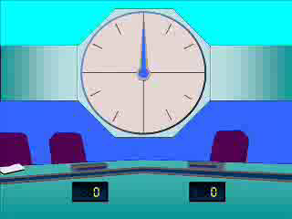
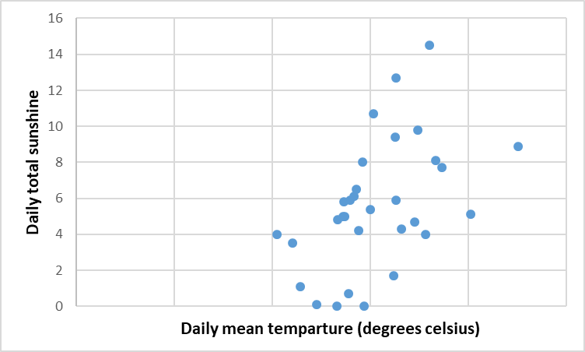
1
Which of the options below best describes the correlation shown in the diagram below?
Moderate positive
Strong positive
Moderate negative
Strong negative

Slide 3
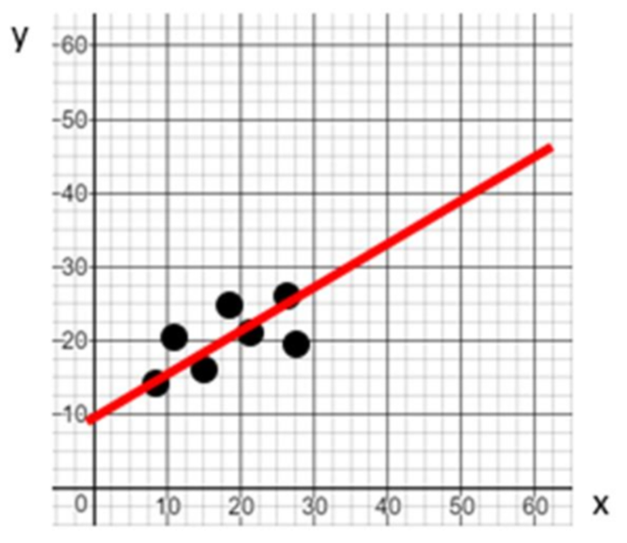
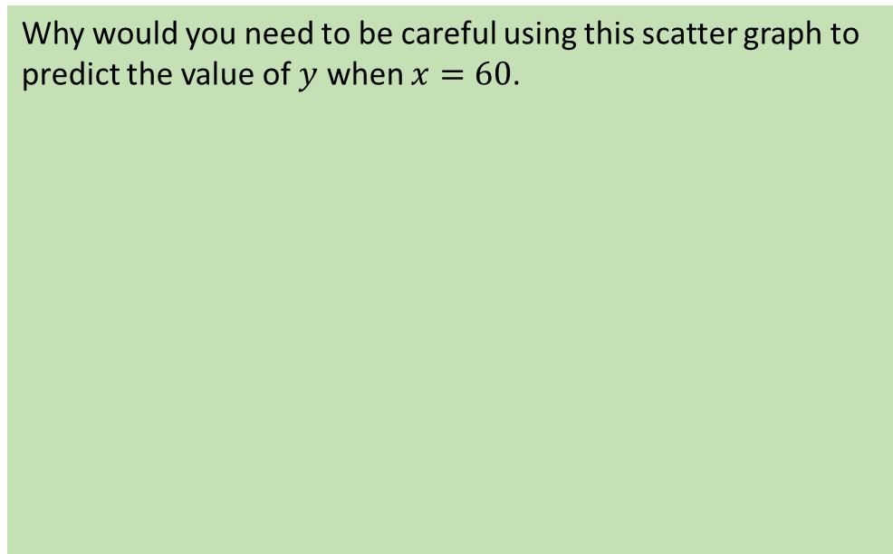
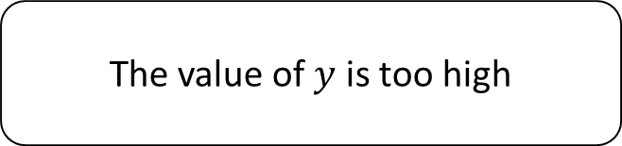
2
Why would you need to be careful using this scatter graph to predict the value of $y$ when $x=60$.
The line of best fit does not pass
through the origin.
There is no correlation
60 lies outside the range of our data
The value of $y$ is too high

Slide 4
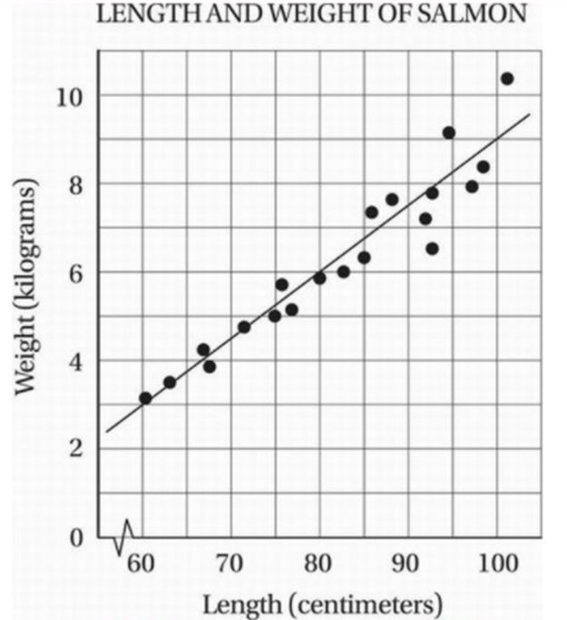
3
According to the data presented in this scatter diagram, which of the following is the best estimate for the weight of a salmon with a length of 85cm?
98kg
6.8kg
6.4kg
6.2kg

