Slide 1
Hypothesis testing
Hypothesis testing is one of the best and most fundamental parts of real life Maths.
I cannot stress how important it is to our everyday lives!
It can determine whether a new cancer drug is actually more effective than another and not just by chance (which would be known as statistically significant).
It can determine whether a new blood pressure tablet actually changes the blood pressure of a patient and that is has not just happened by chance (statistically significant).
In today’s lesson, we will be looking at whether there is statistical evidence to suggest a correlation between two variables based off of a taken sample.
Just because two variables show a slight correlation on a graph does not mean that they are related!

Slide 2

Hypothesis testing
Hypothesis testing can be best thought of as a court case.
The person that is standing on trial is either found not guilty or guilty.
The “default” position is that the person is not guilty as if there isn’t enough evidence against the person, then the jury have to side on the side of caution and not convict.
The stronger the evidence is against the person, the more the jury will start to believe that the person is in fact guilty.
A court case therefore has two hypotheses at the start of a case. The person is not guilty (null hypothesis) or guilty (alternative hypothesis)
$H_{0}$is called the null hypothesis. (Think of this as “no change” or the default position.)
$H_{0}$ is the hypothesis that you assume to be correct (the jury assume that the person is not guilty until substantial evidence is provided to suggest otherwise).
$H_{1}$ is the alternative hypothesis (i.e. that the person is guilty)

Slide 3
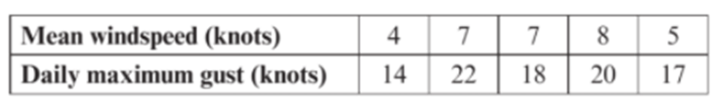

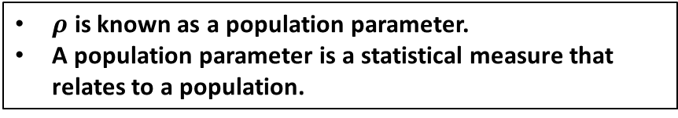

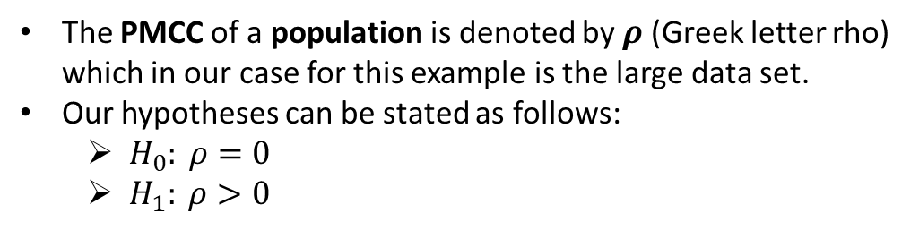
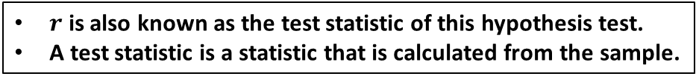
Hypothesis testing
We can use a hypothesis test to determine whether the product moment correlation coefficient for a particular sample indicates that there is likely to be a linear relationship within the whole population or not.
Example
A meteorologist believes that there is a positive correlation between daily mean wind speed and daily maximum gust. She collected data from the large data set for 5 days during August 2015 in the town of Hurn.
$r$ is also known as the test statistic of this hypothesis test.
A test statistic is a statistic that is calculated from the sample.
The PMCC of a sample is denoted by $r$.
For this sample, $r=0.843$ (you can do this on a calculator remember).
The meteorologist believes that there is a positive correlation.
Our “default” position ($H_{0}$) is to assume that there is zero correlation between mean wind speed and daily maximum gust.
The alternative hypothesis ($H_{1}$) is that there is a positive correlation between mean wind speed and daily maximum gust.
We only start to believe $H_{1}$ when substantial evidence is given to us.
The PMCC of a population is denoted by $ρ$ (Greek letter rho) which in our case for this example is the large data set.
Our hypotheses can be stated as follows:
  $H_{0}: ρ=0$
  $H_{1}: ρ>0$
$ρ$ is known as a population parameter.
A population parameter is a statistical measure that relates to a population.

Slide 4
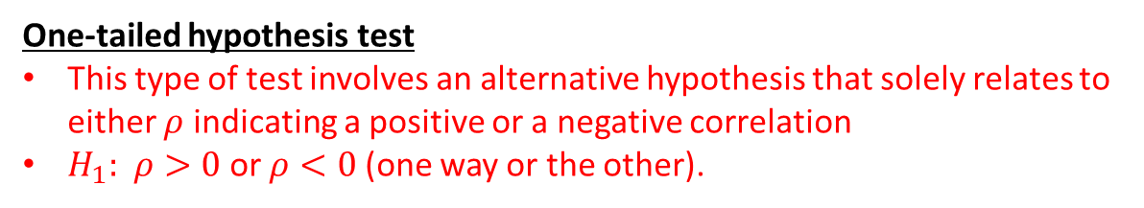
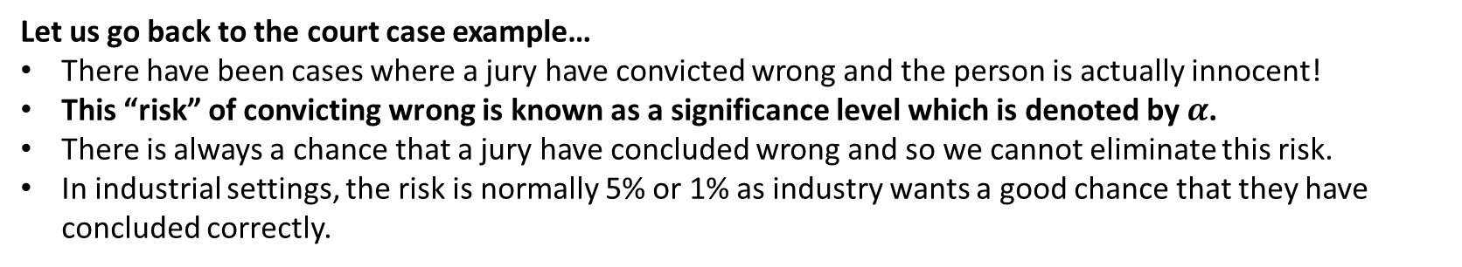
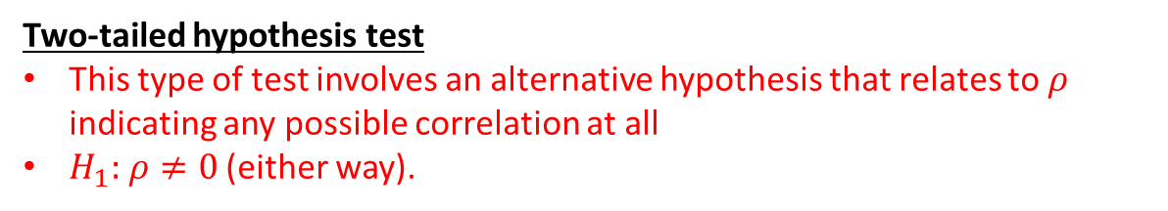
Hypothesis Testing
One-tailed hypothesis test
This type of test involves an alternative hypothesis that solely relates to either $ρ$ indicating a positive or a negative correlation
$H_{1}:$ $ρ>0$ or $ρ<0$ (one way or the other).
Two-tailed hypothesis test
This type of test involves an alternative hypothesis that relates to $ρ$ indicating any possible correlation at all
$H_{1}:$ $ρ≠0$ (either way).
Let us go back to the court case example…
There have been cases where a jury have convicted wrong and the person is actually innocent!
This “risk” of convicting wrong is known as a significance level which is denoted by $α$.
There is always a chance that a jury have concluded wrong and so we cannot eliminate this risk.
In industrial settings, the risk is normally 5% or 1% as industry wants a good chance that they have concluded correctly.

Slide 5
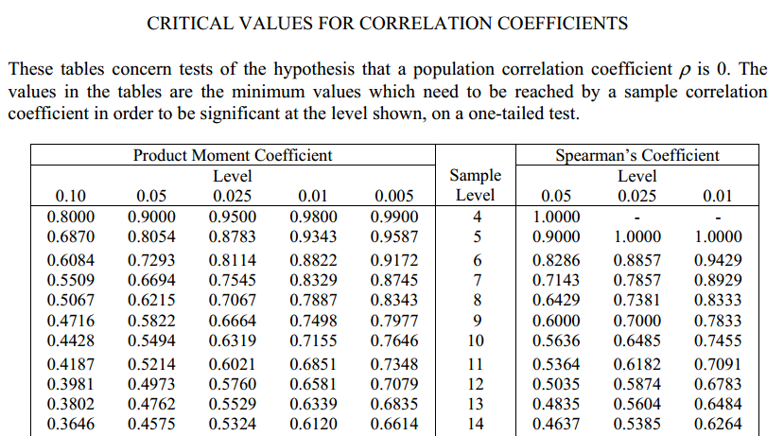
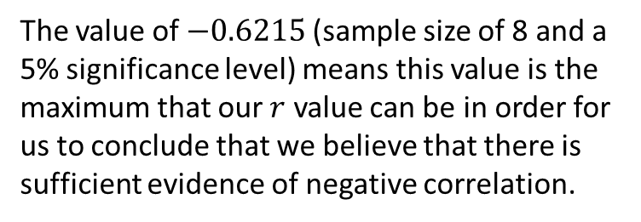
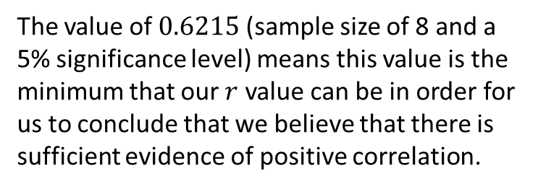
Critical value tables
Earlier it was stated that we only start to believe $H_{1}$ when substantial evidence is given to us, but what is substantial evidence?
We have critical values that depend on sample size and how sure we want to be that we aren’t making a mistake (i.e. the chance that the jury makes the mistake of convicting when the person is innocent).
The value of $0.6215$ (sample size of 8 and a 5% significance level) means this value is the minimum that our $r$ value can be in order for us to conclude that we believe that there is sufficient evidence of positive correlation.
The table works the other way for testing negative correlation by placing a negative in front of the numbers.
The value of $−0.6215$(sample size of 8 and a 5% significance level) means this value is the maximum that our $r$ value can be in order for us to conclude that we believe that there is sufficient evidence of negative correlation.
The values where we would start to believe that two variables are correlated make up what we call a critical region.

Slide 6
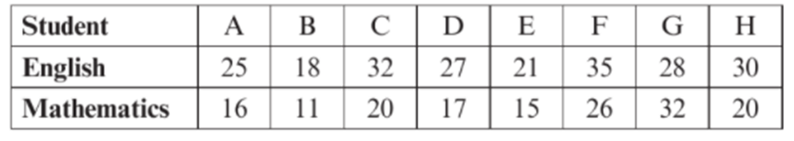


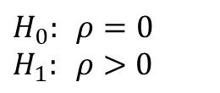
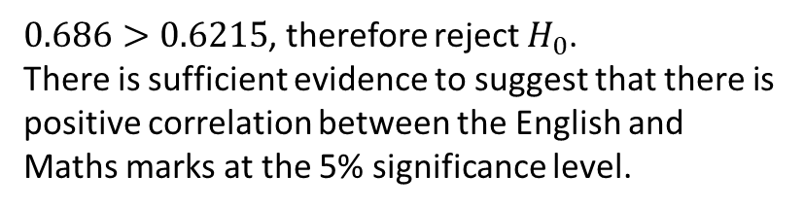



Example
The following table shows the marks attained by 8 students in English and Mathematics tests.
Given that the PMCC is 0.686, test, at the 5% significance level, whether these results show evidence of a positive linear relationship between English and Mathematics. You must state your hypotheses clearly.
Let’s carry out a hypothesis test on whether there is positive correlation between English and Maths marks, at 5% significance level:
$$H_{0}: ρ=0 \\ H_{1}: ρ>0$$
There is no underlying correlation between English and maths marks.
Sample size$=8$
There is an underlying positive correlation between English and maths marks.
Critical value for 5% significance level:
0.6215
Critical region
$$−1$$
$$0$$
$$0.6215$$
$$1$$
$0.686>0.6215$, therefore reject $H_{0}$.
There is sufficient evidence to suggest that there is positive correlation between the English and Maths marks at the 5% significance level.

Slide 7

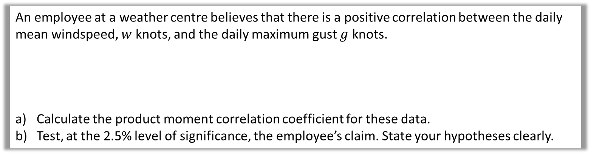
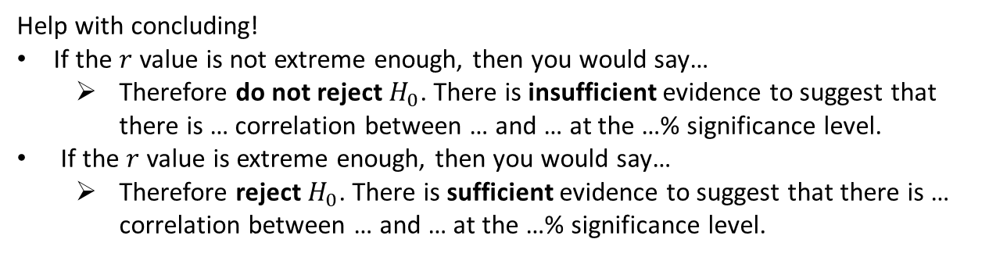
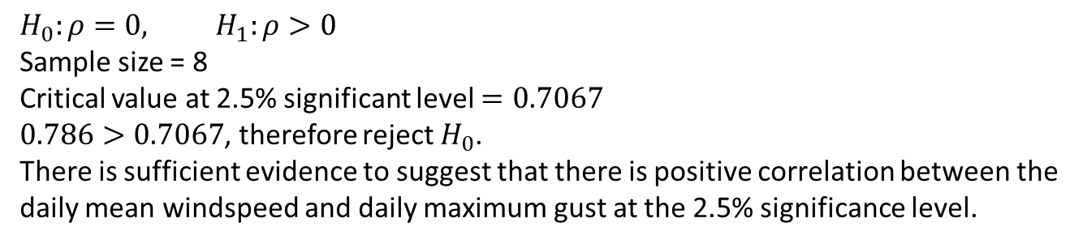

Your turn
An employee at a weather centre believes that there is a positive correlation between the daily mean windspeed, $w$ knots, and the daily maximum gust $g$ knots.
Calculate the product moment correlation coefficient for these data.
Test, at the 2.5% level of significance, the employee’s claim. State your hypotheses clearly.
$$w$$ | 9 | 10 | 14 | 12 | 14 | 9 | 13 | 5
$$g$$ | 21 | 22 | 41 | 24 | 30 | 25 | 29 | 19
a
$$r=0.786$$
b
$$H_{0}:ρ=0, H_{1}:ρ>0$$
Sample size = 8
Critical value at 2.5% significant level $=0.7067$
$0.786>0.7067$, therefore reject $H_{0}$.
There is sufficient evidence to suggest that there is positive correlation between the daily mean windspeed and daily maximum gust at the 2.5% significance level.
Help with concluding!
If the $r$ value is not extreme enough, then you would say…
  Therefore do not reject $H_{0}$. There is insufficient evidence to suggest that there is … correlation between … and … at the …% significance level.
If the $r$ value is extreme enough, then you would say…
  Therefore reject $H_{0}$. There is sufficient evidence to suggest that there is … correlation between … and … at the …% significance level.

Slide 8
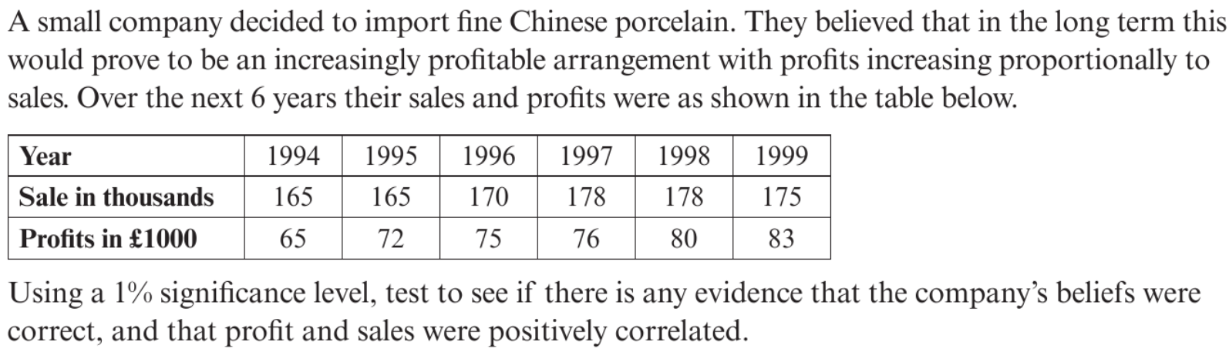
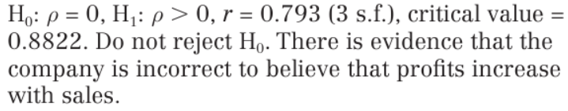
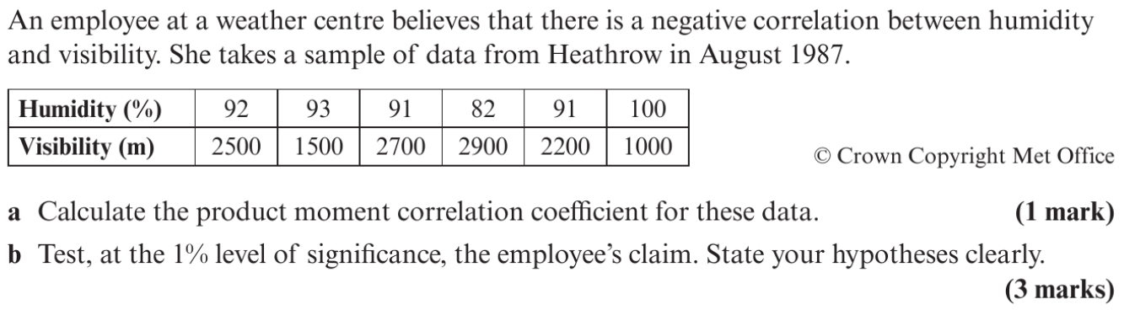
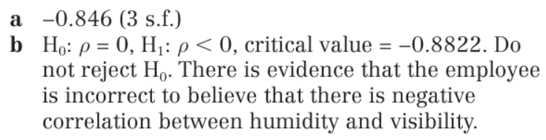
1
2

