Slide 1
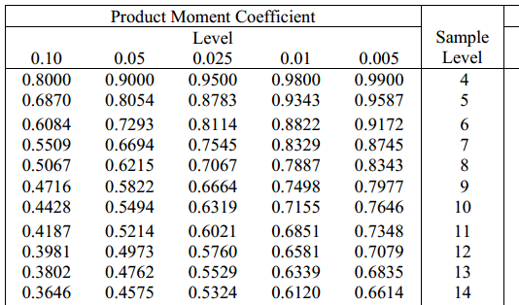

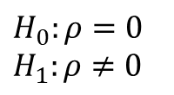


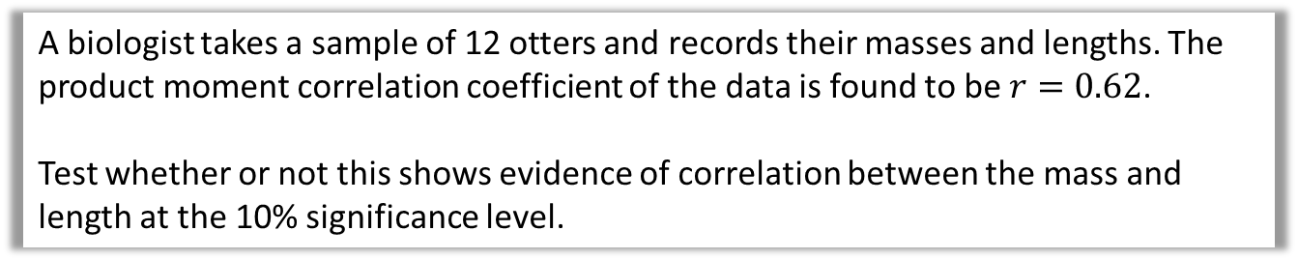
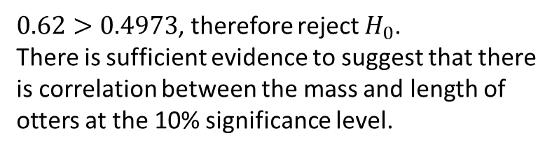




Example
In the previous example we hypothesised that English/Maths marks were positively correlated. But we could also test whether there was any correlation (two-tailed test), i.e. positive or negative.
A biologist takes a sample of 12 otters and records their masses and lengths. The product moment correlation coefficient of the data is found to be $r=0.62$.
Test whether or not this shows evidence of correlation between the mass and length at the 10% significance level.
$$H_{0}:ρ=0 \\ H_{1}:ρ≠0$$
Two-tailed test, so we split the percentage so that we have 5% chance of making a mistake for positive correlation and 5% of making a mistake for negative correlation.
Sample size $=12$
0.4973
Critical value at 5% significance:
Critical region
$$−1$$
$$−0.4973$$
$$0$$
$$0.4973$$
$$1$$
Critical region is $r>0.4973$and $r<−0.4973$
$0.62>0.4973$, therefore reject $H_{0}$.
There is sufficient evidence to suggest that there is correlation between the mass and length of otters at the 10% significance level.

Slide 2
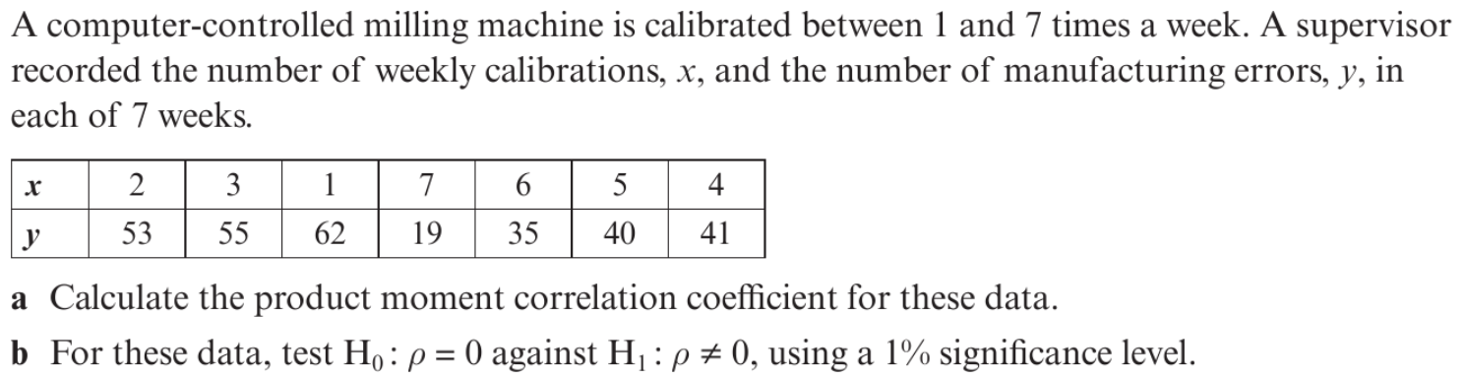
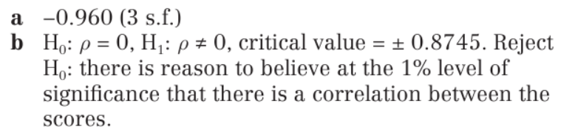
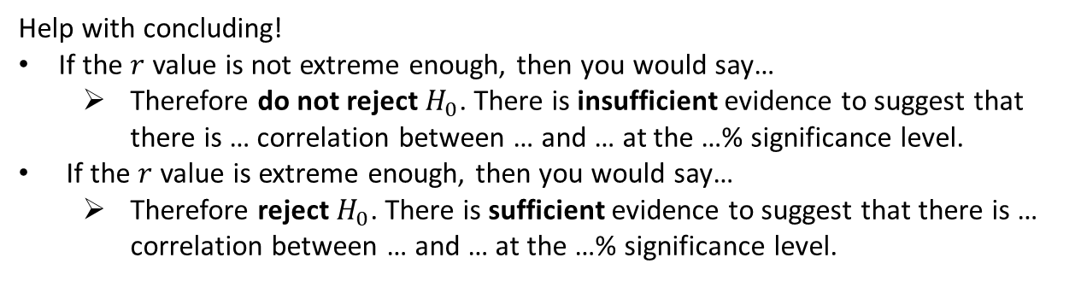
Your turn
Help with concluding!
If the $r$ value is not extreme enough, then you would say…
  Therefore do not reject $H_{0}$. There is insufficient evidence to suggest that there is … correlation between … and … at the …% significance level.
If the $r$ value is extreme enough, then you would say…
  Therefore reject $H_{0}$. There is sufficient evidence to suggest that there is … correlation between … and … at the …% significance level.

Slide 3
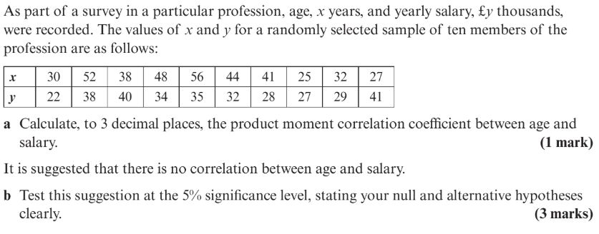
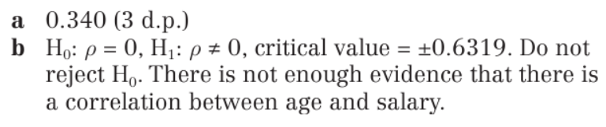
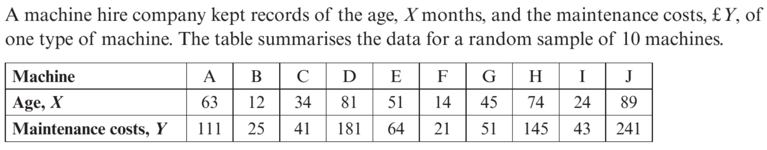
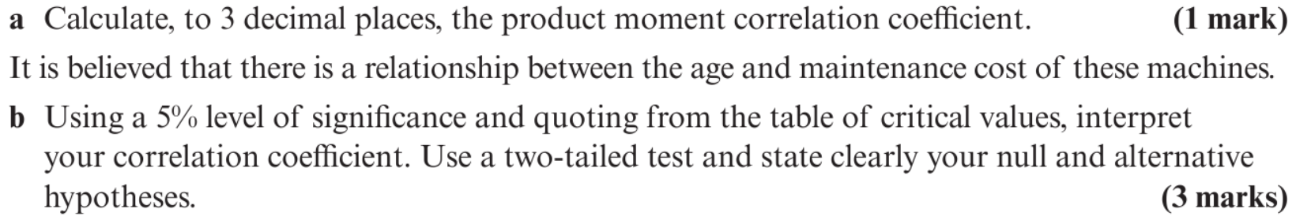
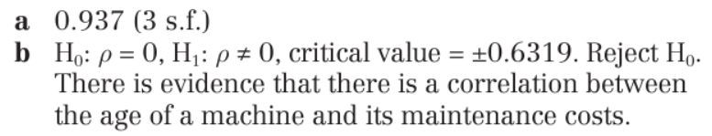
1
2

Slide 4
Mini whiteboards

Slide 5

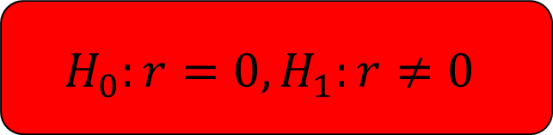
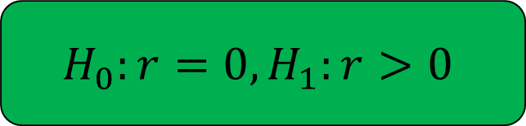
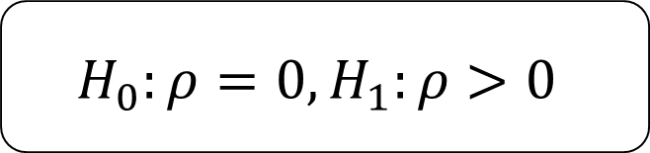
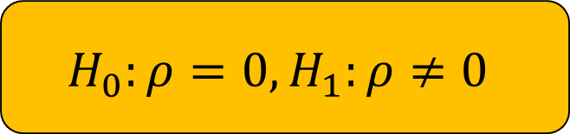
1
A zoologist believe that there is a positive correlation between the lengths and masses of trout in a river. She decides to carry out a hypothesis test to see if there is evidence for her claim. State the hypotheses for this hypothesis test.
$$H_{0}:r=0, H_{1}:r>0$$
$$H_{0}:ρ=0, H_{1}:ρ≠0$$
$$H_{0}:r=0, H_{1}:r≠0$$
$$H_{0}:ρ=0, H_{1}:ρ>0$$

Slide 6


2
Fred is interested in whether there is a relationship between the Engine size of a car and the Fuel economy. He decides to do a hypothesis test to decide whether or not there is evidence of correlation. State the hypotheses for this hypothesis test.
$$H_{0}:r=0, H_{1}:r<0$$
$$H_{0}:ρ=0, H_{1}:ρ≠0$$
$$H_{0}:r=0, H_{1}:r≠0$$
$$H_{0}:ρ=0, H_{1}:ρ<0$$

Slide 7

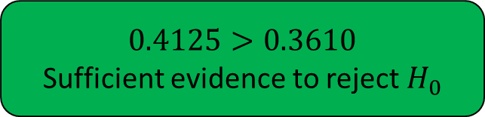
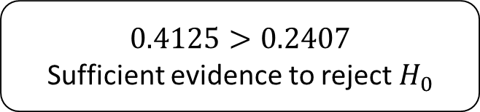
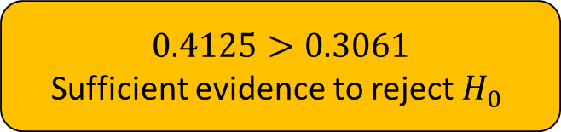
3
A population of students each took two different tests. A sample of 30 students was taken from the population and their scores on the two tests were recorded. A PMCC of 0.4125 as calculated. Test whether or not this shows evidence of positive correlation at the 5% level of significance.
$$0.4125>0.3610$$
Sufficient evidence to reject $H_{0}$
$$0.4125>0.3061$$
Sufficient evidence to reject $H_{0}$
$$0.4125<0.4629$$
Insufficient evidence to reject $H_{0}$
$$0.4125>0.2407$$
Sufficient evidence to reject $H_{0}$

Slide 8
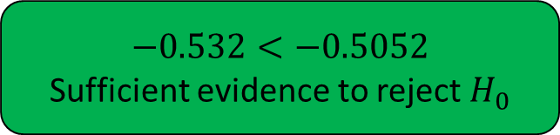
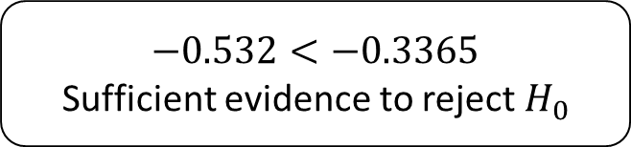
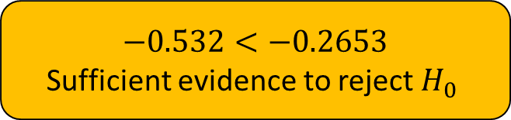
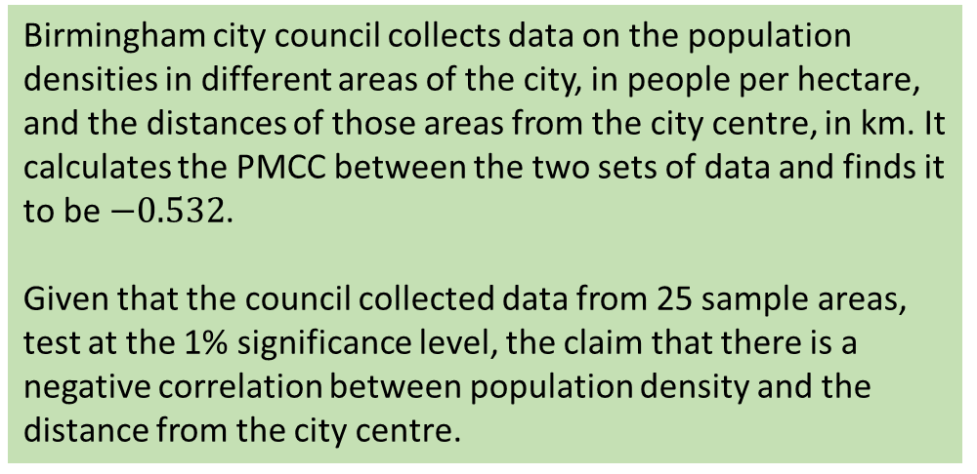
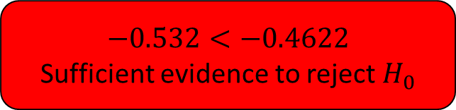
4
Birmingham city council collects data on the population densities in different areas of the city, in people per hectare, and the distances of those areas from the city centre, in km. It calculates the PMCC between the two sets of data and finds it to be $−0.532$.
Given that the council collected data from 25 sample areas, test at the 1% significance level, the claim that there is a negative correlation between population density and the distance from the city centre.
$$−0.532<−0.5052$$
Sufficient evidence to reject $H_{0}$
$$−0.532<−0.2653$$
Sufficient evidence to reject $H_{0}$
$$−0.532<−0.4622$$
Sufficient evidence to reject $H_{0}$
$$−0.532<−0.3365$$
Sufficient evidence to reject $H_{0}$

