Slide 1
Random variables
Consider a bag that has 3 red counters, 4 green counters, 1 blue counter and 2 orange counters in.
If we were to put our hand in and grab a counter, then there are 4 different scenarios.
  I could pick a red counter out of the bag
  I could pick a green counter out of the bag
  I could pick a blue counter out of the bag
  I could pick an orange counter out of the bag
The idea is that this process is completely random and we do not always get the same outcome each time.
The colour of the counter that we pick out of the bag is known as a random variable
Recall that a variable is a collection of values (in our case this is the colours of the counters)
$$x$$ | red | green | blue | orange
$$P(X=x)$$ | 0.3 | 0.4 | 0.1 | 0.2
If each value is assigned a probability of occurring, then it becomes a random variable.
A random variable $X$ represents a single experiment/trial. It consists of outcomes with a probability for each. For example, when we roll 5 dice, the number of sixes rolled would be a random variable.

Slide 2

Understanding check
Are the following discrete random variables or not?
The height, $X$ cm, of a seedling chosen randomly from a group of plants.
This is not a discrete random variable as height is continuous.
The number of times, $R$, a six is rolled when a fair dice is rolled 100 times.
This is a discrete random variables as it is always a whole number and it varies each time.
The number of days, $W$, in a given week.
This is not a discrete random variables as the number of days in a given week is always 7.

Slide 3

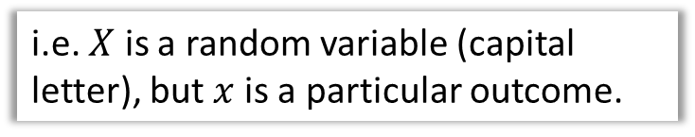

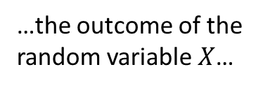
Random variables
A random variable $X$ represents a single experiment/trial. It consists of outcomes with a probability for each. For example, when we roll 5 dice, the number of sixes rolled would be a random variable.
i.e. $X$ is a random variable (capital letter), but $x$ is a particular outcome.
$$P(X=x)$$
“The probability that…
…was the specific outcome $x$”
…the outcome of the random variable $X$…
In this chapter we will be focussing on Discrete random variables (random variables that can only take certain numerical values).

Slide 4

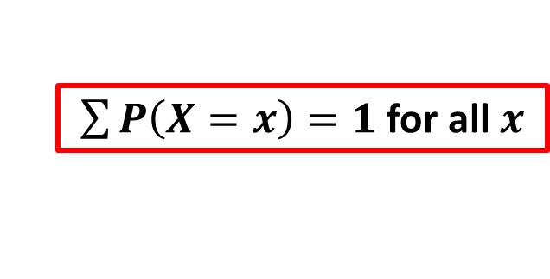
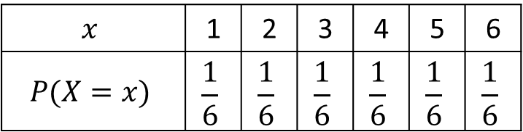
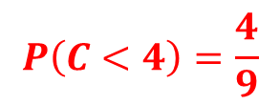
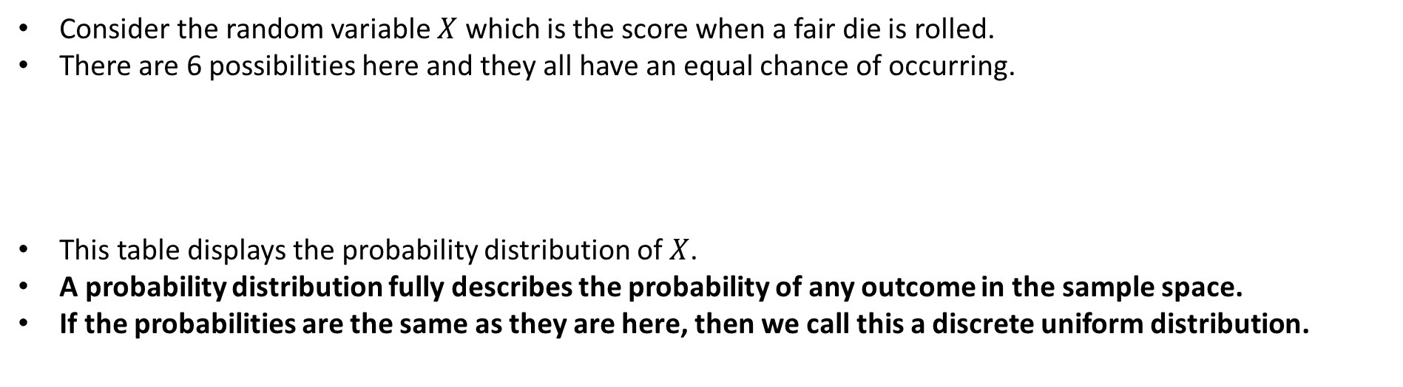
Probability distributions
Consider the random variable $X$ which is the score when a fair die is rolled.
There are 6 possibilities here and they all have an equal chance of occurring.
This table displays the probability distribution of $X$.
A probability distribution fully describes the probability of any outcome in the sample space.
If the probabilities are the same as they are here, then we call this a discrete uniform distribution.
$$x$$ | 1 | 2 | 3 | 4 | 5 | 6
$$P(X=x)$$ | $$\frac{1}{6}$$ | $$\frac{1}{6}$$ | $$\frac{1}{6}$$ | $$\frac{1}{6}$$ | $$\frac{1}{6}$$ | $$\frac{1}{6}$$
$\sum{P\left(X=x\right)=1}$ for all $x$
Exam question example:
Helen believes that the random variable C, representing cloud cover from the large data set, can be modelled by a discrete uniform distribution.
Write down the probability distribution for C.
Using this model, find the probability that the cloud cover is less than 50%
$$P\left(C<4\right)=\frac{4}{9}$$

Slide 5
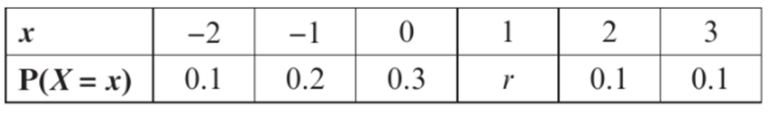
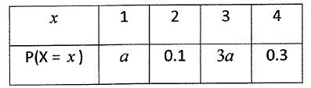
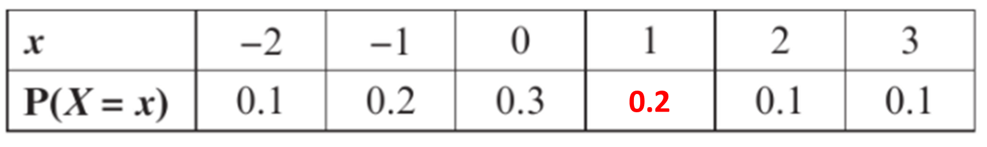
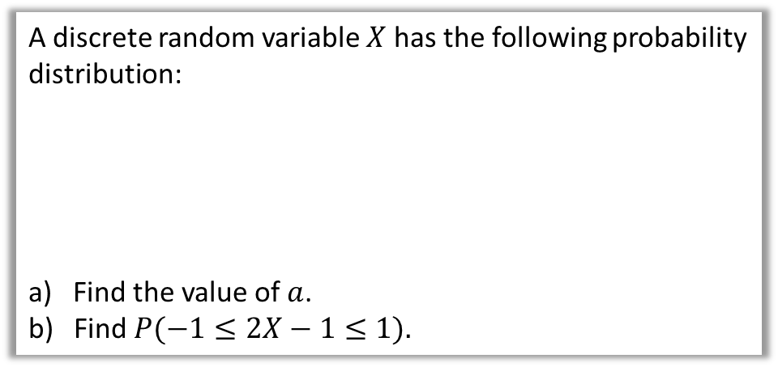




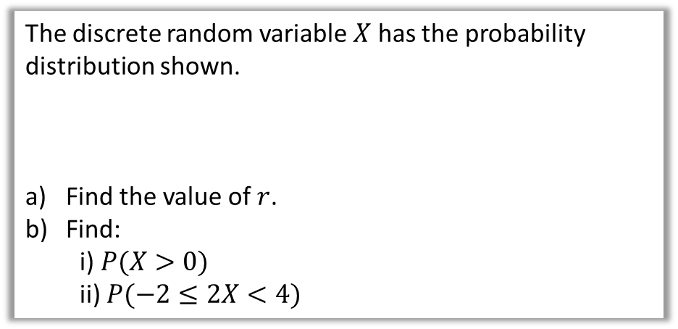

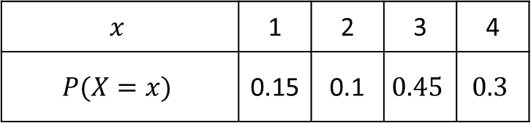

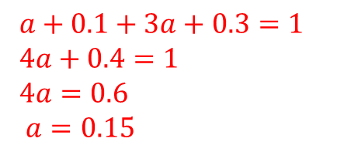


Example
Your turn
The discrete random variable $X$ has the probability distribution shown.
Find the value of $r$.
Find:
  i) $P(X>0)$
  ii) $P(−2≤2X<4)$
A discrete random variable $X$ has the following probability distribution:
a) Find the value of $a$.
Find $P(−1≤2X−1≤1).$
a
$$0.1+0.2+0.3+r+0.1+0.1=1$$
$a+0.1+3a+0.3=1$
$4a+0.4=1$
$4a=0.6$
$a=0.15$
a
$$r+0.8=1$$
$$r=0.2$$
b
b
$$x$$ | 1 | 2 | 3 | 4
$$P(X=x)$$ | 0.15 | 0.1 | $$0.45$$ | $$0.3$$
$$P\left(X>0\right)$$
$$=0.4$$
$$P\left(−2≤2X<4\right)$$
$$=P\left(−1≤X<2\right)$$
$$=0.7$$
$$P\left(0≤X≤1\right)=0.15.$$

Slide 6
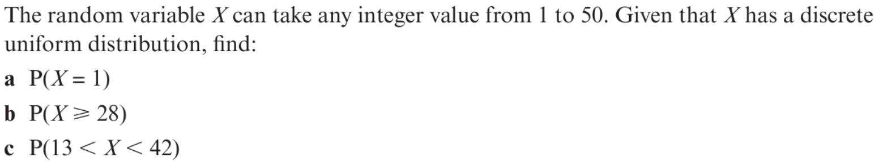
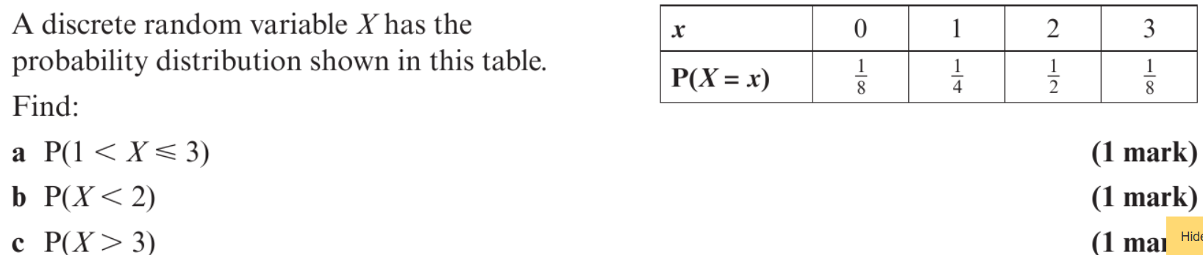
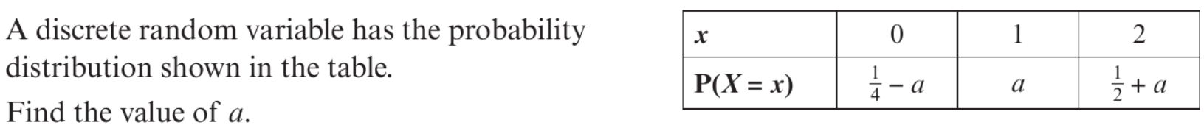

Your turn
1
2
3

