Slide 1
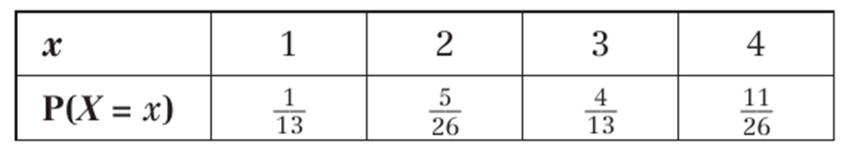
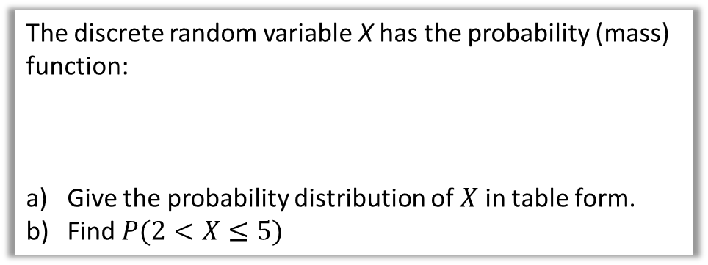



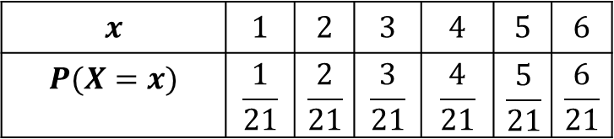

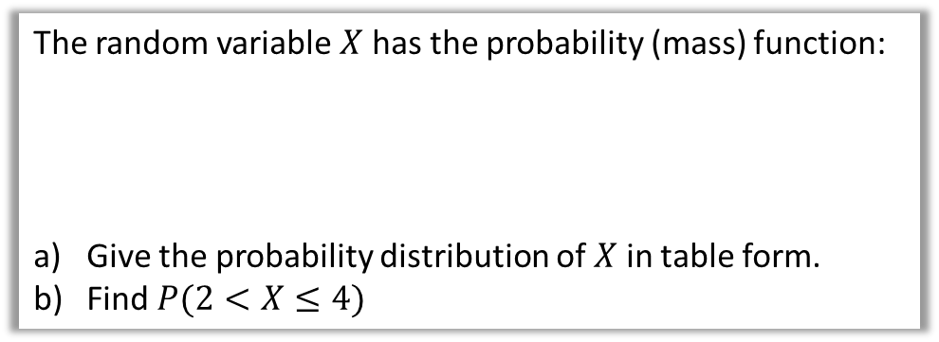
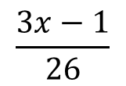







Example 1
Your turn
The random variable $X$ has the probability (mass) function:
Give the probability distribution of $X$ in table form.
Find $P(2<X≤4)$
The discrete random variable X has the probability (mass) function:
Give the probability distribution of $X$ in table form.
Find $P(2<X≤5)$
$$\frac{3x−1}{26}$$
$$P\left(X=x\right)=$$
$$x=1, 2, 3, 4$$
$$\frac{x}{21}$$
$$P\left(X=x\right)=$$
$$x=1, 2, 3, 4, 5, 6$$
a
There are 4 possible outcomes for $X$: 1, 2, 3 and 4
$$P\left(X=1\right)=\frac{2}{26}=\frac{1}{13}$$
$$P\left(X=2\right)=\frac{5}{26}$$
a
$$x$$ | $$1$$ | $$2$$ | $$3$$ | $$4$$ | $$5$$ | $$6$$
$$P(X=x)$$ | $$\frac{1}{21}$$ | $$\frac{2}{21}$$ | $$\frac{3}{21}$$ | $$\frac{4}{21}$$ | $$\frac{5}{21}$$ | $$\frac{6}{21}$$
$$P\left(X=3\right)=\frac{8}{26}=\frac{4}{13}$$
$$P\left(X=4\right)=\frac{11}{26}$$
$$P\left(2<X≤5\right)=\frac{12}{21}$$
b
$$P\left(2<X≤4\right)=\frac{19}{26}$$
b

Slide 2

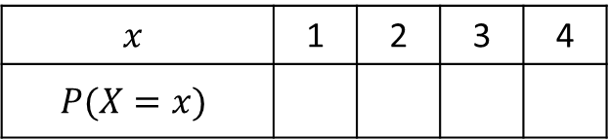
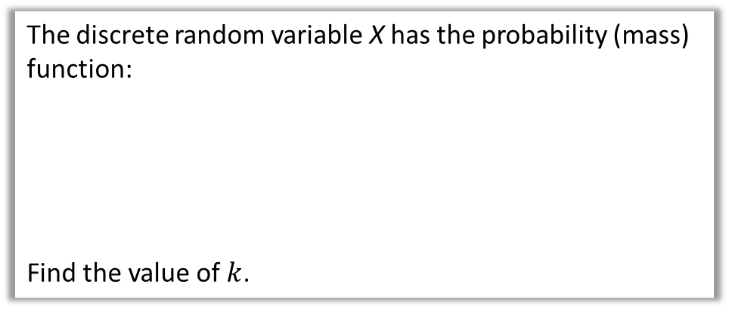




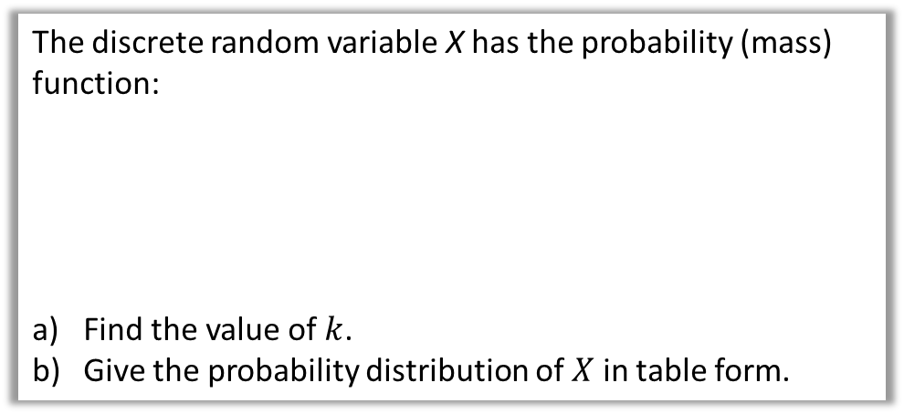

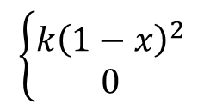


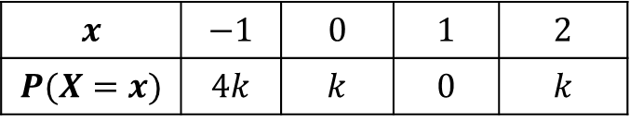


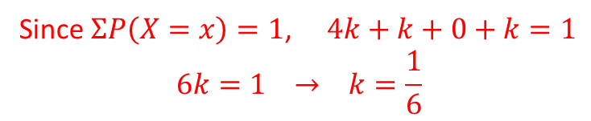


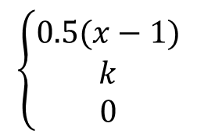


Example 2
Your turn
The discrete random variable X has the probability (mass) function:
Find the value of $k$.
Give the probability distribution of $X$ in table form.
The discrete random variable X has the probability (mass) function:
Find the value of $k$.
$$\left\{\begin{matrix}0.5(x−1) \\ \begin{matrix}k \\ 0\end{matrix}\end{matrix}\right.$$
$$x=1, 2$$
$$\left\{\begin{matrix}k{\left(1−x\right)}^{2} \\ 0\end{matrix}\right.$$
$$x=−1, 0, 1, 2$$
$$P\left(X=x\right)=$$
$$x=3, 4$$
$$P\left(X=x\right)=$$
$$otherwise$$
$$otherwise$$
There are 4 possible outcomes for $X$: 1, 2, 3 and 4
$$x$$ | $$−1$$ | $$0$$ | $$1$$ | $$2$$
$$P(X=x)$$ | $$4k$$ | $$k$$ | $$0$$ | $$k$$
a
Remember that since all outcomes are represented, the probabilities should add up to 1…
$$0.5\left(1−1\right)+0.5\left(2−1\right)+k+k=1$$
Since $ΣP\left(X=x\right)=1$, $4k+k+0+k=1$
$$6k=1 → k=\frac{1}{6}$$
$$2k+0.5=1$$
$$2k=0.5$$
$$k=0.25$$
b
$$x$$ | 1 | 2 | 3 | 4
$$P(X=x)$$
$$0$$
$$0.5$$
$$0.25$$
$$0.25$$

Slide 3
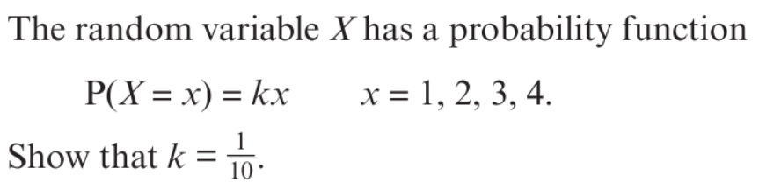
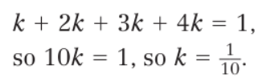
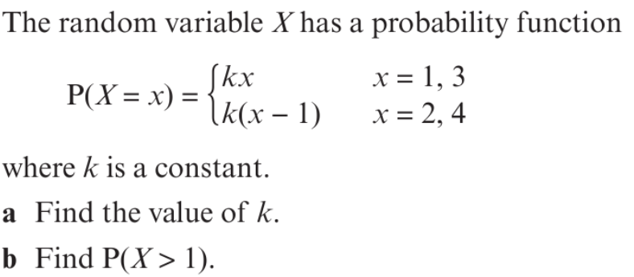

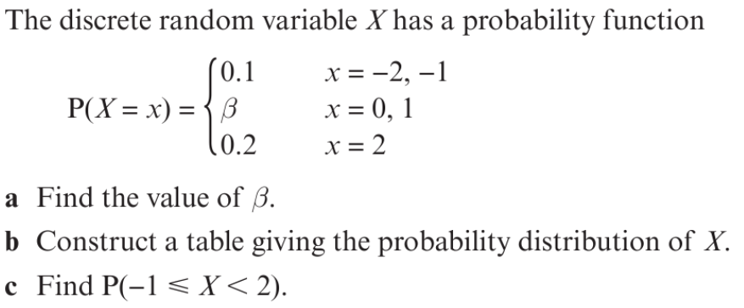
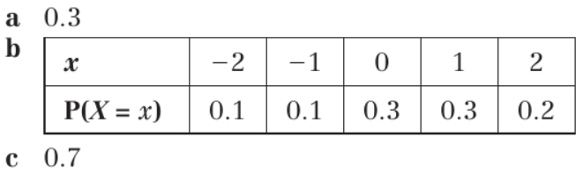
Your turn
1
2
3

Slide 4
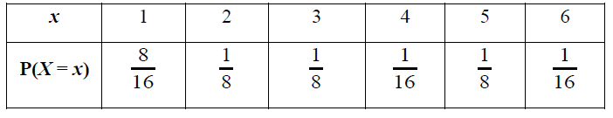
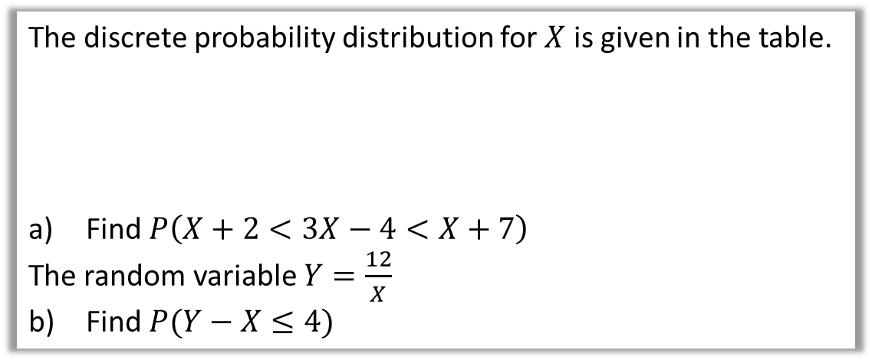
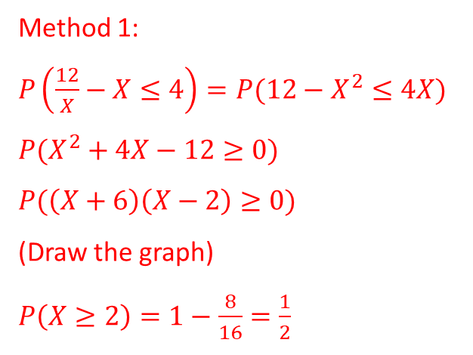




Example 3
The discrete probability distribution for $X$ is given in the table.
Find $P\left(X+2<3X−4<X+7\right)$
The random variable $Y=\frac{12}{X}$
Find $P(Y−X≤4)$
a
$$P(X+6<3X<X+11)$$
$$P(6<2X<11)$$
$$P\left(3<X<5.5\right)=\frac{1}{16}+\frac{1}{8}=\frac{3}{16}$$
b
Method 1:
$P\left(\frac{12}{X}−X≤4\right)=P(12−X^{2}≤4X)$
$P(X^{2}+4X−12≥0)$
$P(\left(X+6\right)\left(X−2\right)≥0)$
(Draw the graph)
$P\left(X≥2\right)=1−\frac{8}{16}=\frac{1}{2}$
Method 2:
$$x$$ | $$1$$ | $$2$$ | $$3$$ | $$4$$ | $$5$$ | $$6$$
$$y$$ | $$12$$ | $$6$$ | $$4$$ | $$3$$ | $$2.4$$ | $$2$$
$$y−x$$ | $$11$$ | $$4$$ | $$1$$ | $$−1$$ | $$−2.6$$ | $$−4$$
$P\left(Y−X≤4\right)=\frac{1}{2}$

Slide 5
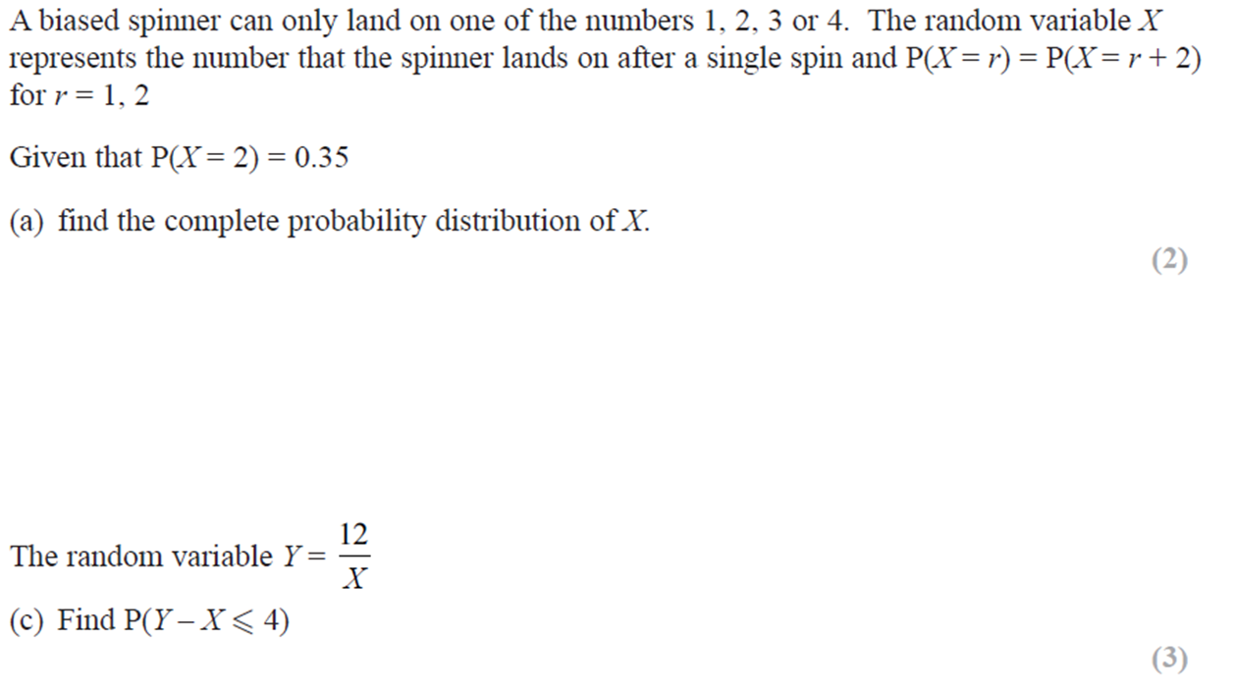
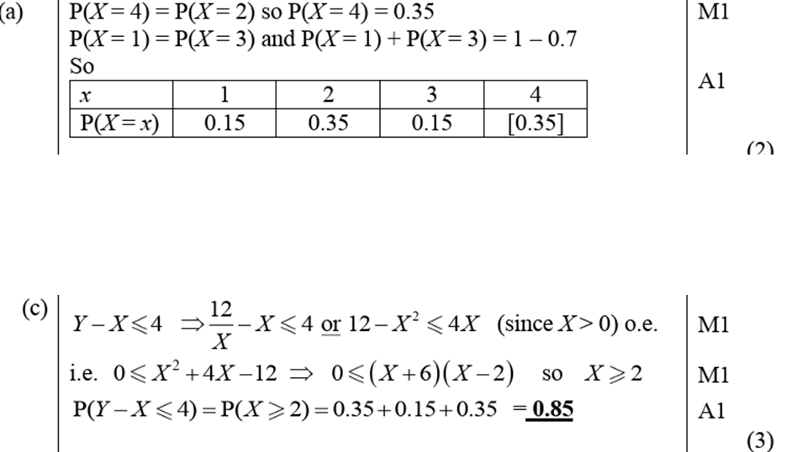
Your turn

