Slide 1
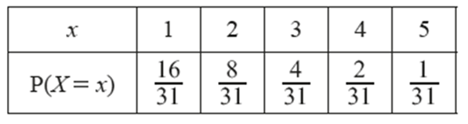
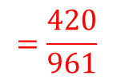
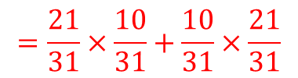
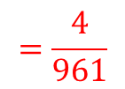
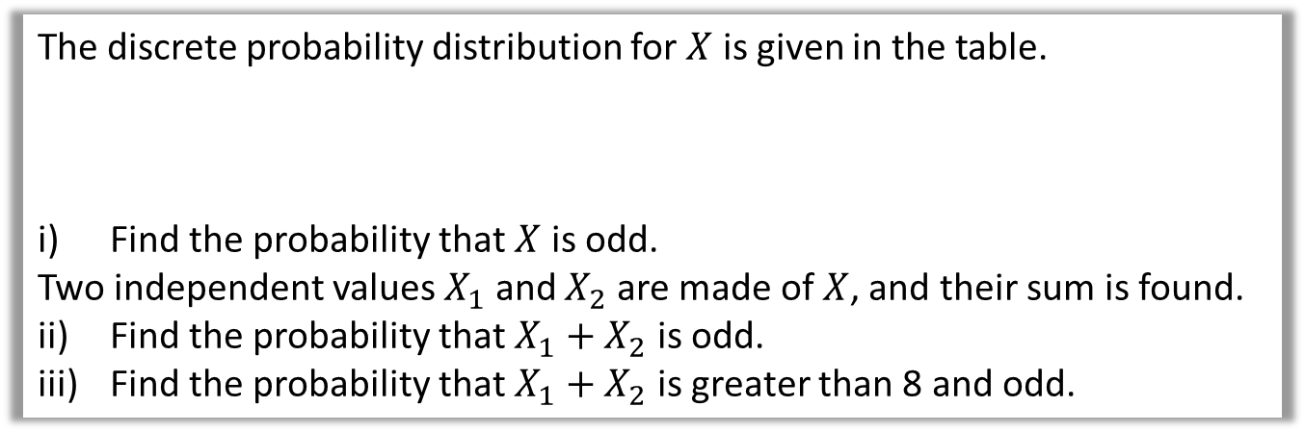
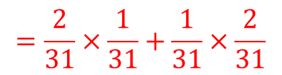

Example
The discrete probability distribution for $X$ is given in the table.
i) Find the probability that $X$ is odd.
Two independent values $X_{1}$ and $X_{2}$ are made of $X$, and their sum is found.
ii) Find the probability that $X_{1}+X_{2}$ is odd.
iii) Find the probability that $X_{1}+X_{2}$ is greater than 8 and odd.
i
$$P\left(X=1, 3, 5\right)=\frac{21}{31}$$
ii
Possible combinations for $X_{1}$ and $X_{2}$ are $X_{1}=Odd \& X_{2}=Even$ OR $X_{1}=Even \& X_{2}=Odd$.
$$P\left(X_{1}+X_{2}=Odd\right)=P\left(X_{1}=Odd \& X_{2}=Even\right)+P(X_{1}=Even \& X_{2}=Odd)$$
$$=\frac{21}{31}×\frac{10}{31}+\frac{10}{31}×\frac{21}{31}$$
$$=\frac{420}{961}$$
iii
Possible combinations for $X_{1}$ and $X_{2}$ are $X_{1}=4 \& X_{2}=5$ OR $X_{1}=5 \& X_{2}=4$
$$P\left(X_{1}+X_{2}>8 and odd\right)=P\left(X_{1}=4 \& X_{2}=5\right)+P\left(X_{1}=5 \& X_{2}=4\right)$$
$$=\frac{2}{31}×\frac{1}{31}+\frac{1}{31}×\frac{2}{31}$$
$$=\frac{4}{961}$$

Slide 2
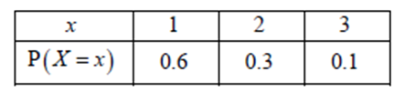
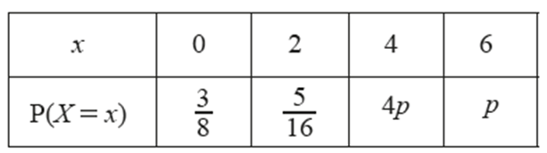
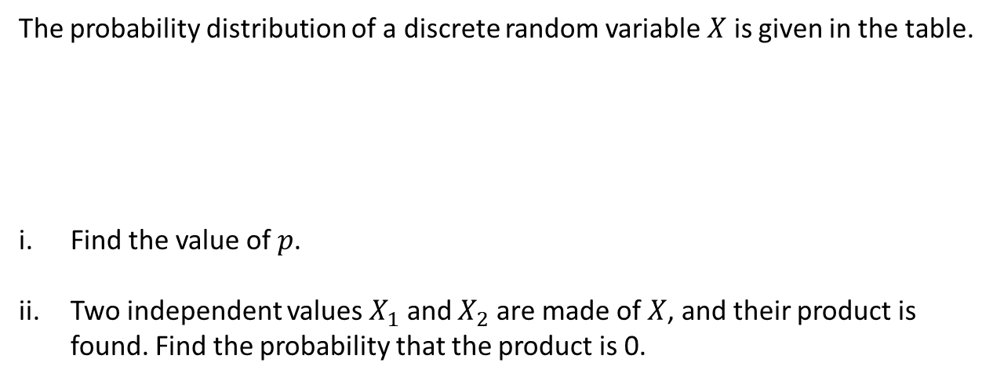
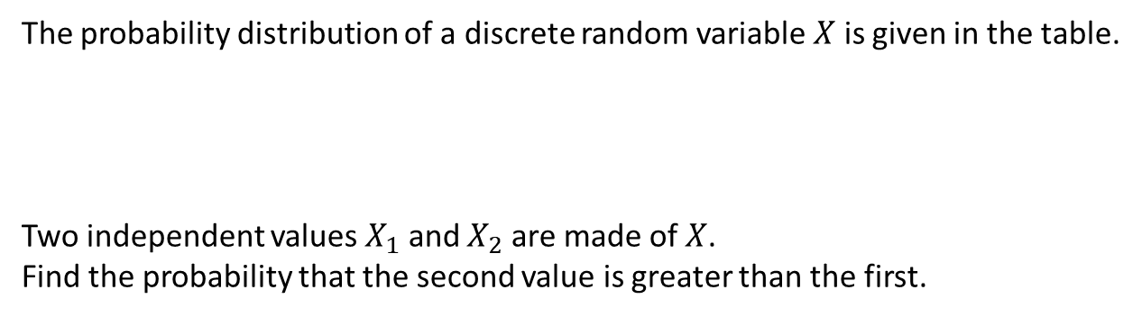
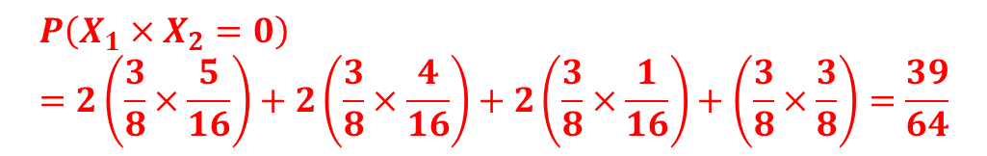
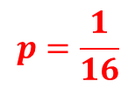
Questions
1
The probability distribution of a discrete random variable $X$ is given in the table.
Two independent values $X_{1}$ and $X_{2}$ are made of $X$.
Find the probability that the second value is greater than the first.
$$P\left(X_{2}>X_{1}\right)=0.6×0.3+0.6×0.1+0.3×0.1=0.27$$
2
The probability distribution of a discrete random variable $X$ is given in the table.
Find the value of $p$.
Two independent values $X_{1}$ and $X_{2}$ are made of $X$, and their product is found. Find the probability that the product is 0.
$$p=\frac{1}{16}$$
$$P\left(X_{1}×X_{2}=0\right)=2\left(\frac{3}{8}×\frac{5}{16}\right)+2\left(\frac{3}{8}×\frac{4}{16}\right)+2\left(\frac{3}{8}×\frac{1}{16}\right)+\left(\frac{3}{8}×\frac{3}{8}\right)=\frac{39}{64}$$

Slide 3

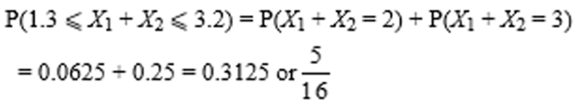



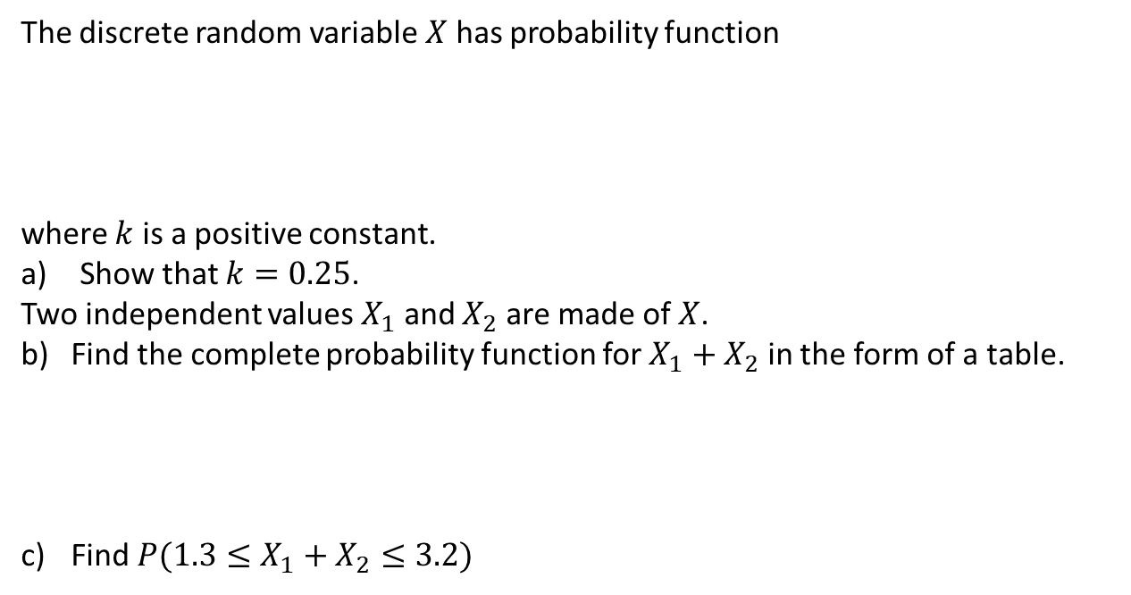


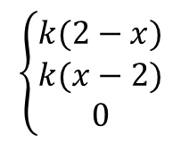
Questions
3
The discrete random variable $X$ has probability function
where $k$ is a positive constant.
Show that $k=0.25$.
Two independent values $X_{1}$ and $X_{2}$ are made of $X$.
Find the complete probability function for $X_{1}+X_{2}$ in the form of a table.
Find $P(1.3≤X_{1}+X_{2}≤3.2)$
$$\left\{\begin{matrix}k(2−x) \\ \begin{matrix}k(x−2) \\ 0\end{matrix}\end{matrix}\right.$$
$$x=0, 1, 2$$
$$x=3$$
$$P\left(X=x\right)=$$
$$otherwise$$
$$2k+k+0+k=1 k=0.25$$

Slide 4
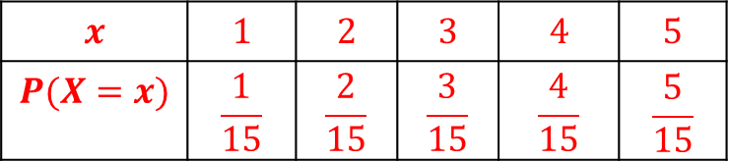

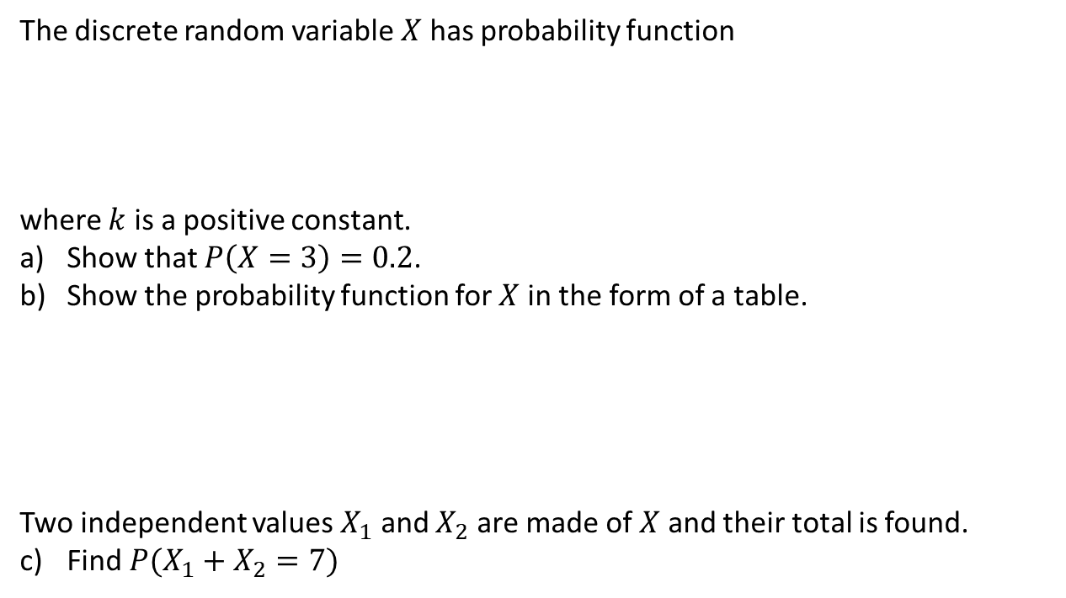


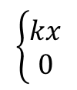
Questions
4
The discrete random variable $X$ has probability function
where $k$ is a positive constant.
Show that $P\left(X=3\right)=0.2$.
Show the probability function for $X$ in the form of a table.
Two independent values $X_{1}$ and $X_{2}$ are made of $X$ and their total is found.
Find $P(X_{1}+X_{2}=7)$
$$\left\{\begin{matrix}kx \\ 0\end{matrix}\right.$$
$$x=1, 2, 3, 4, 5$$
$$P\left(X=x\right)=$$
$$otherwise$$
$k+2k+3k+4k+5k=1, k=\frac{1}{15}$ . So $P\left(X=3\right)=\frac{1}{15}×3=\frac{1}{5}=0.2$
$$x$$ | $$1$$ | $$2$$ | $$3$$ | $$4$$ | $$5$$
$$P(X=x)$$ | $$\frac{1}{15}$$ | $$\frac{2}{15}$$ | $$\frac{3}{15}$$ | $$\frac{4}{15}$$ | $$\frac{5}{15}$$
$$P\left(X_{1}+X_{2}=7\right)=\frac{3}{15}×\frac{4}{15}+\frac{4}{15}×\frac{3}{15}+\frac{2}{15}×\frac{5}{15}+\frac{5}{15}×\frac{2}{15}=\frac{44}{225}$$

Slide 5
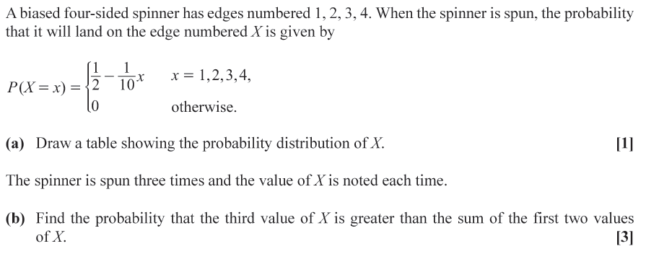
Exam question

Slide 6

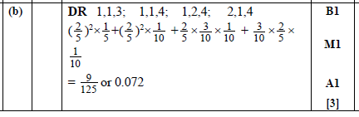
Mark scheme

