Slide 1
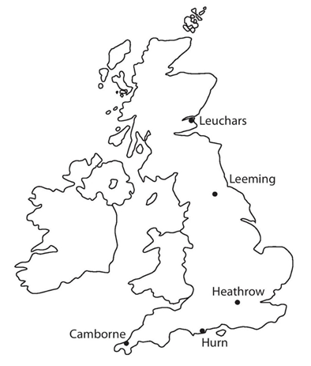
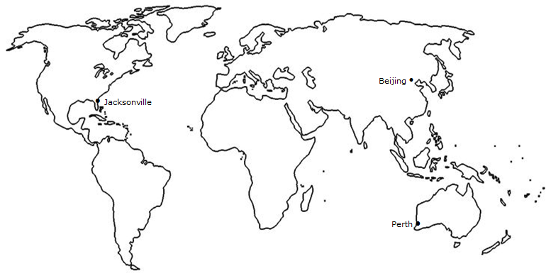
The large data set
The large data set contains information recorded in 1987 and 2015 at weather stations around the world (as shown).
The data was recorded in both 1987 and 2015 (May to October), and you will most likely be asked to draw comparisons between the two.
You do not need to memorise the data but being familiar with it and the locations shown will be useful.
Leuchars is a lot further north than any other location and it is by the sea so we would expect it to be colder than other locations like Hurn and Heathrow.
Perth is the only location in the southern hemisphere and so has opposite seasons to all the other locations.

Slide 2
The large data set
Data set variables
The LDS features 11 variables:
• Daily Mean Temperature
• Daily Total Rainfall
• Daily Total Sunshine
• Daily Maximum Relative Humidity
• Daily Mean Windspeed
• Daily Maximum Gust
• Daily Mean Wind Direction
• Daily Maximum Gust Direction
• Cloud Cover
• Visibility
• Pressure
If a reading is not available, then it is listed as ‘n/a’.
These values are simply ignored as values if we are asked to do some calculations with a set of values containing some.

Slide 3
The variables in more detail
Daily Maximum Temperature
This is measured in Degrees Celsius.
Data values are given to one decimal place.
A negative value indicates a temperature less than 0℃.
Daily Total Rainfall
All totals are given in millimetres.
If the total amount of rainfall recorded is less than 0.05mm, then it is recorded as ‘tr’ (trace).
A “tr” value is treated as 0 if we have to do a calculation with it.
Daily Total Sunshine
Values for this are given in hours and recorded to one decimal place.
For example, an entry of ‘4.5’ would indicate that there were 4.5 hours (e.g. four and a half hours) of sunshine on that particular day in that particular location.
Daily Maximum Relative Humidity
Relative humidity is a measure of the saturation of water vapour in the atmosphere.
Higher relative humidities indicate that the air contains more water vapour.
The values are given as a percentage. Values above 95% are associated with mist and fog.
If the relative humidity is 100%, then the air is fully saturated and precipitation can occur.

Slide 4
The variables in more detail
Daily Mean Windspeed
Daily mean windspeed is measured in knots in one column. 1 knot is 1.15 miles per hour.
The daily mean windspeed is also recorded using the Beaufort scale in another column.
  This is a non-numerical and empirical scale that maps windspeeds to a number and then a descriptive term.
  The descriptive terms are light, moderate and fresh.
  Light happens the most in most locations.
Daily Maximum Gust
This is the maximum instantaneous speed that occurred over a 24 hour period.
It is measured in knots.
Daily Mean Wind Direction
The daily mean wind direction is averaged over the 24 hours of the day.
This value is given in degrees relative to true North and is the direction the wind was blowing from.
The corresponding cardinal direction is also given.
Values are rounded to the nearest 10 degrees.
Daily Maximum Gust Direction
This is the direction the wind was blowing from in the hour that the corresponding daily maximum gust occurred. Values are given in degrees relative to true North.
The corresponding cardinal direction is also given.
The direction of the maximum gust is the direction from which the wind was blowing.

Slide 5
Beaufort scale
Beaufort scale | Descriptive term | Average speed at 10metres above ground
1-3 | Light | 1-10 knots
4 | Moderate | 11-16 knots
5 | Fresh | 17-21 knots

Slide 6
The variables in more detail
Cloud cover
This is a measure of the fraction of the celestial dome covered by cloud.
It is measured in eighths.
The technical unit in this case is the okta.
A value of 0 oktas represents a clear sky, while a value of 8 indicates complete overcast (discrete variable with 9 values).
Visibility
This is measured horizontally. Readings are given in decametres (1dm=10m).
Unavailable data is indicated by a dash. Usually between 1000dm and 7000dm.
Less than 100dm is fog and less than 200dm is mist.
Pressure
The measurement is taken at the location and converted into the equivalent amount for the pressure at sea level (to remove the effect of altitude at location).
Pressure is measured in hectopascals (hPa) to the nearest whole number.
This value is always around 1000 hPa.
Higher pressure is associated with good weather.
Lower pressure is associated with rain, cold, cloud.
The UK locations have pressures of 980 to 1040 hPa.
The overseas locations have pressures of 1000 to 1040 hPa.
How pressure works and explanation as to how it affects weather.

Slide 7
Mini whiteboards!

Slide 8

1
The weather for the 5 UK stations was sampled how many years apart?
25 years apart
18 years apart
28 years apart
27 years apart

Slide 9
2
n/a in any of the cells means
No answer
Data not available
0
The measuring device was broken
for that day(s)

Slide 10
3
tr in any of the cells for “Daily total rainfall” means
Torrential (an amount greater than
500mm)
Torrential (an amount greater than
500cm)
Trace (an amount less than 0.005mm)
Trace (an amount less than 0.05mm)

Slide 11
4
How should we treat “tr” in calculations such as for the mean?
0
0.025
0.05
Just ignore it

Slide 12
5
Daily total sunshine is measured to…
Tenth of an hour
Nearest minute
Nearest 5 minutes
Nearest tenth of a minute

Slide 13
6
Wind speeds are given in…
Miles per hour
Kilometres per hour
Knots
Parsecs per second

Slide 14
7
What is an upper bound for cloud cover measured in Oktas?
9
8
7
6
Extra question: How many values are there for cloud cover?

Slide 15
8
The most northern station is
Leuchars
Jacksonville
Hurn
Cambourne

Slide 16
9
The weather station closest to the equator is…
Perth
Jacksonville
Leeming
Cambourne

Slide 17
10
Cardinal direction is an example of…
Continuous data
Quantitative data
Bivariate data
Qualitative data

Slide 18
Interesting data in the large data set
The average daily rainfall for 6 days of October 1987 is shown in the table for the locations of Hurn and Leuchars. What do you notice?
Date | Hurn | Leuchars
14/10/1987 | 11.2 | 0.9
15/10/1987 | 18.5 | 9.1
16/10/1987 | 2.8 | 2.2
17/10/1987 | 0 | 5.5
18/10/1987 | 6.4 | 9.1
19/10/1987 | 1.8 | 15.2
Does anyone know what happened on these days in 1987?
The great storm of 1987!
https://www.youtube.com/watch?v=NnxjZ-aFkjs
https://www.youtube.com/watch?v=ciBox3QHYq4

Slide 19
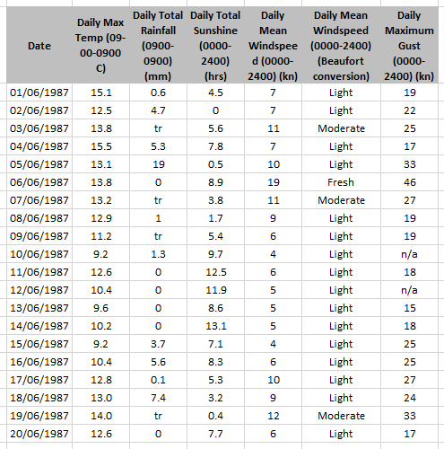
Example 1
Hurn
(a) Describe the type of data represented by daily total rainfall.
Alison is investigating daily maximum gust. She wants to select a sample of size 5 from the first 20 days in Hurn in June 1987. She uses the first two digits of the date as a sampling frame and generates five random numbers between 1 and 20.
b) State the type of sample selected by Alison.
c) Explain why Alison’s process might not generate a sample of size 5.
a
Continuous quantitative data.
b
Simple random sample.
c
Some of the data values are not available (n/a).

Slide 20

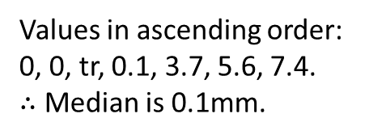
Example 2
Calculate:
The mean daily maximum temperature for the first five days of June in Hurn in 1987.
The median daily total rainfall for the week of 14th June to 20th June inclusive.
The median daily total rainfall for the same week in Perth was 19.00mm. Karl states that more southerly countries experience higher rainfall during June. State with a reason whether your answer to part (b) supports this statement.
Hurn
a
$$70÷5=14 °C$$
b
Values in ascending order:
0, 0, tr, 0.1, 3.7, 5.6, 7.4.
$∴$ Median is 0.1mm.
c
Perth is in Australia, which is south of the UK, and the median rainfall was higher. However, this is a very small sample from a single location in each country so does not provide enough evidence to support Karl’s statement.

Slide 21
A weather forecast in more detail
High pressure (winds circulate clockwise)
https://www.youtube.com/watch?v=PF2pRVGIbak
Low pressure (winds circulate anticlockwise)
https://www.youtube.com/watch?v=x8u4cNfU_aA

Slide 22
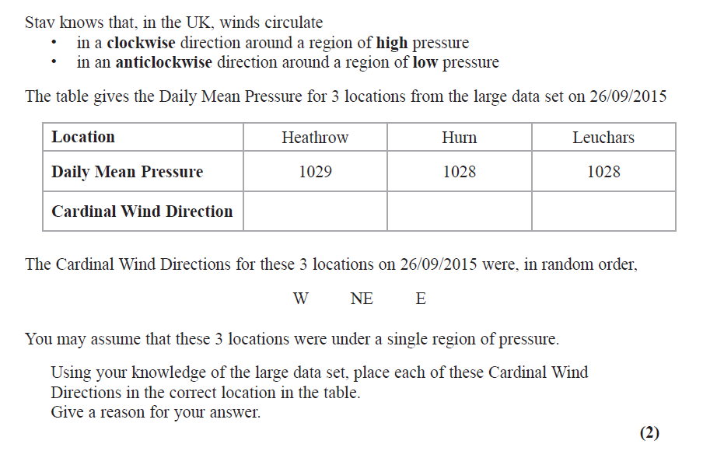
Example 3 (exam question)
NE
E
W
Pressure is normally around 1000 and so all three locations are indicating a high pressure which means a clockwise direction of winds.
Wind direction is the direction at which it blows from.

Slide 23
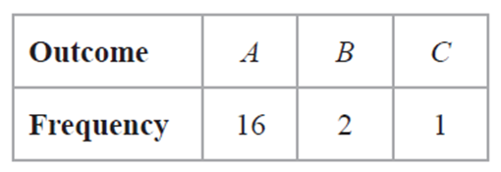
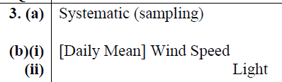

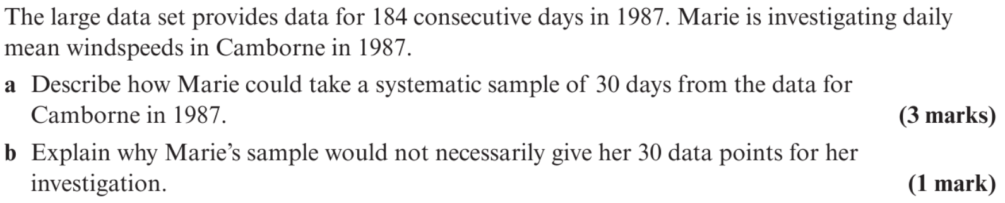
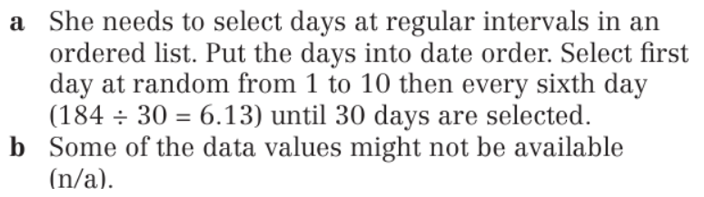
1
Helen is studying one of the qualitative variables from the large data set for Heathrow from 2015. She started with the data from 3rd May and then took every 10th reading. There were only 3 different outcomes with the following frequencies:
State the sampling technique Helen used.
From your knowledge of the large data set
  Suggest which variable was being studied,
  State the name of outcome A.
2
3

