Slide 1





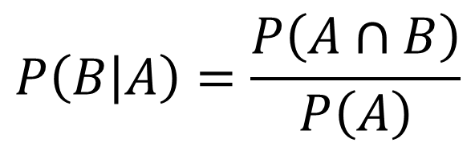




Conditional probability
Think about how we formed a probability tree at GCSE:
$$P\left(A∩B\right)=P\left(A\right)×P\left(B | A\right)$$
P$\left(B|A\right)$
$$B$$
$$P\left(A\right)$$
$$A$$
Read the ‘|’ symbol as “given that”.
i.e. “B occurred given that A occurred”.
$$B′$$
$$B$$
$$A′$$
$$B′$$
Alternatively (and more commonly):
Memory Tip: You’re dividing by the event you’re conditioning on.
$$P\left(B | A\right)=\frac{P\left(A∩B\right)}{P\left(A\right)}$$

Slide 2

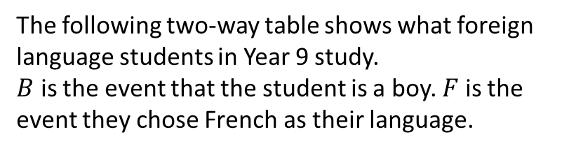
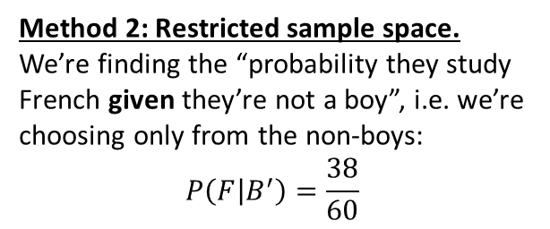
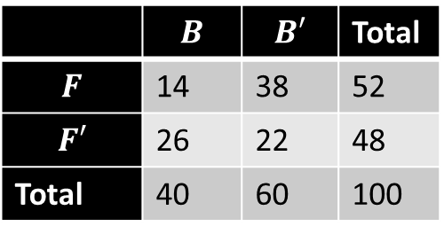
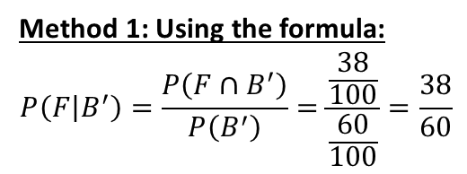
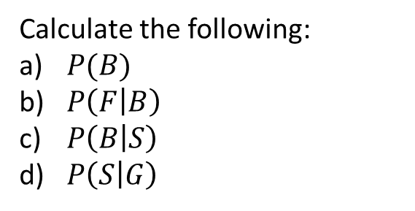

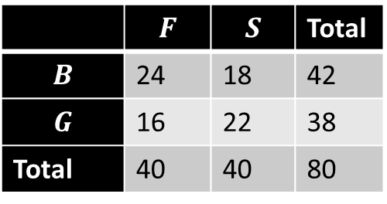

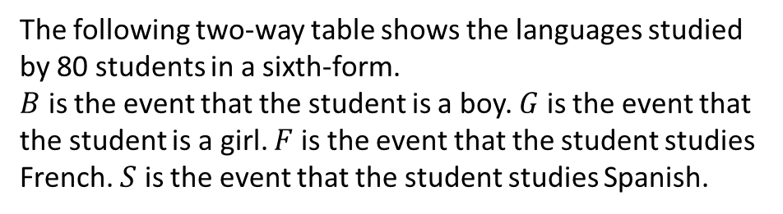
Example
Your turn
The following two-way table shows what foreign language students in Year 9 study.
$B$ is the event that the student is a boy. $F$ is the event they chose French as their language.
The following two-way table shows the languages studied by 80 students in a sixth-form.
$B$ is the event that the student is a boy. $G$ is the event that the student is a girl. $F$ is the event that the student studies French. $S$ is the event that the student studies Spanish.
 | $$B$$ | $$B′$$ | Total
$$F$$ | 14 | 38 | 52
$$F′$$ | 26 | 22 | 48
Total | 40 | 60 | 100
 | $$F$$ | $$S$$ | Total
$$B$$ | 24 | 18 | 42
$$G$$ | 16 | 22 | 38
Total | 40 | 40 | 80
a
Determine the probability of $P\left(F | B^{′}\right)$.
Method 1: Using the formula:
$$P\left(F | B^{′}\right)=\frac{P\left(F∩B^{′}\right)}{P\left(B^{′}\right)}=\frac{\frac{38}{100}}{\frac{60}{100}}=\frac{38}{60}$$
Calculate the following:
$P(B)$
$P\left(F | B\right)$
$P\left(B | S\right)$
$P\left(S | G\right)$
21/40
4/7
9/20
11/19
Method 2: Restricted sample space.
We’re finding the “probability they study French given they’re not a boy”, i.e. we’re choosing only from the non-boys:
$$P\left(F | B^{′}\right)=\frac{38}{60}$$
$\frac{26}{48}$
b
$$P\left(B | F^{′}\right)=$$

Slide 3
Mini whiteboards

Slide 4

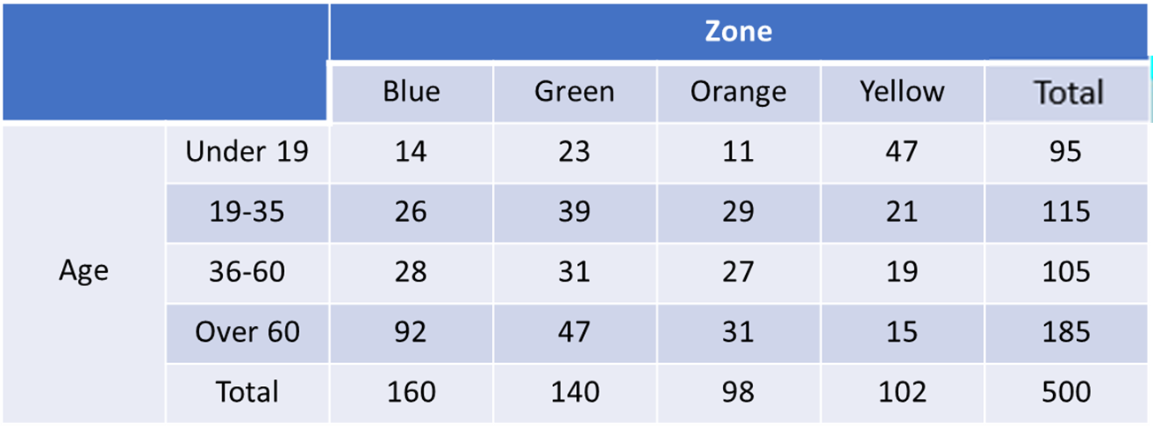
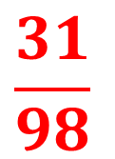
1
A random sample of 500 visitors to 4 zones of a museum were asked their age in years. The results are summarised in the table below.
Find the probability that a visitor chosen at random was over 60 given that they visited the orange zone.
$$\frac{31}{98}$$

Slide 5
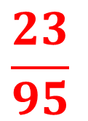
2
A random sample of 500 visitors to 4 zones of a museum were asked their age in years. The results are summarised in the table below.
Find the probability that a visitor chosen at random visited the green zone given that they were under 19.
$$\frac{23}{95}$$

Slide 6
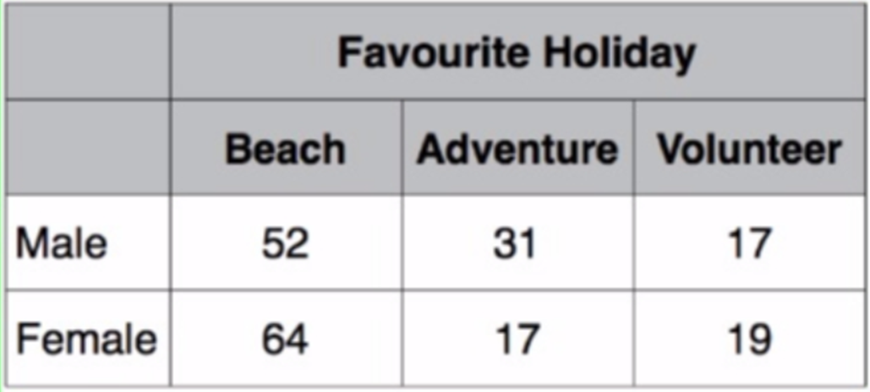




3
A survey of 200 people was conducted and broken down into male and female.
A person is chosen at random. Given that the person chose “Beach”, calculate the probability that they were male.
$$\frac{52}{100}$$
$$\frac{52}{200}$$
$$\frac{52}{116}$$
$$\frac{52}{64}$$

Slide 7
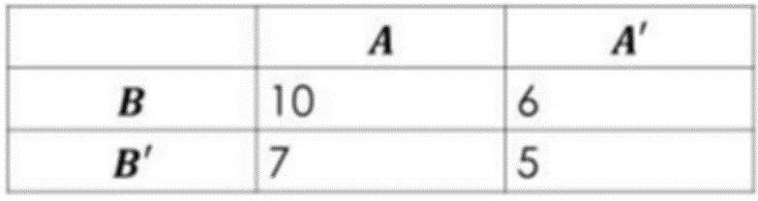




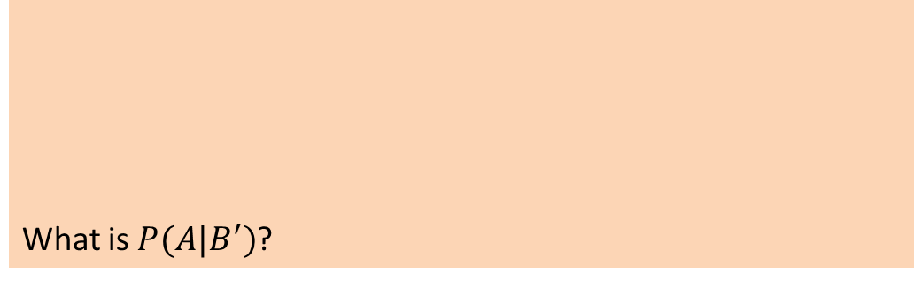
4
What is $P(A|B^{′})$?
$$\frac{7}{12}$$
$$\frac{17}{12}$$
$$\frac{7}{28}$$
$$7$$

Slide 8

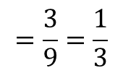



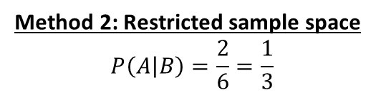


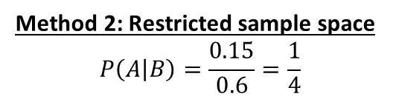

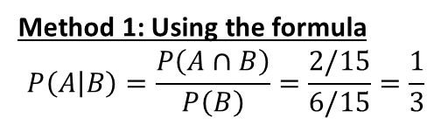



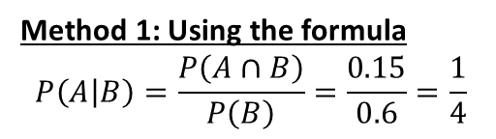



Example
Your turn
Using the Venn Diagram, determine:
Using the Venn Diagram, determine:
$$S$$
$$S$$
$$A$$
$$B$$
$$A$$
$$B$$
2
3
0.25
6
0.15
4
0.45
0.15
a
$P\left(A | B\right)$
$P\left(A | B\right)$
a
Method 1: Using the formula
$$P\left(A | B\right)=\frac{P\left(A∩B\right)}{P\left(B\right)}=\frac{2/15}{6/15}=\frac{1}{3}$$
Method 1: Using the formula
$$P\left(A | B\right)=\frac{P\left(A∩B\right)}{P\left(B\right)}=\frac{0.15}{0.6}=\frac{1}{4}$$
Method 2: Restricted sample space
$$P\left(A | B\right)=\frac{2}{6}=\frac{1}{3}$$
Method 2: Restricted sample space
$$P\left(A | B\right)=\frac{0.15}{0.6}=\frac{1}{4}$$
Berwick’s advice:
You should use method 2 when you have a picture of a Venn diagram for most questions.
$$=\frac{3}{9}=\frac{1}{3}$$
b
$$P\left(A′ | B′\right)$$
$$P\left(B′ | A\right)$$
$$=0.625$$
b
$$P\left(B | A∪B\right)$$
$=\frac{6}{12}=\frac{1}{2}$
$$=\frac{12}{17}$$
c
c
$$P\left(B | A∪B\right)$$

Slide 9
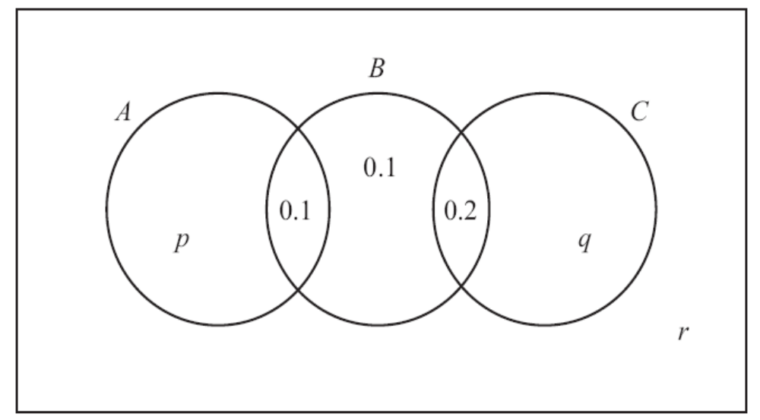
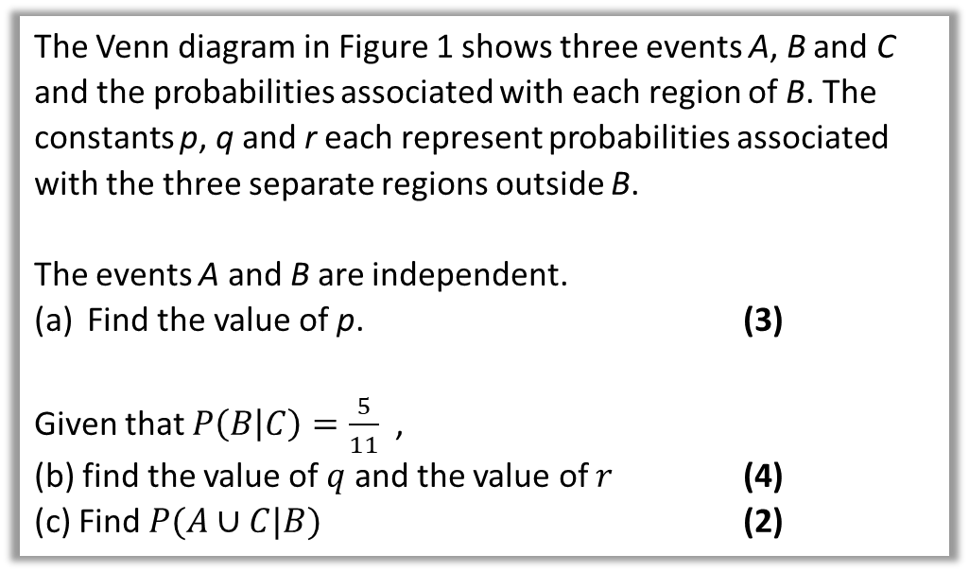
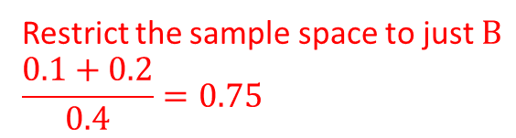
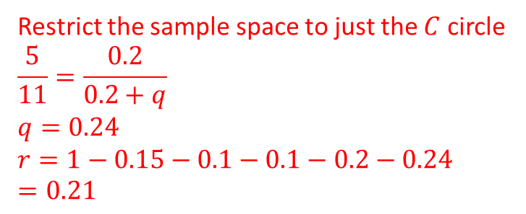
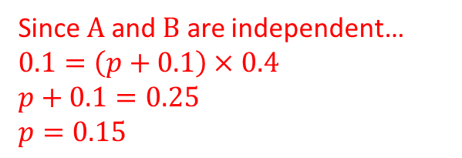
Example
The Venn diagram in Figure 1 shows three events A, B and C and the probabilities associated with each region of B. The constants p, q and r each represent probabilities associated with the three separate regions outside B.
The events A and B are independent.
Find the value of p. (3)
Given that $P\left(B | C\right)=\frac{5}{11}$ ,
(b) find the value of $q$ and the value of $r$ (4)
(c) Find $P(A∪C|B)$ (2)
Since $A$ and $B$ are independent…
$0.1=\left(p+0.1\right)×0.4$
$p+0.1=0.25$
$p=0.15$
Restrict the sample space to just the $C$ circle
$$\frac{5}{11}=\frac{0.2}{0.2+q}$$
$$q=0.24$$
$$r=1−0.15−0.1−0.1−0.2−0.24$$
$$=0.21$$
c
Restrict the sample space to just $B$
$$\frac{0.1+0.2}{0.4}=0.75$$
a
b

Slide 10
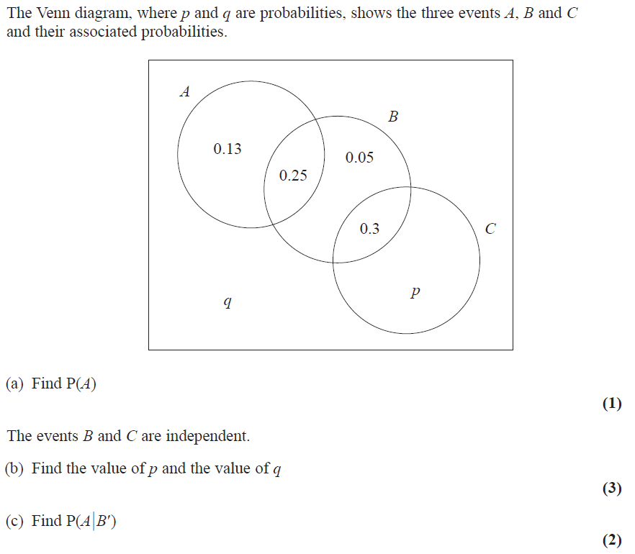
Your turn
Notes:
2023 paper

Slide 11
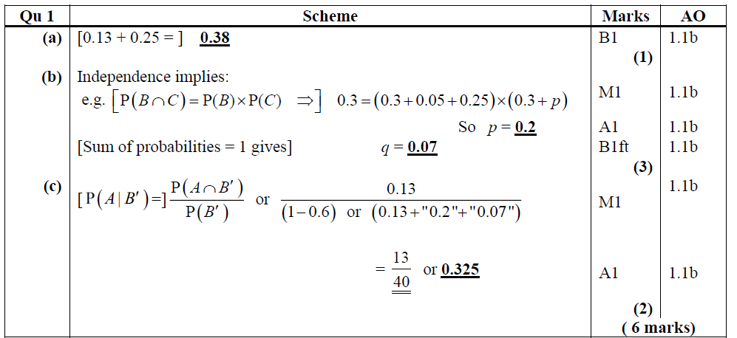
Mark scheme

Slide 12
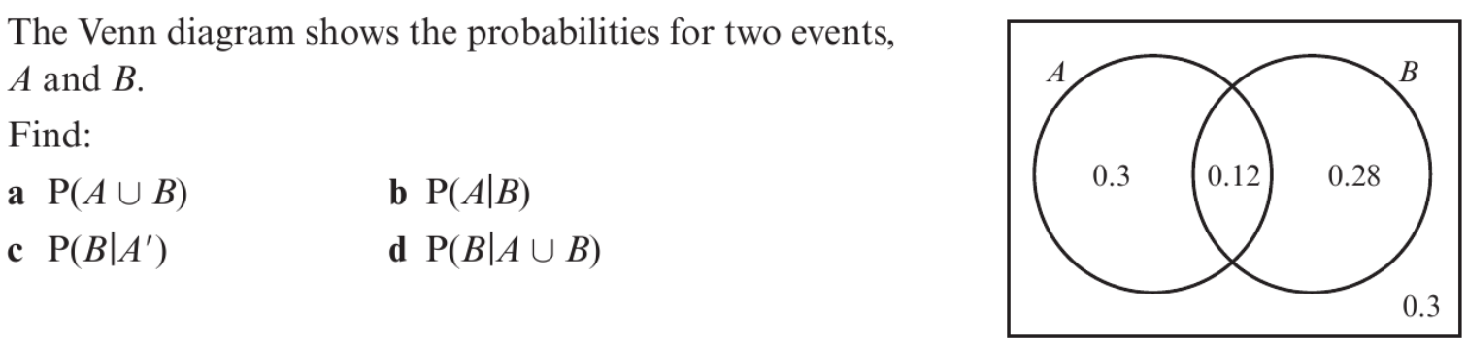

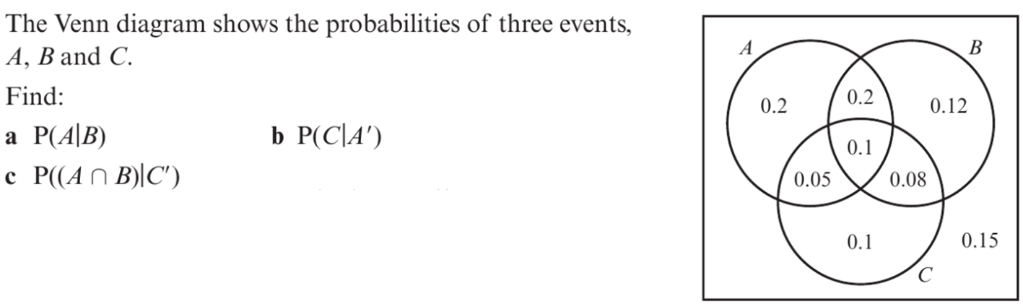
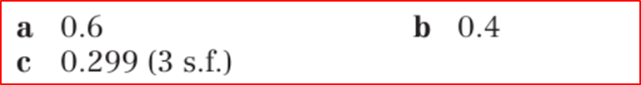
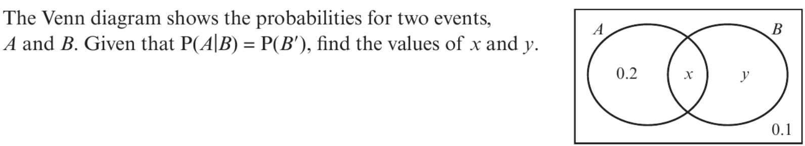

1
2
3

