Slide 1
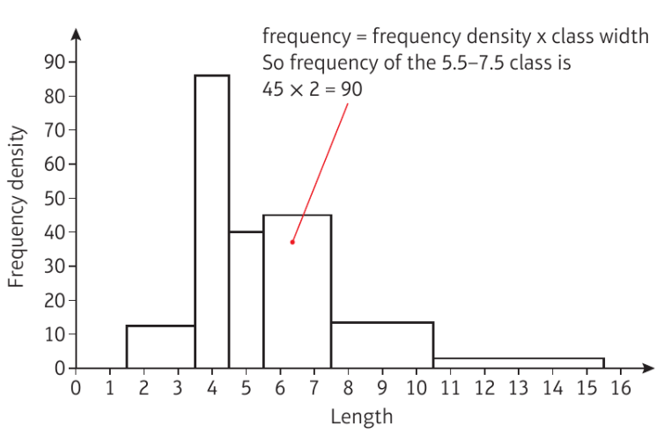
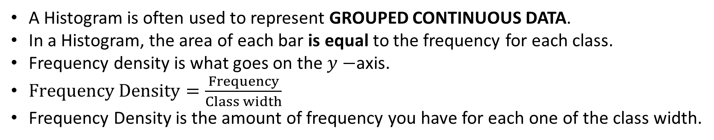
Histograms
A Histogram is often used to represent GROUPED CONTINUOUS DATA.
In a Histogram, the area of each bar is equal to the frequency for each class.
Frequency density is what goes on the $y−$axis.
$Frequency Density=\frac{Frequency}{Class width}$
Frequency Density is the amount of frequency you have for each one of the class width.

Slide 2
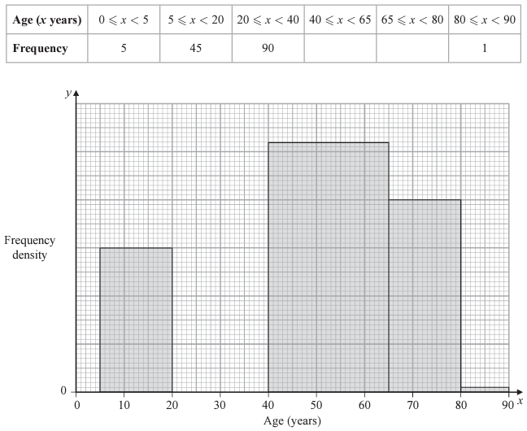
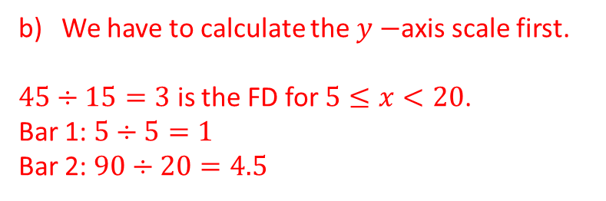
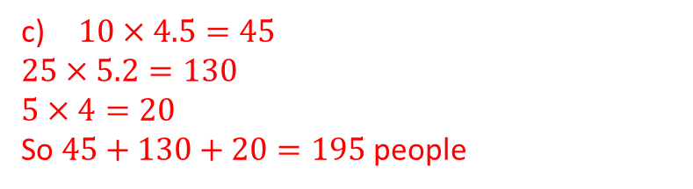
Example 1
The partially completed table and partially completed histogram give information about the ages of passengers on an airline.
There were no passengers aged 90 or over.
Age is continuous and the data is in groups so a Histogram is appropriate.
We have to calculate the $y−$axis scale first.
$45÷15=3$ is the FD for $5≤x<20$.
Bar 1: $5÷5=1$
Bar 2: $90÷20=4.5$
130
60
6
5
$10×4.5=45$
$25×5.2=130$
$5×4=20$
So $45+130+20=195$ people
4
3
2
1
Give a reason to support the use of a Histogram to represent this data.
Complete the histogram for this data and the table.
Estimate how many passengers are between 30 and 70 years old.

Slide 3
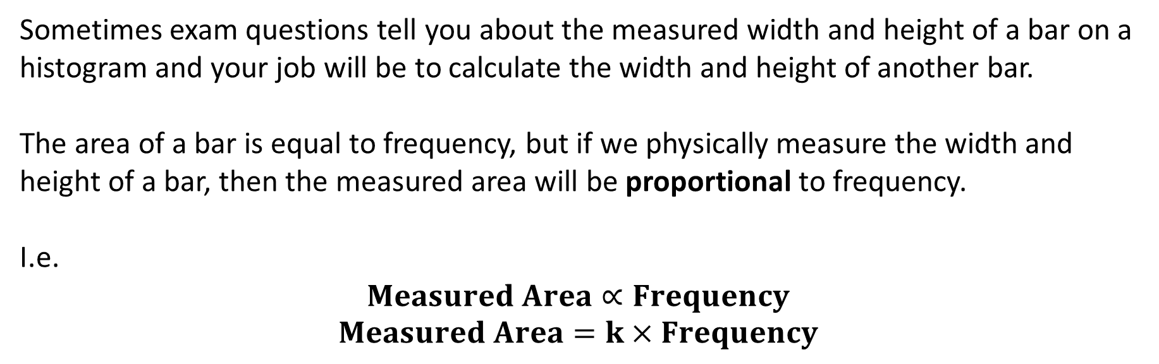
More on histograms
Sometimes exam questions tell you about the measured width and height of a bar on a histogram and your job will be to calculate the width and height of another bar.
The area of a bar is equal to frequency, but if we physically measure the width and height of a bar, then the measured area will be proportional to frequency.
I.e.
$$Measured Area∝Frequency$$
$$Measured Area=k×Frequency$$

Slide 4
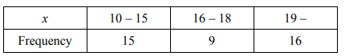
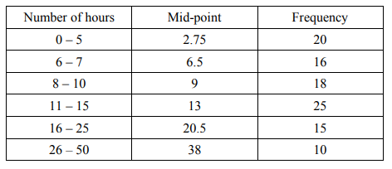

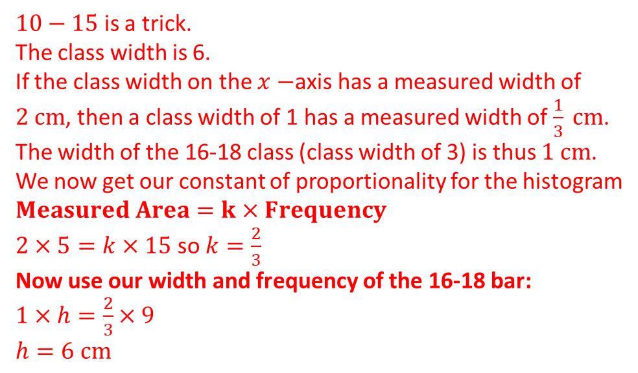
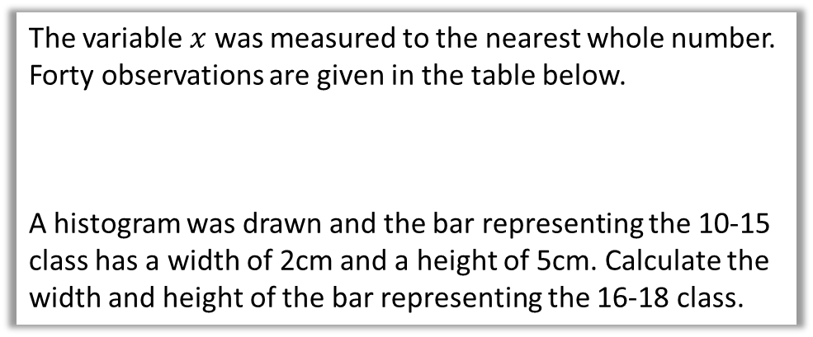
Example 2
Your turn
The variable $x$ was measured to the nearest whole number. Forty observations are given in the table below.
A histogram was drawn and the bar representing the 10-15 class has a width of 2cm and a height of 5cm. Calculate the width and height of the bar representing the 16-18 class.
In a shopping survey a random sample of 104 teenagers were asked how many hours, to the nearest hour, they spent shopping in the last month. The results are summarised in the table below.
A histogram was drawn and the group (8-10) hours was represented by a rectangle that was 1.5cm wide and 3cm high. Calculate the width and height of the rectangle representing the group 16-25.
$10−15$ is a trick.
The class width is 6.
If the class width on the $x−$axis has a measured width of $2 cm$, then a class width of 1 has a measured width of $\frac{1}{3} cm$.
The width of the 16-18 class (class width of 3) is thus $1 cm$.
We now get our constant of proportionality for the histogram
$Measured Area=k×Frequency$
$2×5=k×15$ so $k=\frac{2}{3}$
Now use our width and frequency of the 16-18 bar:
$1×h=\frac{2}{3}×9$
$h=6 cm$

Slide 5



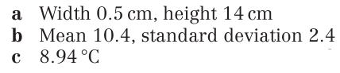
Questions
Do the questions off of the sheet that I have given you. Some of the questions in the textbook have changed.
1
2
3
4

