Slide 1
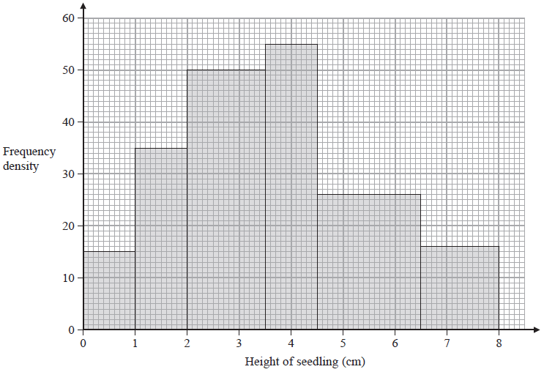
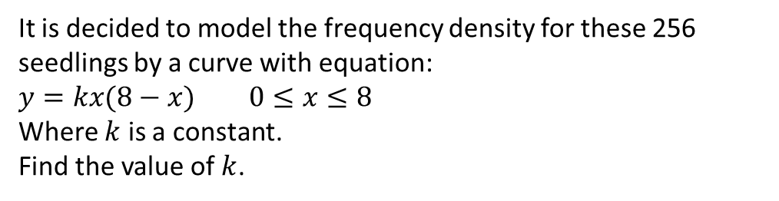
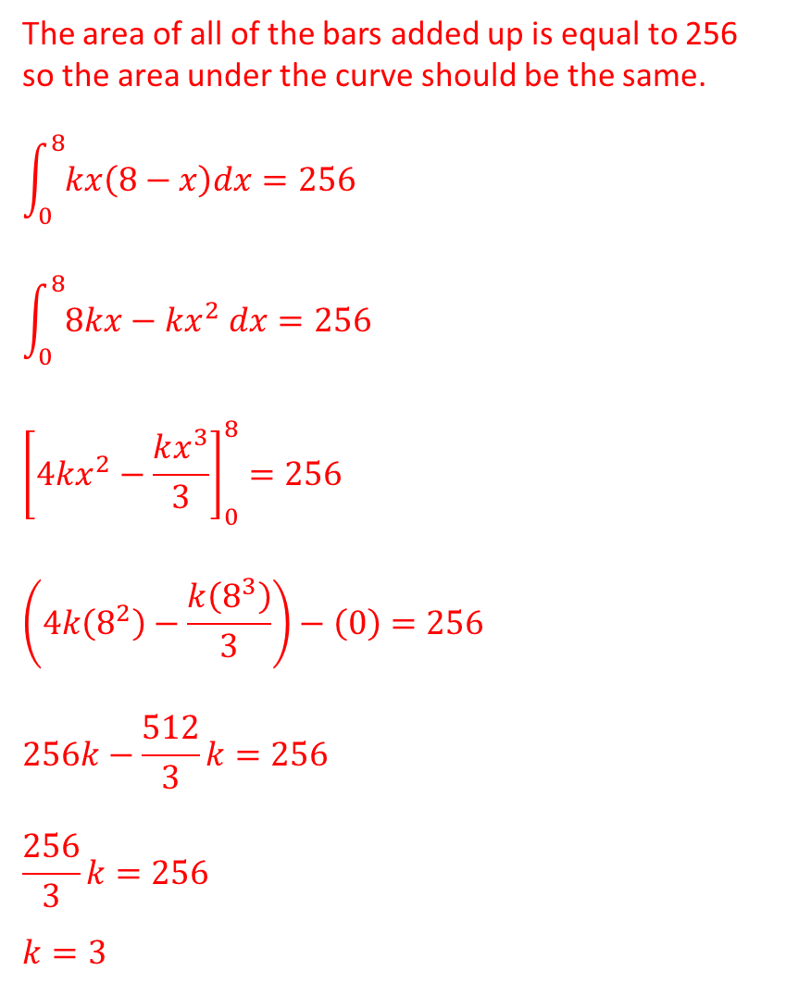
Example
The area of all of the bars added up is equal to 256 so the area under the curve should be the same.
$$\int_{0}^{8}{kx\left(8−x\right)dx=256}$$
$$\int_{0}^{8}{8kx−kx^{2} dx=256}$$
$${\left[4kx^{2}−\frac{kx^{3}}{3}\right]}_{0}^{8}=256$$
$$\left(4k\left(8^{2}\right)−\frac{k\left(8^{3}\right)}{3}\right)−\left(0\right)=256$$
$$256k−\frac{512}{3}k=256$$
$$\frac{256}{3}k=256$$
$$k=3$$
The histogram summaries the heights of 256 seedlings two weeks after they were planted.
It is decided to model the frequency density for these 256 seedlings by a curve with equation:
$y=kx(8−x)$ $0≤x≤8$
Where $k$ is a constant.
Find the value of $k$.

Slide 2
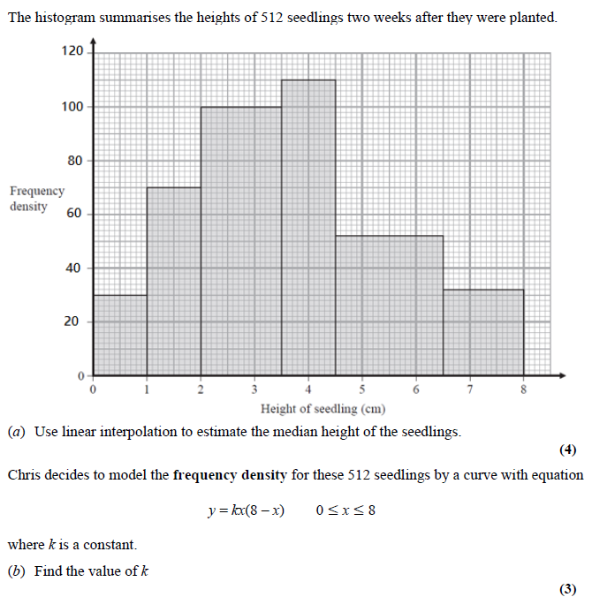
Questions

Slide 3
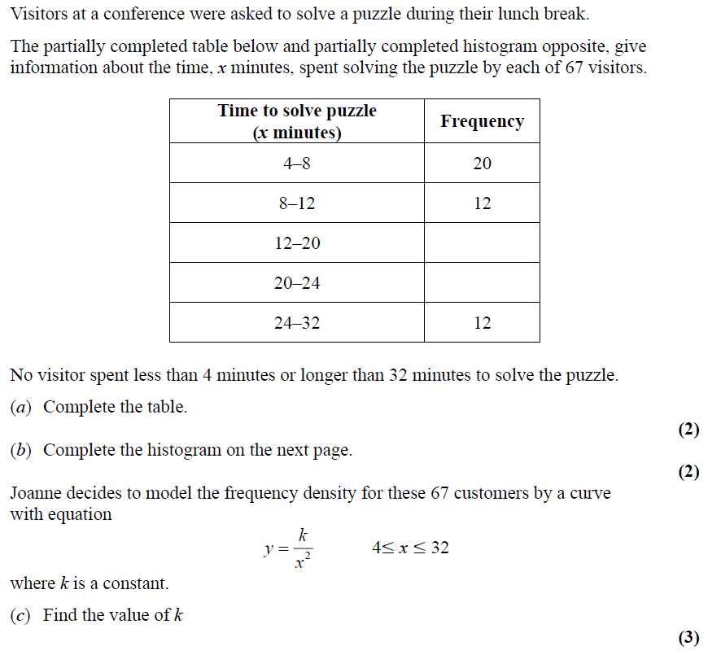
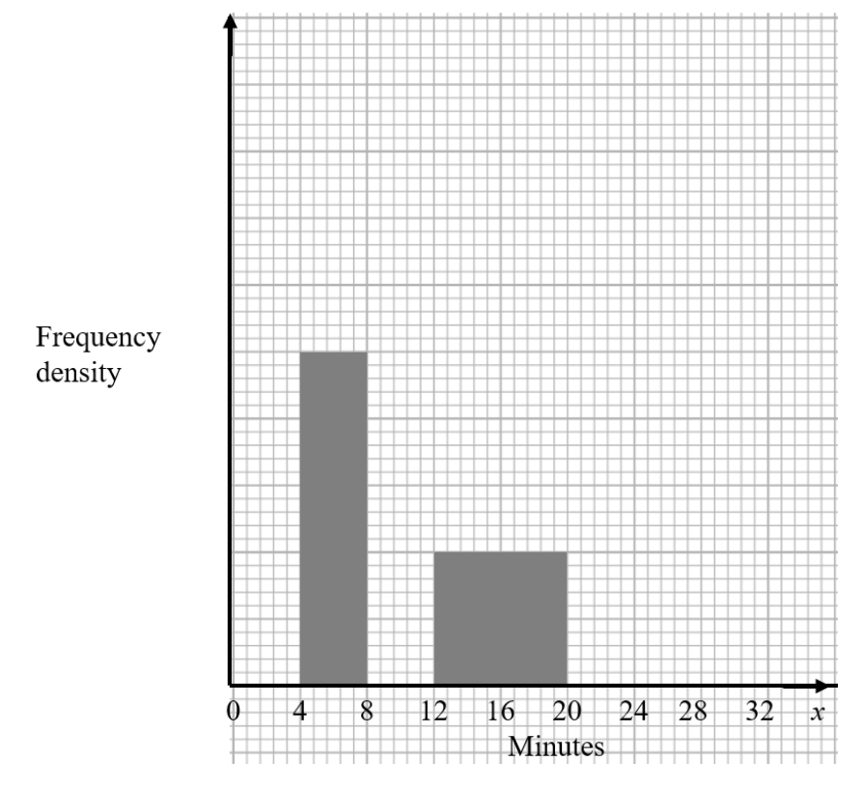
Questions

Slide 4
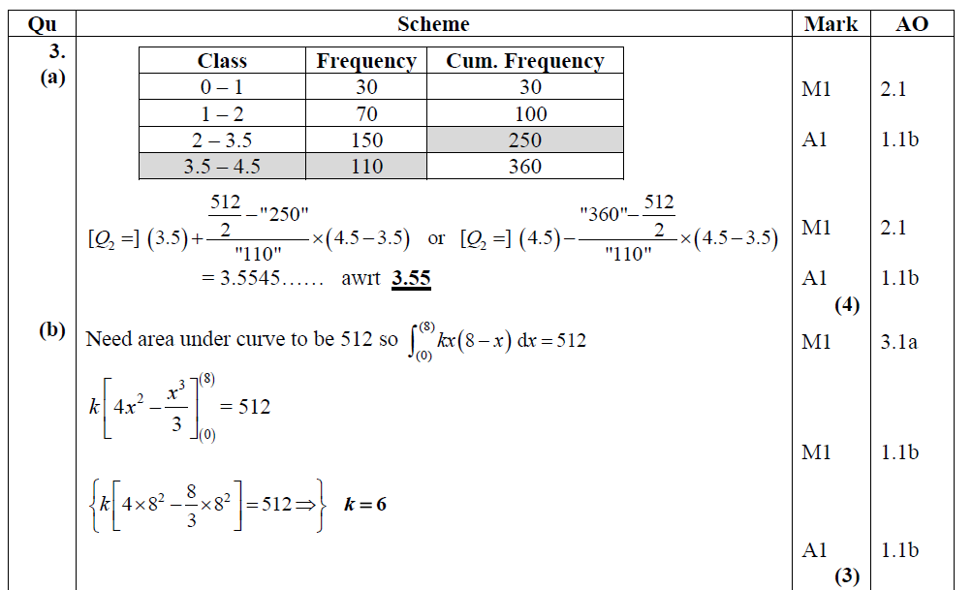
Answers

Slide 5
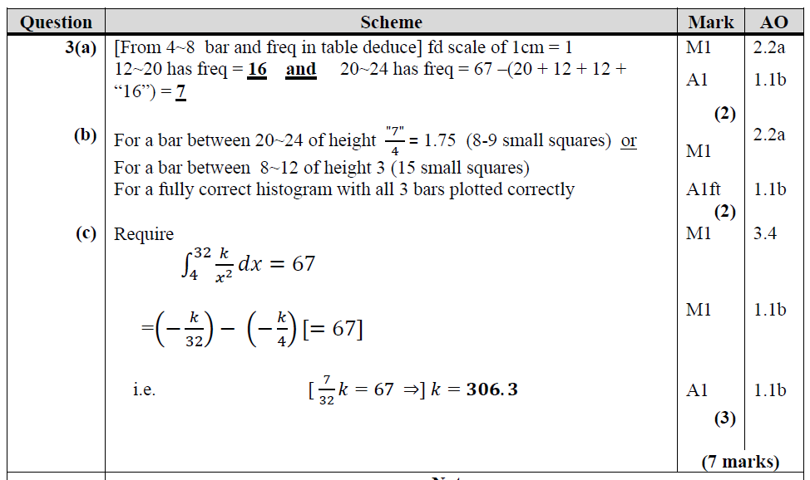
Answers

