Slide 1
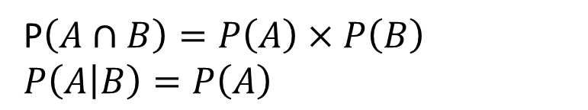
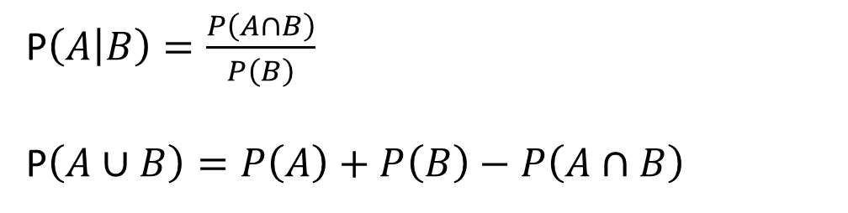
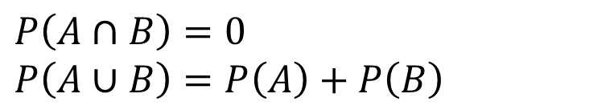
Laws of probability
If events $A$ and $B$ are independent:
P$\left(A∩B\right)=P\left(A\right)×P\left(B\right)$
$P\left(A | B\right)=P\left(A\right)$
If events $A$ and $B$ are mutually exclusive:
$P\left(A∩B\right)=0$
$P\left(A∪B\right)=P\left(A\right)+P\left(B\right)$
In general:
P$\left(A | B\right)=\frac{P\left(A∩B\right)}{P\left(B\right)}$
P$\left(A∪B\right)=P\left(A\right)+P\left(B\right)−P\left(A∩B\right)$

Slide 2
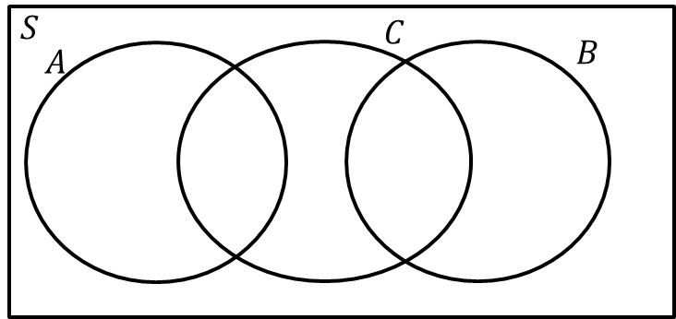
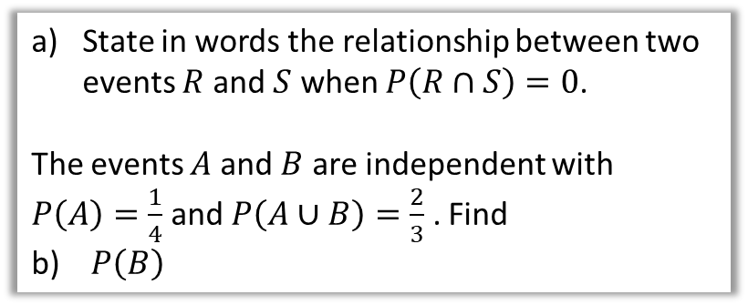
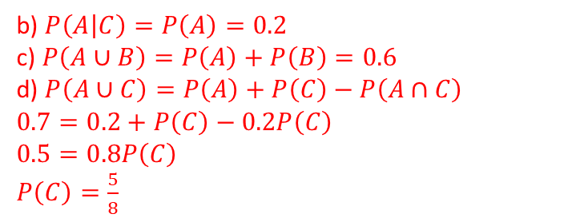
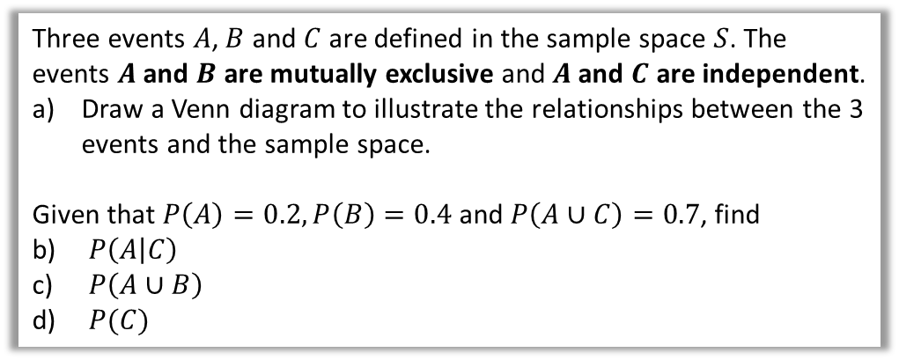
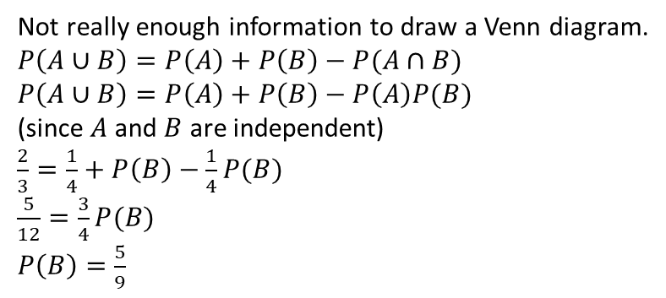

Example 1
Your turn
State in words the relationship between two events $R$ and $S$ when $P\left(R∩S\right)=0$.
The events $A$ and $B$ are independent with $P\left(A\right)=\frac{1}{4}$ and $P\left(A∪B\right)=\frac{2}{3}$ . Find
$P\left(B\right)$
Three events $A$, $B$ and $C$ are defined in the sample space $S$. The events $A$ and $B$ are mutually exclusive and $A$ and $C$ are independent.
Draw a Venn diagram to illustrate the relationships between the 3 events and the sample space.
Given that $P\left(A\right)=0.2, P\left(B\right)=0.4$ and $P\left(A∪C\right)=0.7$, find
$P\left(A | C\right)$
$P\left(A∪B\right)$
$P(C)$
a
$R$ and $S$ are mutually exclusive.
b
Not really enough information to draw a Venn diagram.
$P\left(A∪B\right)=P\left(A\right)+P\left(B\right)−P(A∩B)$
$P\left(A∪B\right)=P\left(A\right)+P\left(B\right)−P\left(A\right)P(B)$
(since $A$ and $B$ are independent)
$\frac{2}{3}=\frac{1}{4}+P\left(B\right)−\frac{1}{4}P(B)$
$\frac{5}{12}=\frac{3}{4}P(B)$
$P\left(B\right)=\frac{5}{9}$
a)
b) $P\left(A | C\right)=P\left(A\right)=0.2$
c) $P\left(A∪B\right)=P\left(A\right)+P\left(B\right)=0.6$
d) $P\left(A∪C\right)=P\left(A\right)+P\left(C\right)−P\left(A∩C\right)$
$0.7=0.2+P\left(C\right)−0.2P\left(C\right)$
$0.5=0.8P\left(C\right)$
$P\left(C\right)=\frac{5}{8}$

Slide 3
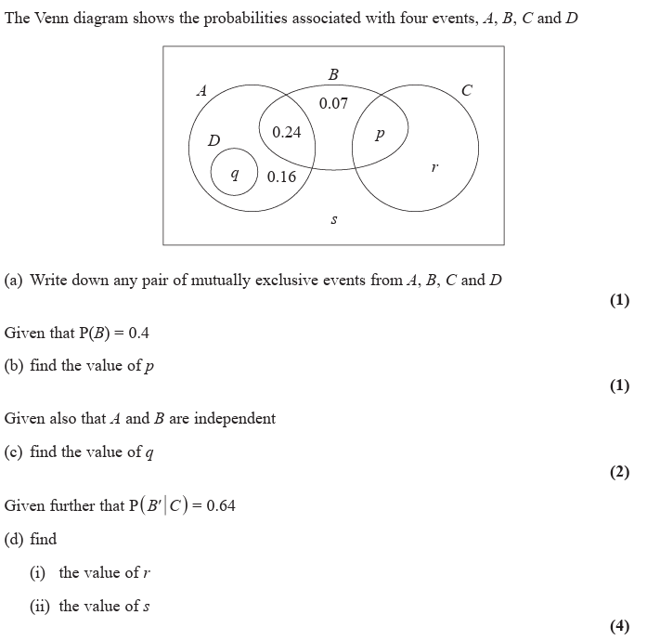
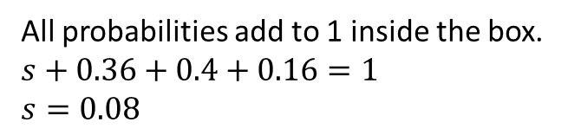
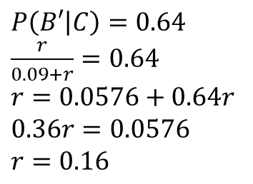
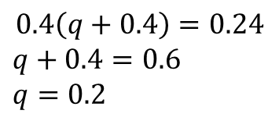
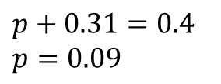

Example 2
$A$ and $C$
a
b
$p+0.31=0.4$
$p=0.09$
c
$$0.4\left(q+0.4\right)=0.24$$
$q+0.4=0.6$
$q=0.2$
di
$P\left(B′ | C\right)=0.64$
$\frac{r}{0.09+r}=0.64$
$r=0.0576+0.64r$
$0.36r=0.0576$
$r=0.16$
dii
All probabilities add to 1 inside the box.
$s+0.36+0.4+0.16=1$
$s=0.08$
Notes:
2020

Slide 4
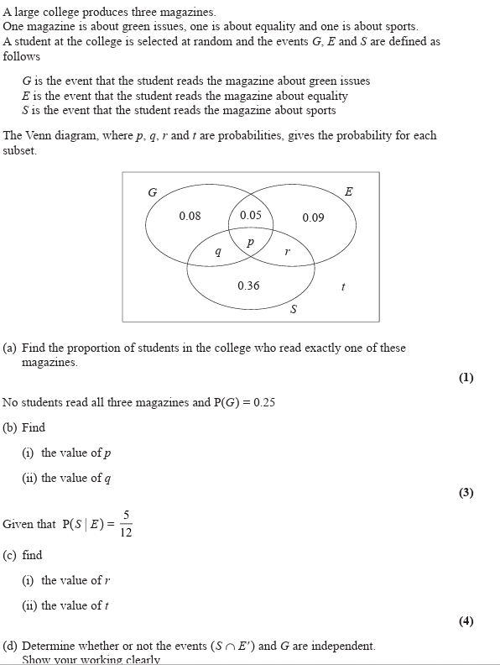
EQ1
Notes:
2021

Slide 5
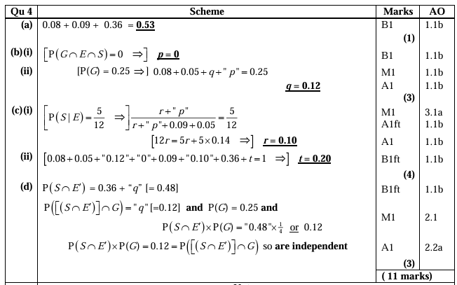

Slide 6
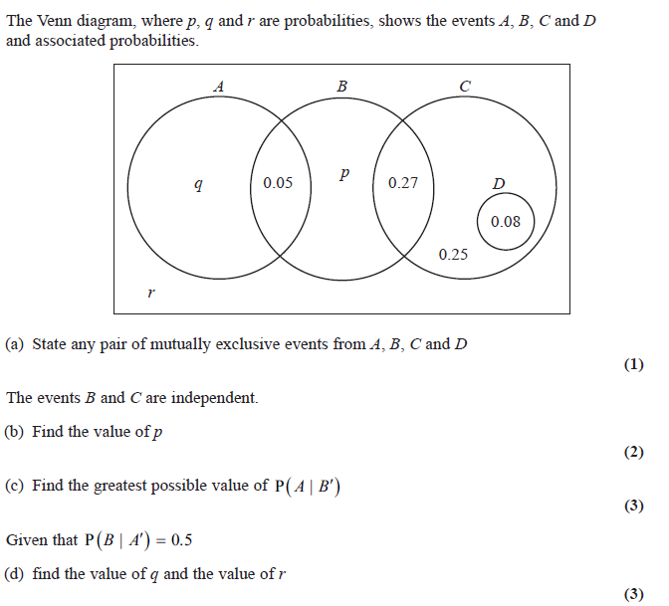
EQ2
Notes:
2024

Slide 7
