Slide 1

Starter:
Complete in Silence Please

Slide 3



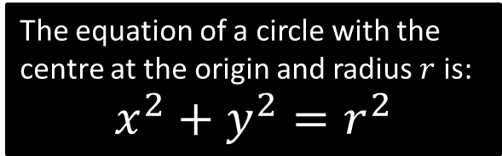






Equation of a circle centred at the origin
$$y$$
How could we show how $r$, $x$ and $y$ are related?
$$r$$
$$\left(x,y\right)$$
We draw a right-angled triangle inside the circle with one vertex at the origin and another at the circumference
$$r$$
$$y$$
$$r$$
$$x$$
$$x$$
The equation of a circle with the centre at the origin and radius $r$ is:
$$x^{2}+y^{2}=r^{2}$$

Slide 4
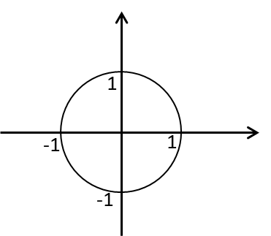
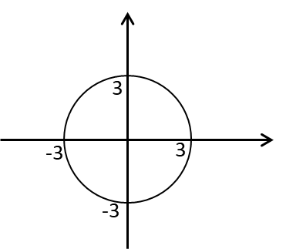
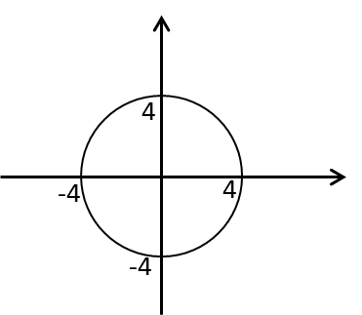
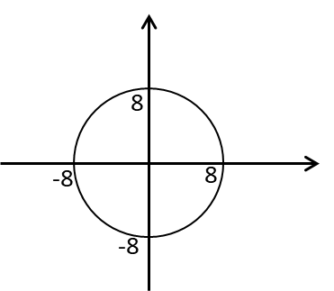
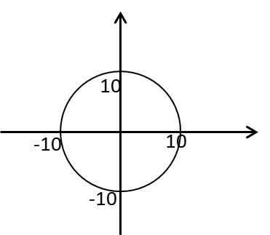





Circle check
$$x2 + y2 = 1$$
$$x2 + y2 = 9$$
$$x2 + y2 = 16$$
$$x2 + y2 = 64$$
$$x2 + y2 = 100$$

Slide 5
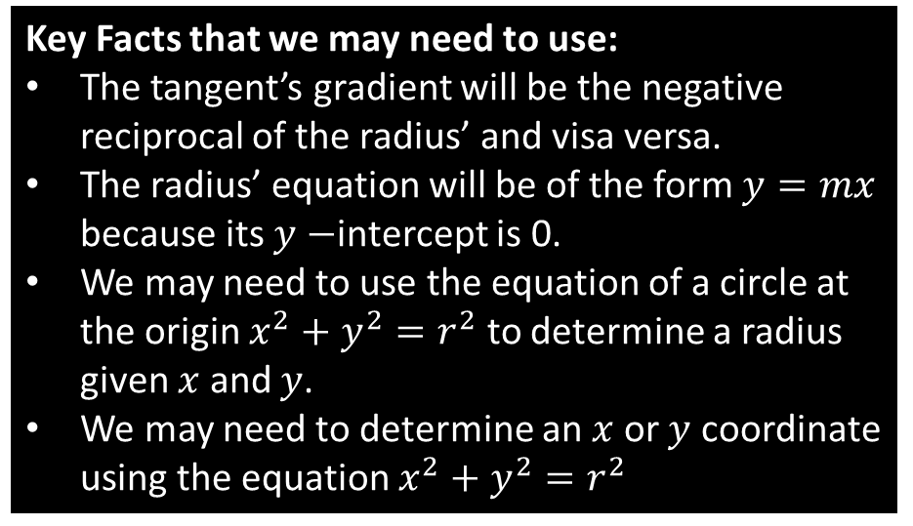






Tangents and Radii
Key Facts that we may need to use:
The tangent’s gradient will be the negative reciprocal of the radius’ and visa versa.
The radius’ equation will be of the form $y=mx$ because its $y−$intercept is 0.
We may need to use the equation of a circle at the origin $x^{2}+y^{2}=r^{2}$ to determine a radius given $x$ and $y$.
We may need to determine an $x$ or $y$ coordinate using the equation $x^{2}+y^{2}=r^{2}$
$$r$$
$$P\left(x,y\right)$$
$$x$$
$$−r$$
$$r$$
$$−r$$

Slide 6
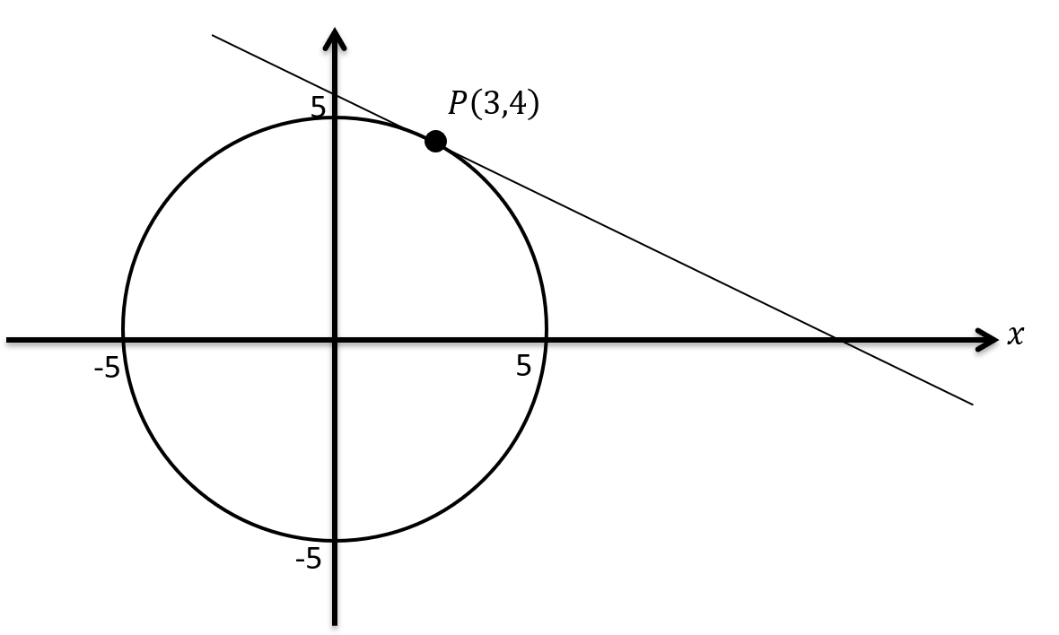

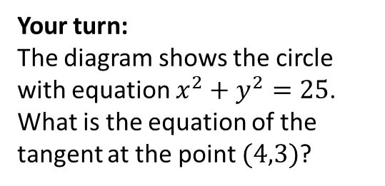

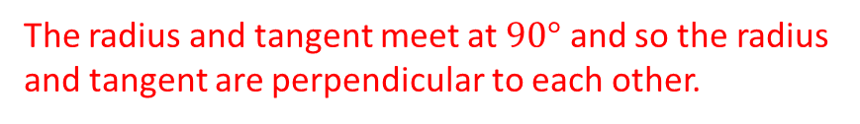
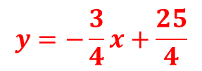

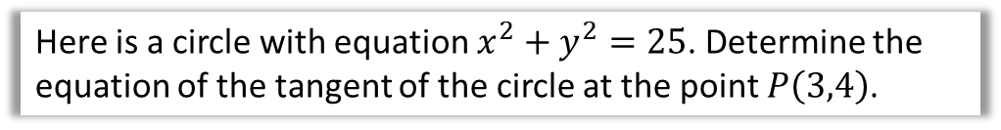



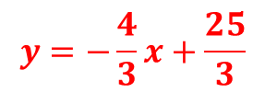
Example 1
Here is a circle with equation $x^{2}+y^{2}=25$. Determine the equation of the tangent of the circle at the point $P\left(3,4\right)$.
The radius is always perpendicular to the tangent line. ALWAYS draw in the radius!
The radius and tangent meet at $90°$ and so the radius and tangent are perpendicular to each other.
We find the gradient of the radius first.
Two points on the radius are (0,0) and (3,4) so the gradient is 4/3.
The tangent’s gradient is therefore -3/4.
$y=−\frac{3}{4}x+c$ and it goes through (3,4)
$4=−\frac{3}{4}×3+c$
5
$4=−\frac{9}{4}+c$
Your turn:
The diagram shows the circle with equation $x^{2}+y^{2}=25$. What is the equation of the tangent at the point $(4,3)$?
$$\left(4,3\right)$$
$c=4+\frac{9}{4}=\frac{25}{4}$
5
$$x$$
$$y=−\frac{3}{4}x+\frac{25}{4}$$
-5
$$y=−\frac{4}{3}x+\frac{25}{3}$$
-5

Slide 7
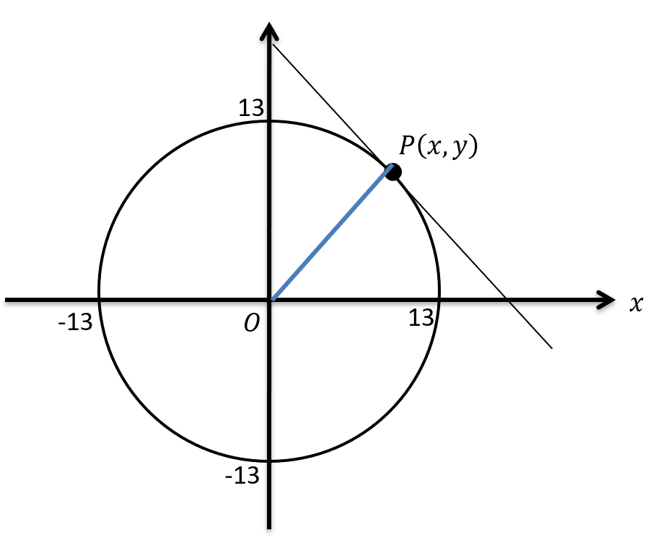
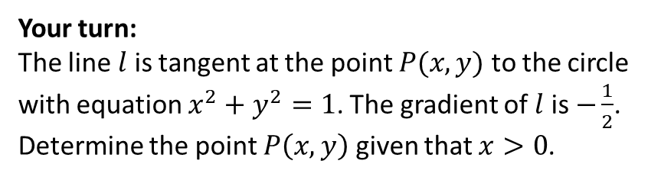
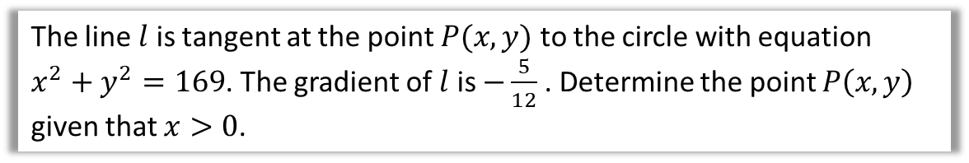
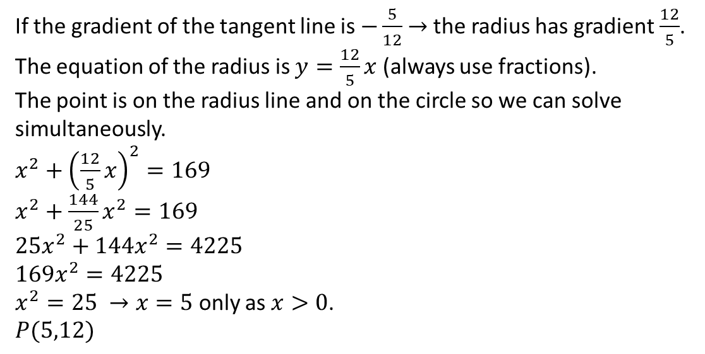
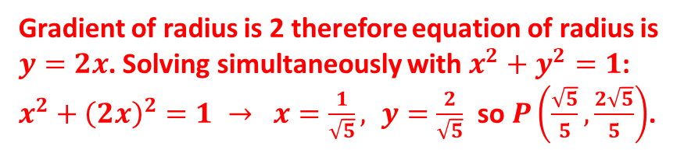
Example 2
Berwick’s advice:
Draw a diagram with a circle question if there isn’t one to see what is happening.
The line $l$ is tangent at the point $P(x,y)$ to the circle with equation $x^{2}+y^{2}=169$. The gradient of $l$ is $−\frac{5}{12}$ . Determine the point $P\left(x,y\right)$ given that $x>0$.
If the gradient of the tangent line is $−\frac{5}{12}$ $→$ the radius has gradient $\frac{12}{5}$.
The equation of the radius is $y=\frac{12}{5}x$ (always use fractions).
The point is on the radius line and on the circle so we can solve simultaneously.
$x^{2}+{\left(\frac{12}{5}x\right)}^{2}=169$
$x^{2}+\frac{144}{25}x^{2}=169$
$25x^{2}+144x^{2}=4225$
$169x^{2}=4225$
$x^{2}=25 →x=5$ only as $x>0$.
$P(5,12)$
Your turn:
The line $l$ is tangent at the point $P(x,y)$ to the circle with equation $x^{2}+y^{2}=1$. The gradient of $l$ is $−\frac{1}{2}$. Determine the point $P\left(x,y\right)$ given that $x>0$.
Gradient of radius is 2 therefore equation of radius is $y=2x$. Solving simultaneously with $x^{2}+y^{2}=1$:
$x^{2}+{\left(2x\right)}^{2}=1 → x=\frac{1}{\sqrt{5}}, y=\frac{2}{\sqrt{5}}$ so $P\left(\frac{\sqrt{5}}{5},\frac{2\sqrt{5}}{5}\right)$.

Slide 8
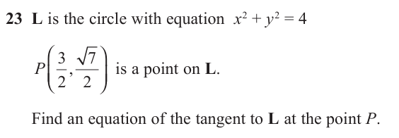
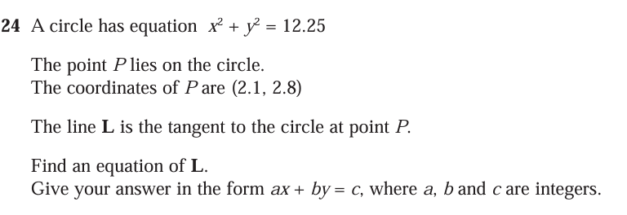
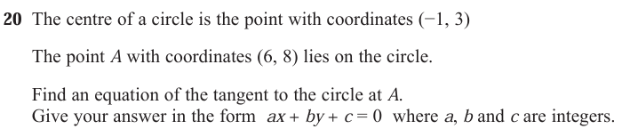
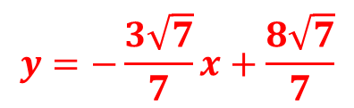


Questions
1
$$y=−\frac{3\sqrt{7}}{7}x+\frac{8\sqrt{7}}{7}$$
2
$$6x+8y=35$$
3
$$5x+7y−82=0$$

Slide 9
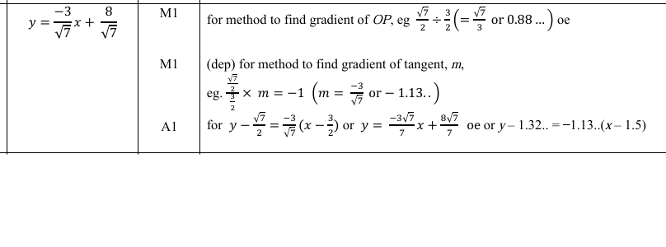
Notes:
June 2017 2H

Slide 10
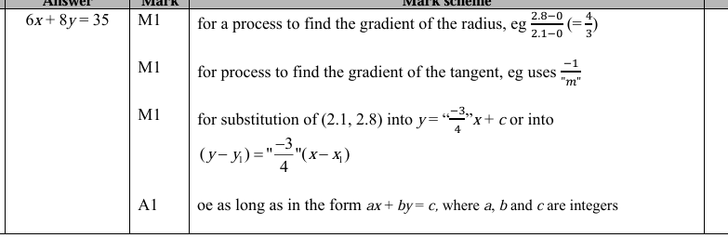
Notes:
Nov 2022 2H

