Slide 1

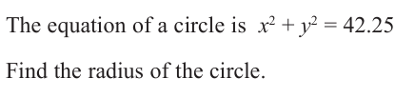
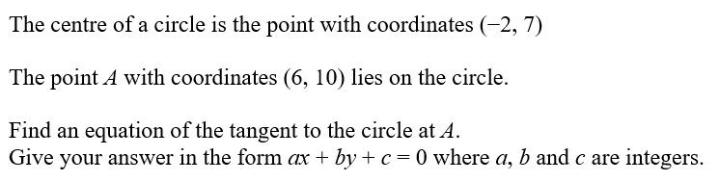


Starter:
1
$$6.5$$
2
Draw a rough sketch to see what is going on.
Complete in Silence Please

Slide 2
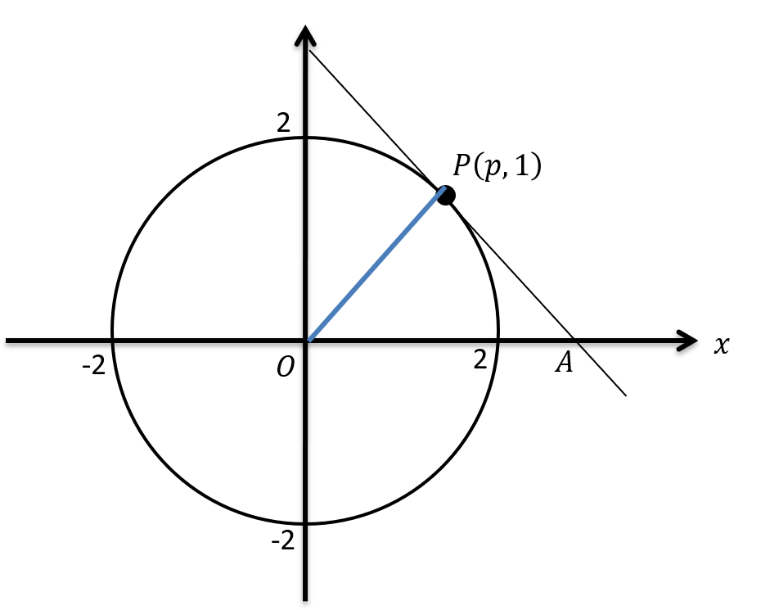




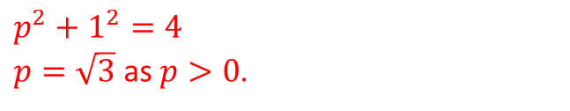
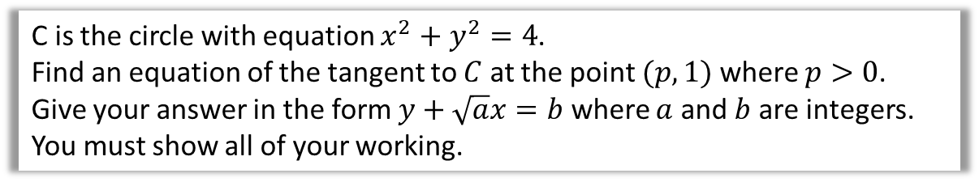

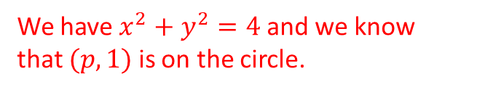

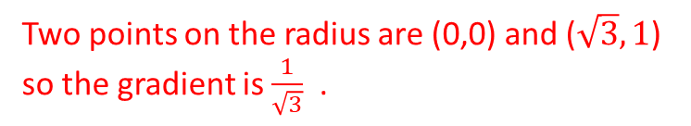

Example 1
C is the circle with equation $x^{2}+y^{2}=4$.
Find an equation of the tangent to $C$ at the point $(p,1)$ where $p>0$.
Give your answer in the form $y+\sqrt{a}x=b$ where $a$ and $b$ are integers.
You must show all of your working.
To find an equation of a tangent, then we need a point to work with.
We have $x^{2}+y^{2}=4$ and we know that $(p,1)$ is on the circle.
Berwick’s advice:
Draw a diagram with a circle question if there isn’t one to see what is happening.
$p^{2}+1^{2}=4$
$p=\sqrt{3}$ as $p>0$.
We find the gradient of the radius first.
Two points on the radius are (0,0) and ($\sqrt{3}, 1$) so the gradient is $\frac{1}{\sqrt{3}}$.
The tangent’s gradient is therefore $−\sqrt{3}$.
$y=−\sqrt{3}x+c$ and it goes through ($\sqrt{3}, 1$)
$1=−\sqrt{3}×\sqrt{3}+c$
$1=−3+c$
$$c=4$$
$$y=−\sqrt{3}x+4$$
$$y+\sqrt{3}x=4$$

Slide 3
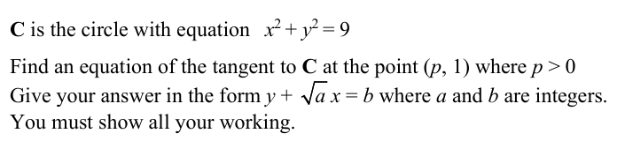

Your turn

Slide 4
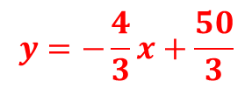

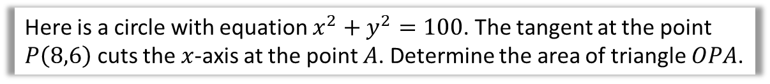
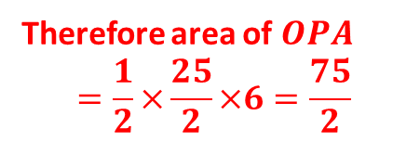








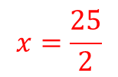
Example 2
Here is a circle with equation $x^{2}+y^{2}=100$. The tangent at the point $P\left(8,6\right)$ cuts the $x$-axis at the point $A$. Determine the area of triangle $OPA$.
We find the gradient of the radius first.
Two points on the radius are (0,0) and (8,6) so the gradient is 3/4.
10
$$P\left(8,6\right)$$
The tangent’s gradient is therefore -4/3.
$y=−\frac{4}{3}x+c$ and it goes through (8,6)
$6=−\frac{4}{3}×8+c$
10
$$x$$
$6=−\frac{32}{3}+c$
-10
$$O$$
$$A$$
$c=6+\frac{32}{3}=\frac{50}{3}$
$$y=−\frac{4}{3}x+\frac{50}{3}$$
-10
Point A is when $y=0$, so $0=−\frac{4}{3}x+\frac{50}{3}$
Therefore area of $OPA$
$$=\frac{1}{2}×\frac{25}{2}×6=\frac{75}{2}$$
$$x=\frac{25}{2}$$

Slide 5
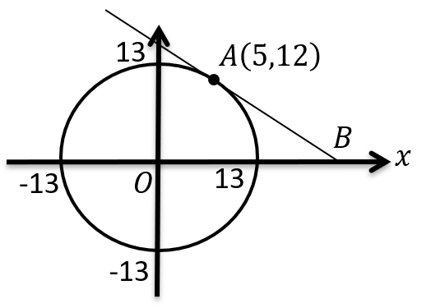
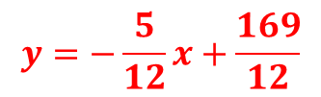
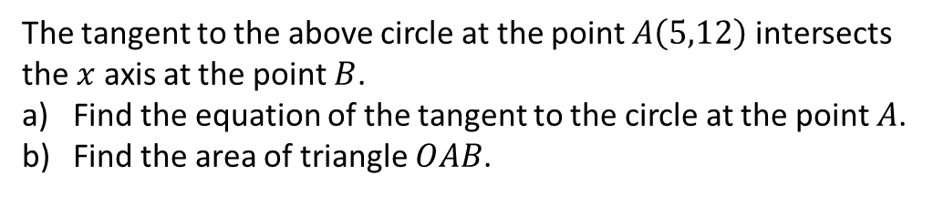
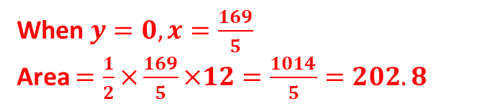
Your turn
The tangent to the above circle at the point $A\left(5,12\right)$ intersects the $x$ axis at the point $B$.
Find the equation of the tangent to the circle at the point $A$.
Find the area of triangle $OAB$.
$$y=−\frac{5}{12}x+\frac{169}{12}$$
When $y=0, x=\frac{169}{5}$
Area $=\frac{1}{2}×\frac{169}{5}×12=\frac{1014}{5}=202.8$

Slide 6
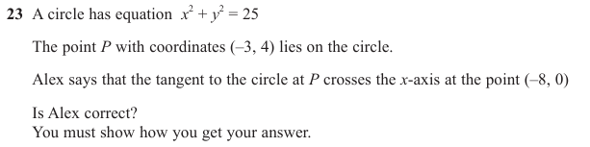
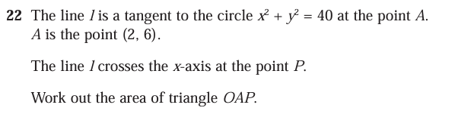
Questions
1
Alex is not correct.
2
Area is 60.

