Slide 1


Starter:
Hint: If we solved these simultaneously, then how many points of intersection would there be?
Complete in Silence Please

Slide 2
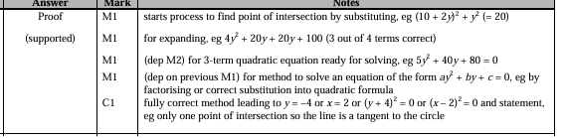

Slide 3


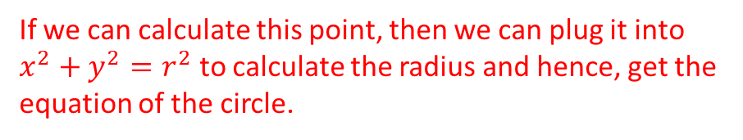







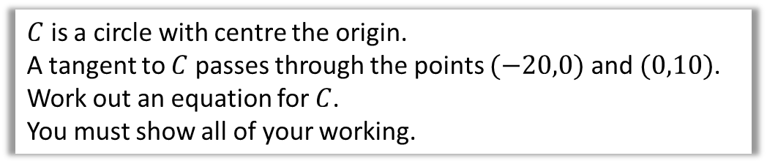






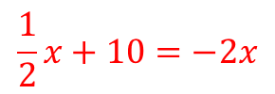
Example
$C$ is a circle with centre the origin.
A tangent to $C$ passes through the points $(−20,0)$ and $(0,10)$.
Work out an equation for $C$.
You must show all of your working.
The tangent and radius meet at a point on the circle
If we can calculate this point, then we can plug it into $x^{2}+y^{2}=r^{2}$ to calculate the radius and hence, get the equation of the circle.
The gradient from $(−20,0)$ to $(0,10)$ is $\frac{10}{20}=\frac{1}{2}$
$$\left(0,10\right)$$
The tangent has the equation $y=\frac{1}{2}x+10$.
$$r$$
The radius’ gradient is $−2$.
The radius has the equation $y=−2x$.
Now solve simultaneously.
$$\left(−20,0\right)$$
$$x$$
$$\frac{1}{2}x+10=−2x$$
$$−r$$
$$O$$
$$r$$
$$x+20=−4x$$
$$5x=−20$$
$$−r$$
$$x=−4 →y=8$$
$${\left(−4\right)}^{2}=8^{2}=80 →x^{2}+y^{2}=80$$

Slide 4
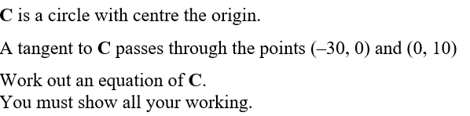
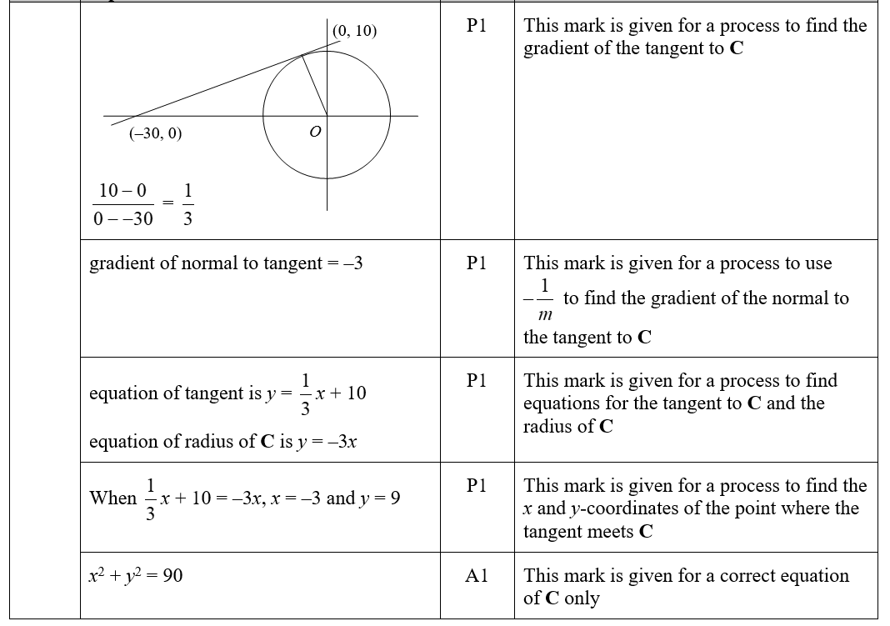
Your turn

Slide 5
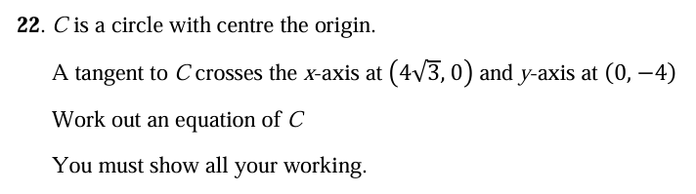
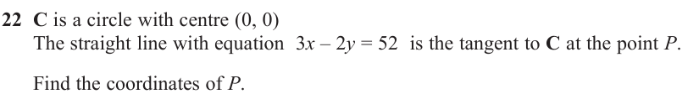


Questions
1
$$x^{2}+y^{2}=12$$
2
$$(12,−8)$$

