Slide 1

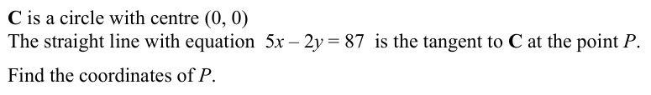
Starter:
Complete in Silence Please

Slide 2
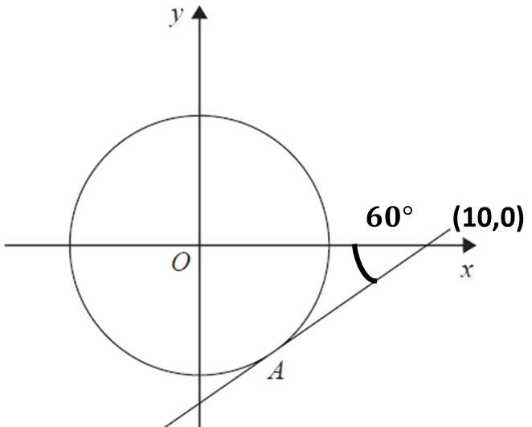
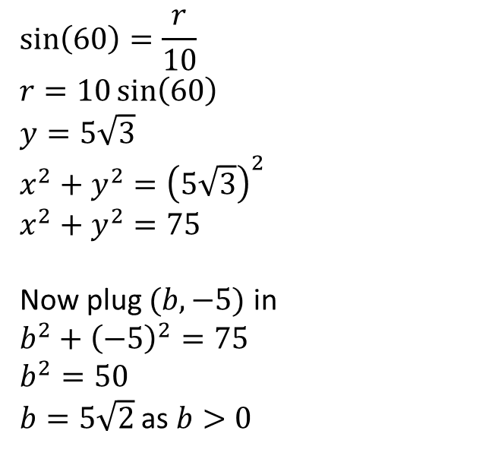
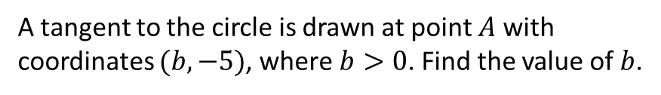



Example 1
The diagram shows a circle with a centre at the origin.
$10$
$r$
$60°$
$$\sin\left(60\right)=\frac{r}{10}$$
$$r=10\sin\left(60\right)$$
$$y=5\sqrt{3}$$
$$x^{2}+y^{2}={\left(5\sqrt{3}\right)}^{2}$$
$$x^{2}+y^{2}=75$$
Now plug $(b,−5)$ in
$$b^{2}+{\left(−5\right)}^{2}=75$$
$$b^{2}=50$$
$b=5\sqrt{2}$ as $b>0$
A tangent to the circle is drawn at point $A$ with coordinates $(b,−5)$, where $b>0$. Find the value of $b$.

Slide 3
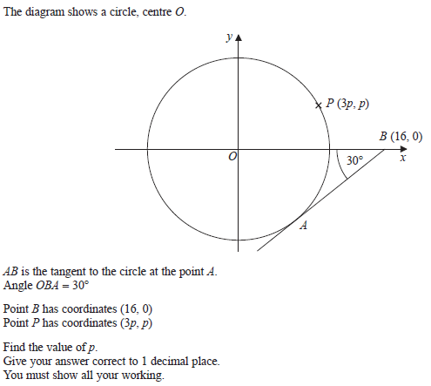
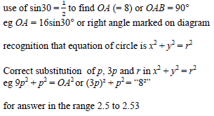
Your turn

Slide 4
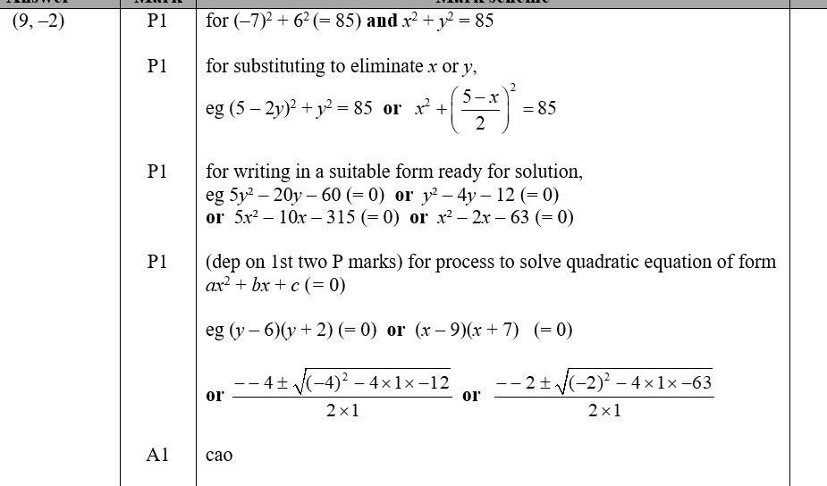
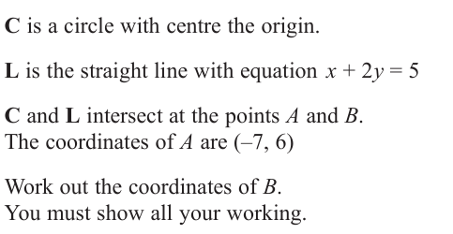
Exam question

Slide 5
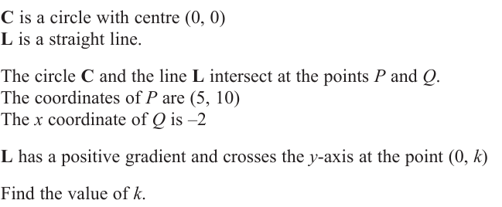

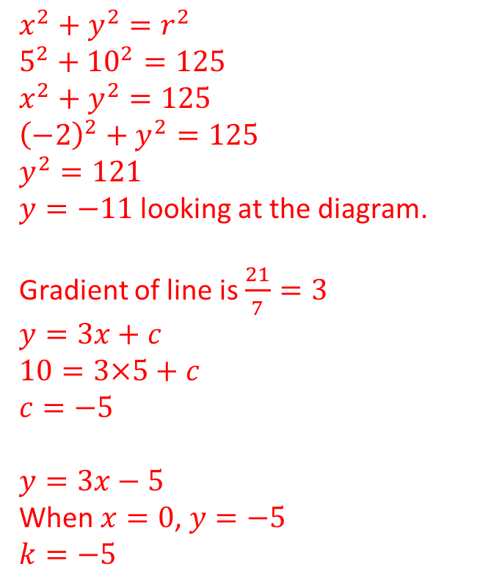


Example 2
$x^{2}+y^{2}=r^{2}$
$5^{2}+{10}^{2}=125$
$x^{2}+y^{2}=125$
${\left(−2\right)}^{2}+y^{2}=125$
$y^{2}=121$
$y=−11$ looking at the diagram.
Gradient of line is $\frac{21}{7}=3$
$y=3x+c$
$10=3×5+c$
$c=−5$
$y=3x−5$
When $x=0$, $y=−5$
$k=−5$
$$P(5,10)$$
$$O$$
$$Q(−2,?)$$

Slide 6
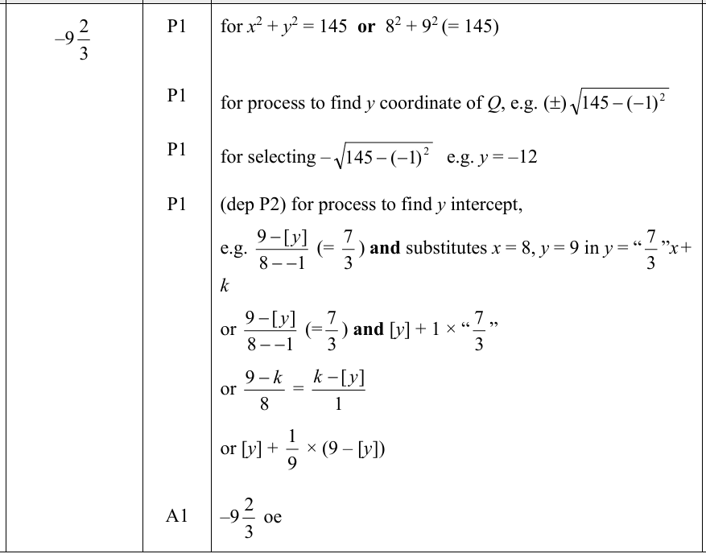
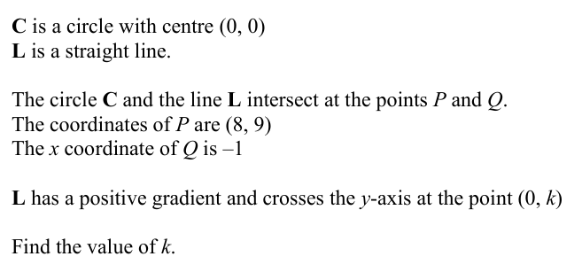
Your turn

